Slide 1
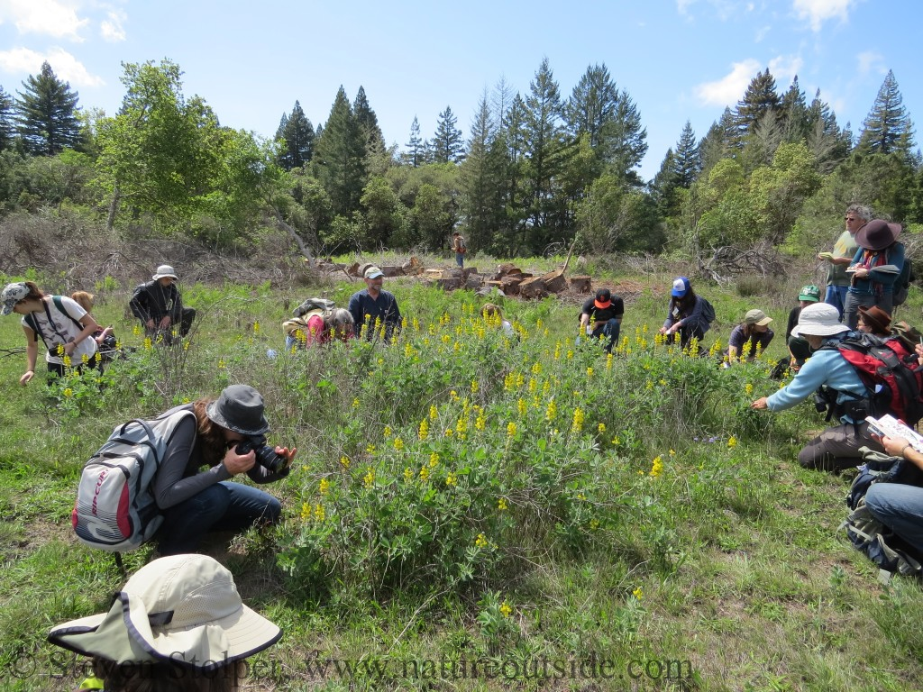

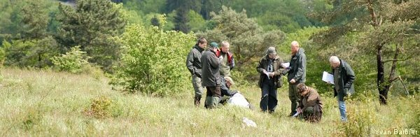
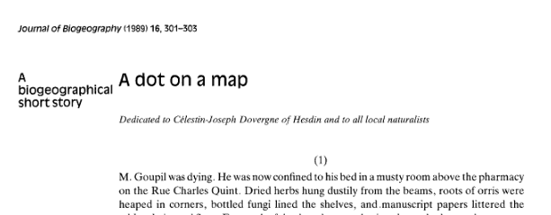

Changes in the behaviour of field observers since the development of digital interfaces
Marc Dufrêne
CiBioGo – 19.03.2024
Notes:
Changes in the behaviour of field observers since the development of digital interfaces

Slide 2
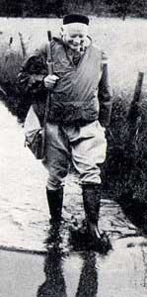
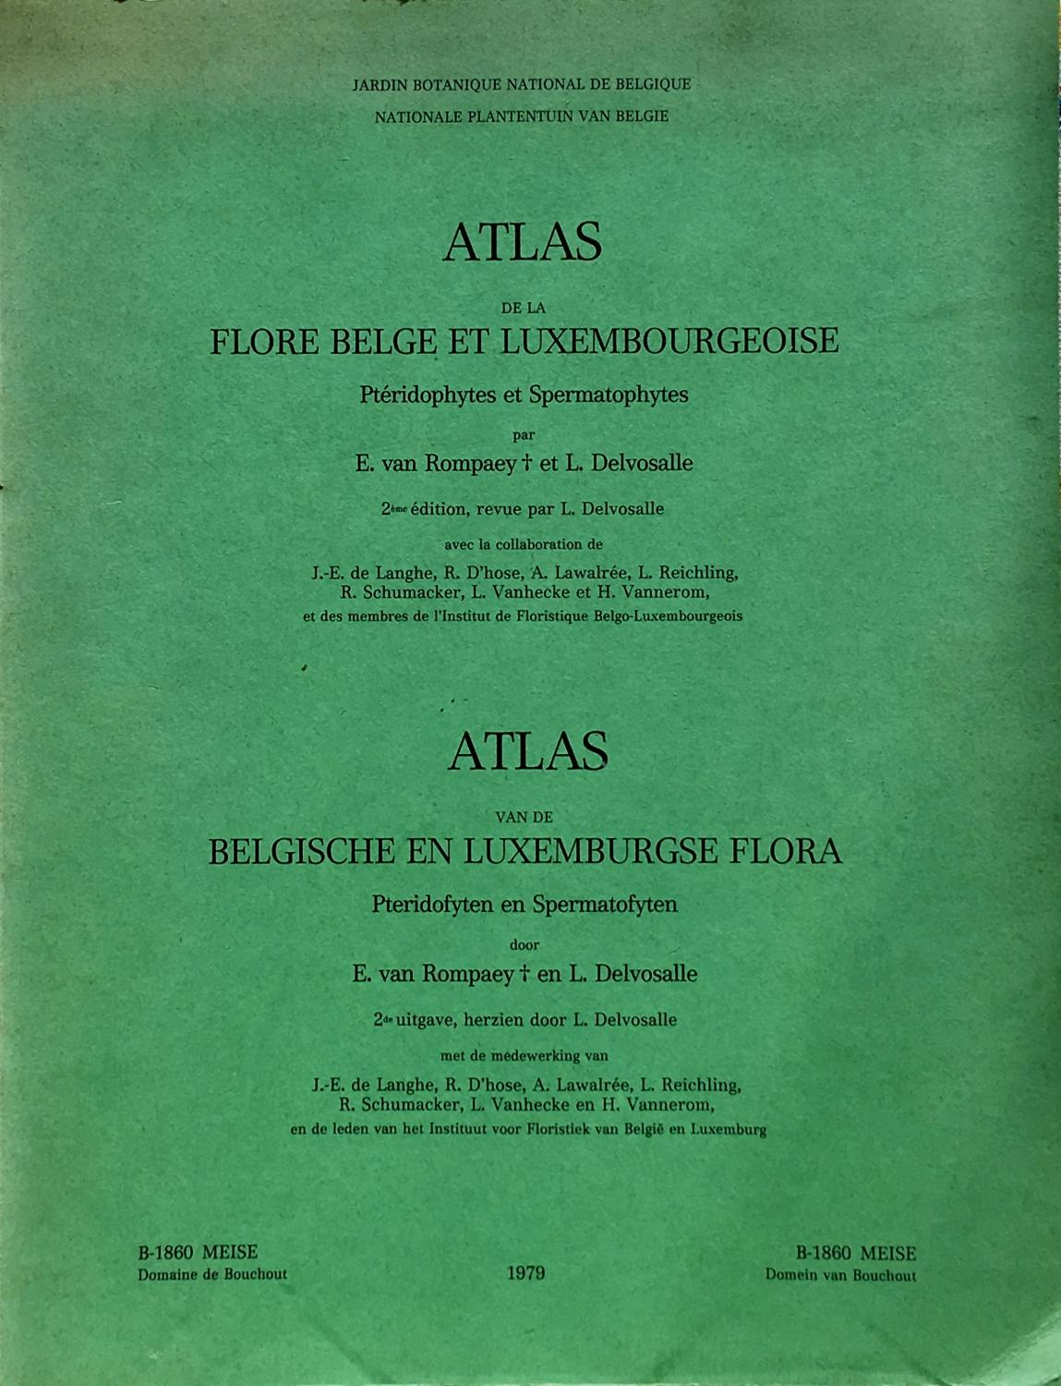
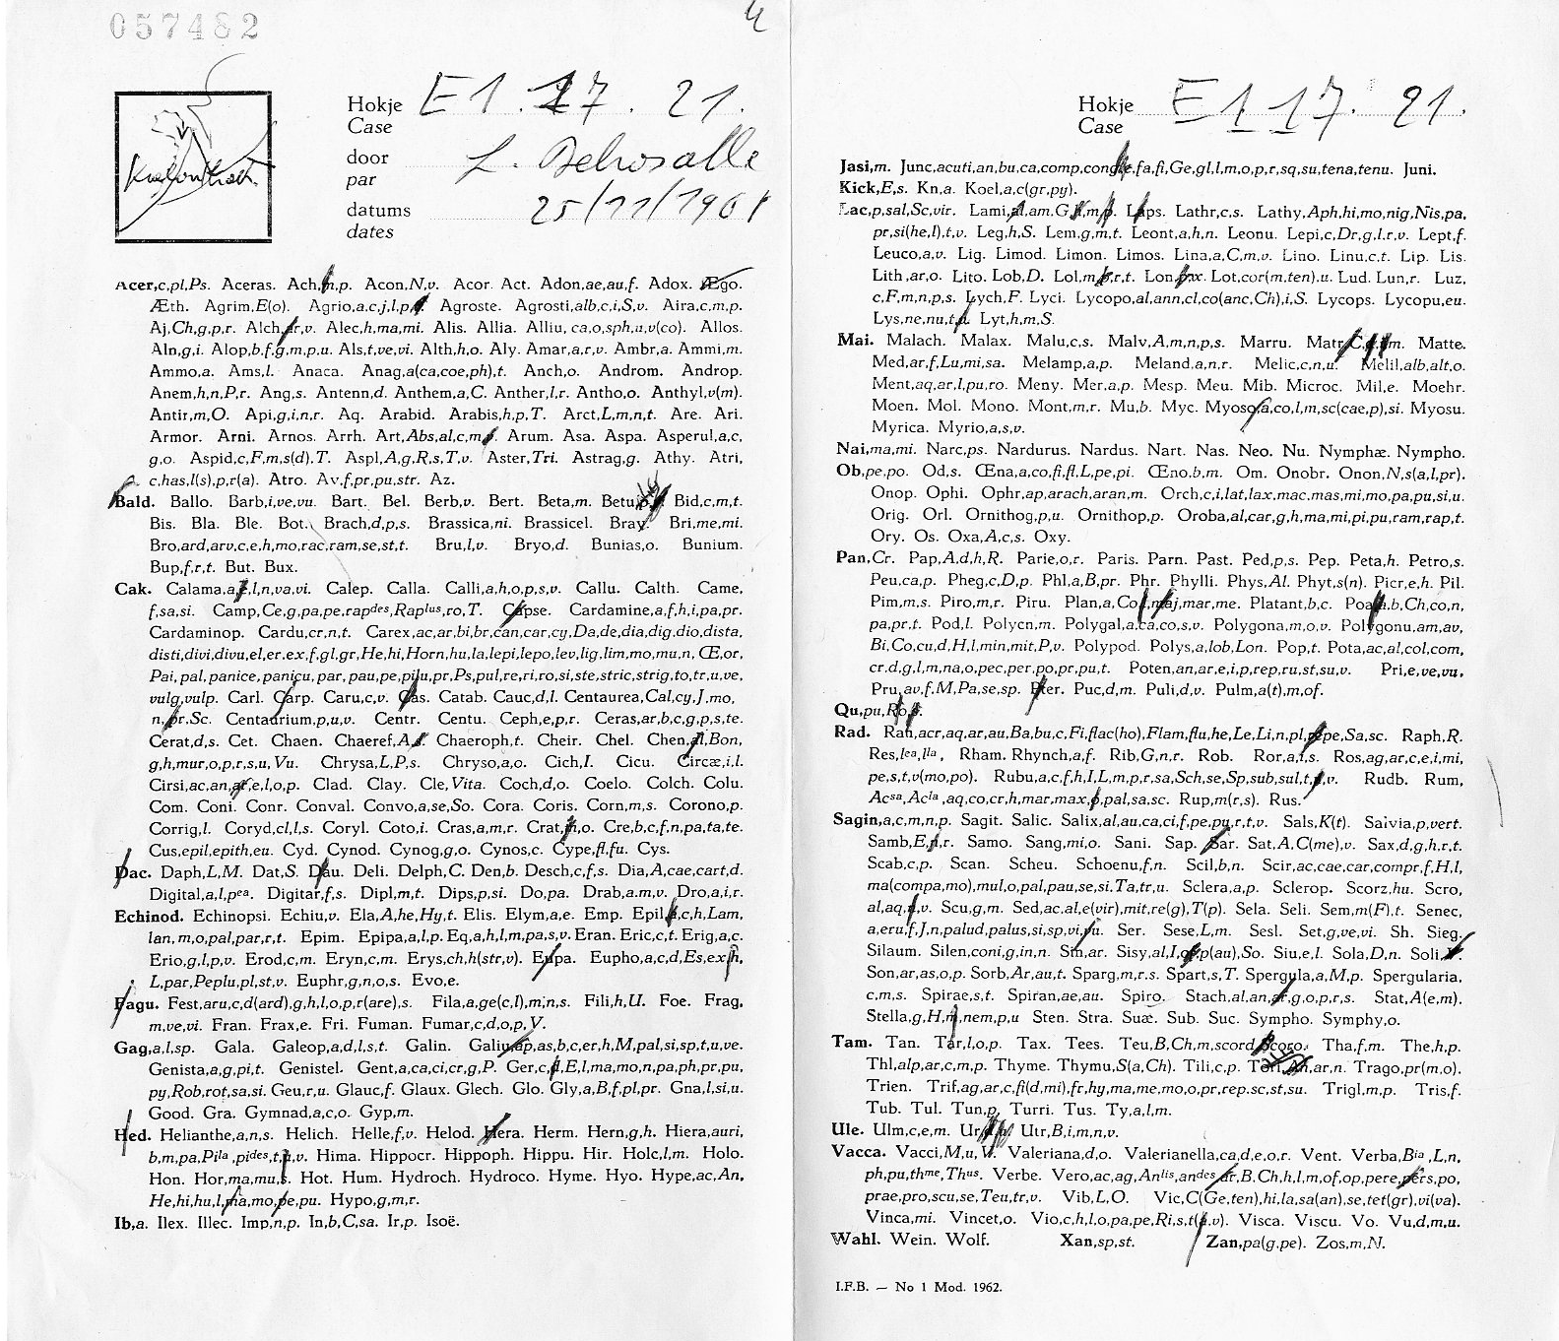
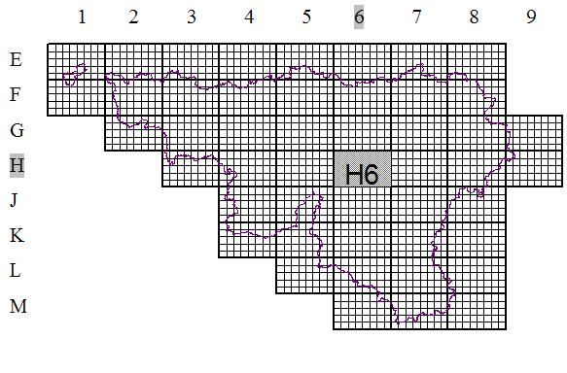
The history of naturalist data in Wallonia
Atlas of the flora of Belgium and Luxembourg by van Rompaey & Delvosalle (1972, 1979)
Field survey with species checklist sheets
=> 1.640 taxa
=> 680.000 data
Hand-mapping maps to produce an atlas
Notes:
Belgium has a long naturalist tradition. The first atlas of the flora of Belgium and Luxembourg has been published fifty years ago.
Botanists have systematically explored the country, completing standardised forms to record the presence of species.
These checklists were then used to compile atlas maps by hand.

Slide 3
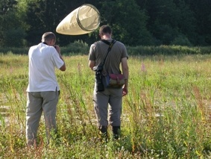
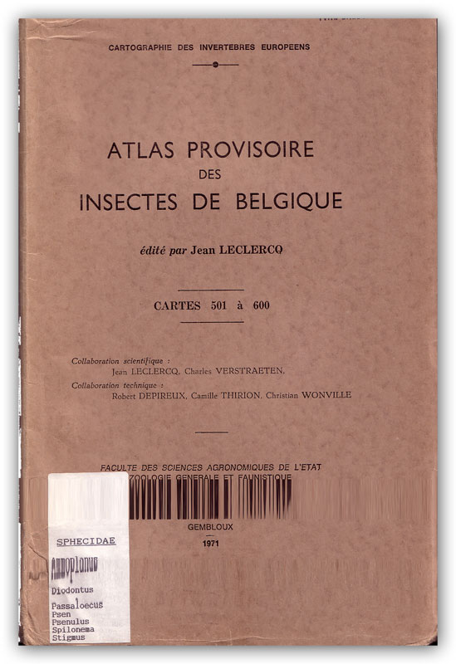
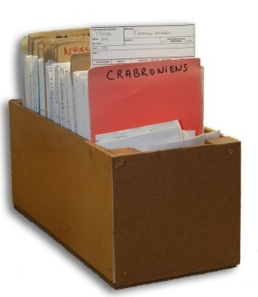
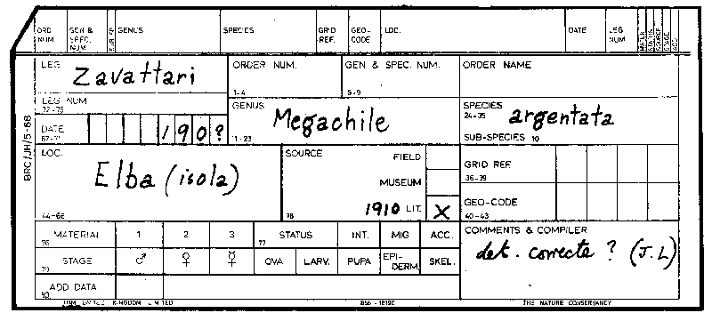
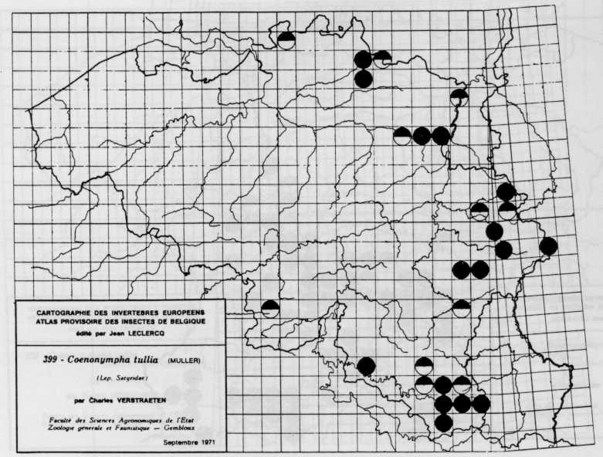
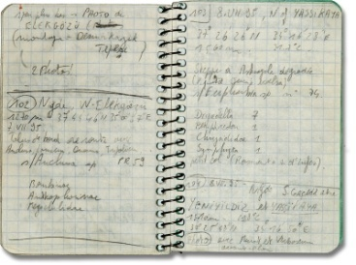
The history of naturalist data in Wallonia
Provisional Atlas of the Insects of Belgium launched by Jean Leclercq in the early 1970s
gommettes
=> Development of several projects to produce the first entomological atlases in Europe
Notes:
At the same time, similar inventories were carried out on insects, where records of species in collections were used to produce distribution maps for almost 2000 species.

Slide 4
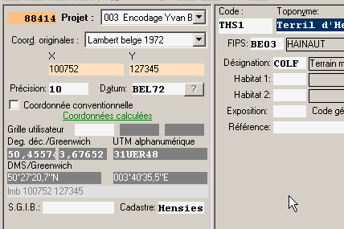
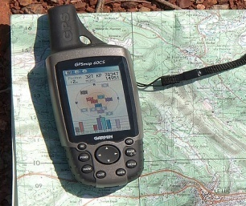
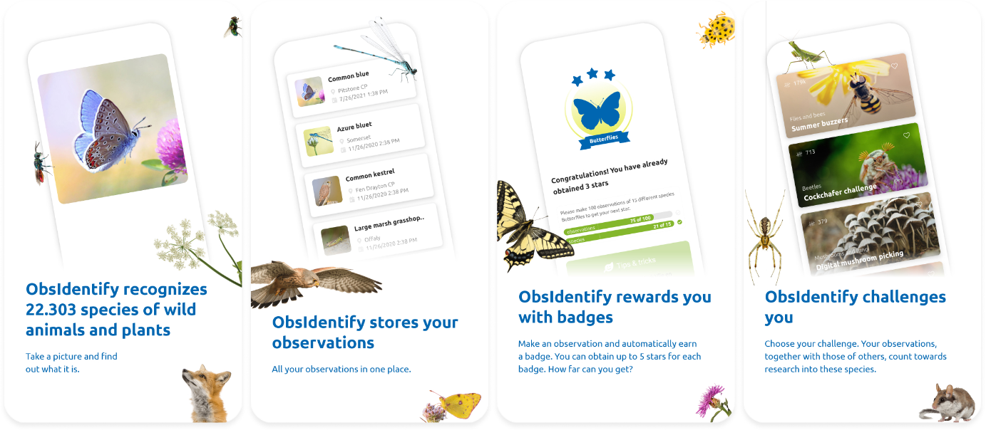
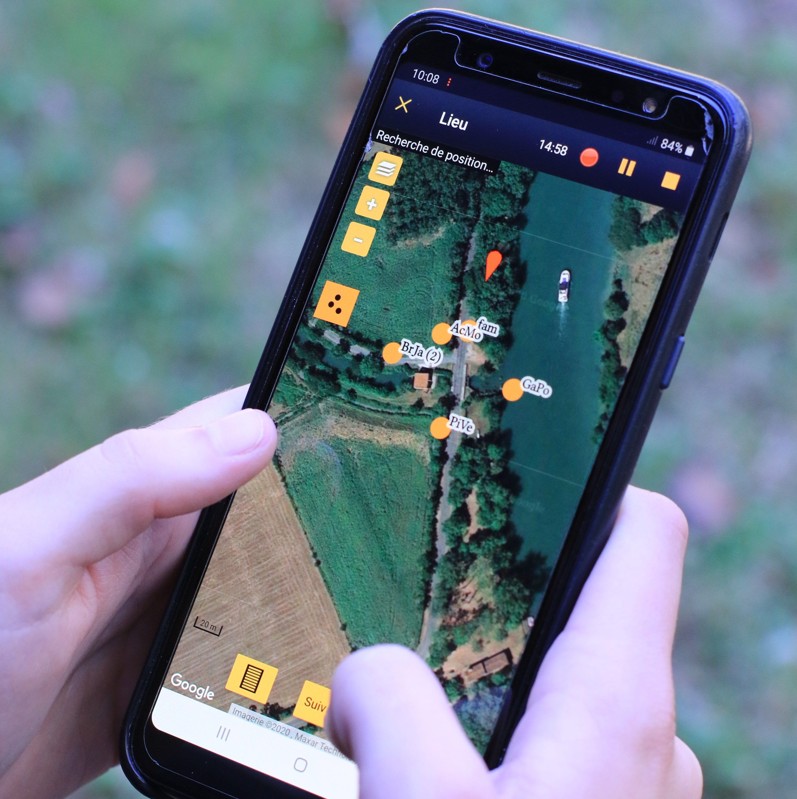
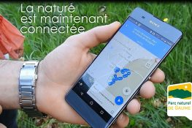
The history of naturalist data in Wallonia
Since the 90s => computerisation of encoding
Barbier et al. (2000) DFF
Since 2000 => computerisation - identification support
Notes:
Since the 1990s, the encoding of observations has evolved with the use of digital encoding interfaces enabling many contributors to encode their observations.
# Recently, the interfaces have evolved further to enable encoding to be carried out directly in the field, and even to enable the species observed to be identified directly.

Slide 5
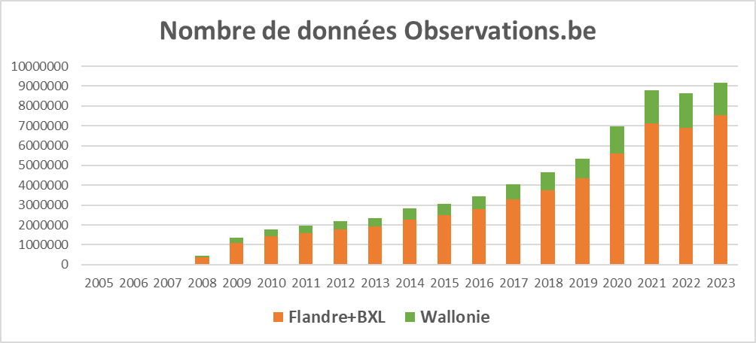
The history of naturalist data in Wallonia
9 MB of data/year in Belgium
Walloni1 : < 20%
Data multiplication thanks to the development of virtual encoding media
Democratisation of access thanks to determination tools such as artificial intelligence
=> So we should be delighted to see so much data available !
Notes:
Thanks to these new interfaces,
# which increase the quantity of information available,
and to artificial intelligence,
# which enables more people to identify species, over 9 million observations are made every year in Belgium, 20% of which are made in Wallonia.
# So we should be happy to see so much data available !

Slide 6

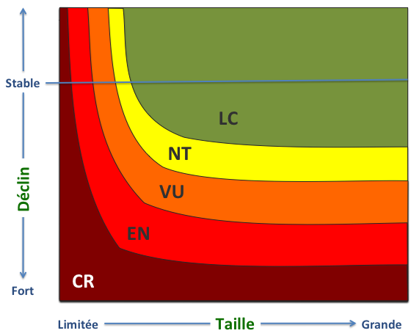
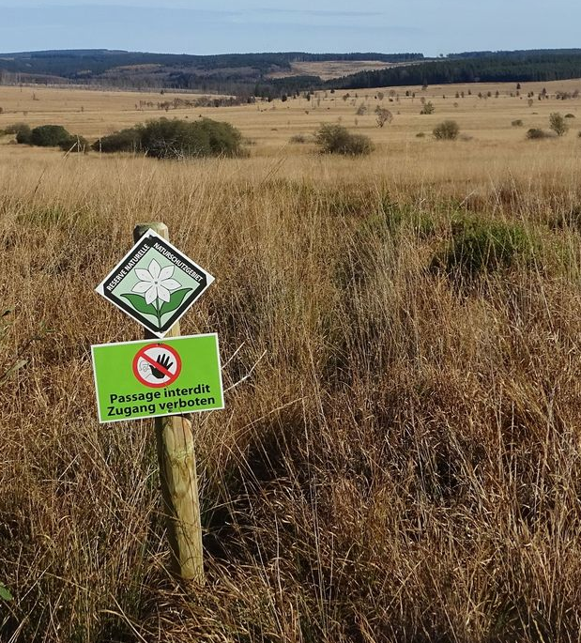
What are the uses of databases?
  They contribute to species knowledge but also the definition of legal constraints
Identification of the vulnerability of taxa
Legal protection for certain threatened taxa, with constraints imposed on third parties
Important criteria for defining the ecological network
Identification of priorities for site protection and restoration measures
It's better not to make too many mistakes and to be able to trust the data ...
Notes:
But what are the uses of such databases ? These data are not only used to produce atlases.
They are also important for identifying the most endangered species, and
# those that will be able to benefit from a protection status with legal constraints.
# These data are also important to build ecological networks and to define conservation strategies on the field.
# It is therefore essential to be able to trust the data.

Slide 7
More data = more information?
This proliferation of data raises a number of questions :
Is it the right taxon ?
  => Accuracy of taxonomy and the validation processes
Is it well located ?
=> Accuracy of the coordinates
Is it relevant ?
=> Enough additional details to use it correctly
Is it not spatially biased ?
=> Sampling of the territory (regular, aggregated, time-depend, …)
We will focus here only on the consequences of the changes in behaviour generated by the widespread use of these new systems for encoding biological observations
Notes:
This proliferation of data raises a number of questions about : the accuracy of taxonomy and the validation processes
# the accuracy of coordinates
# the quality of additional details to use it correctly – we have by example a lot of bird data but only 2% can be used to assess a reproduction
# the sampling of the territory– we know by example that a third to almost an half of observations are made in less than 10% of the territory near protected areas.
# I will not going into details about all these questions to focus only on the consequences of the changes in behaviour generated by the widespread use of these new technological systems for encoding biological observations.

Slide 8
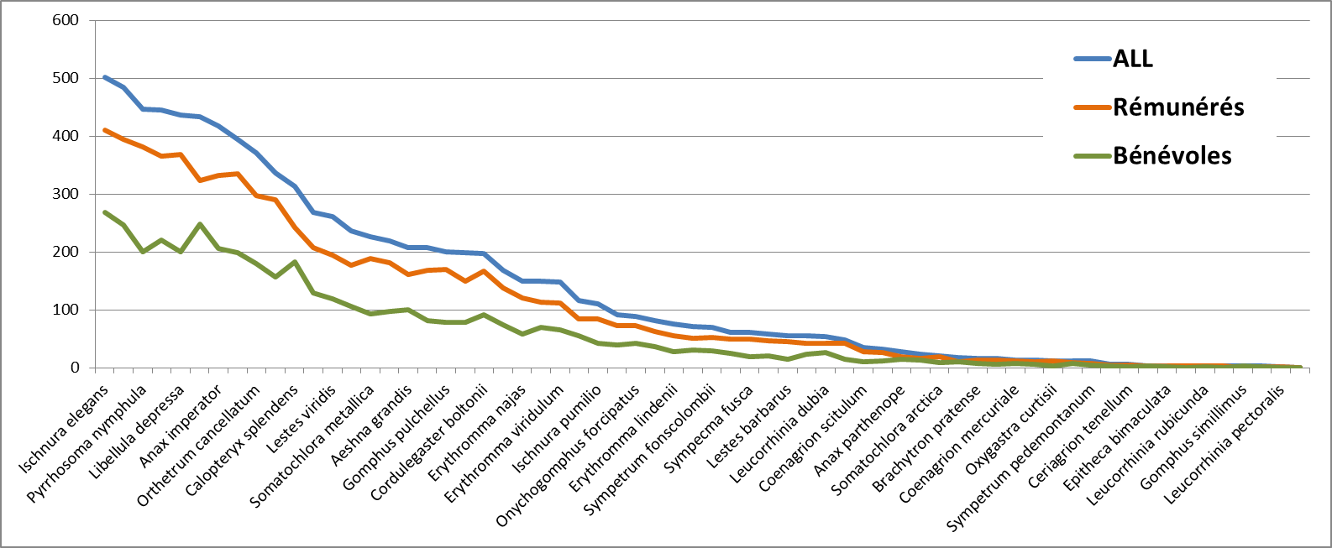
More data = more information?
Changes in observer contribution :
The contribution of volunteers compared with professionals (working in NGOs, universities, consultancies) in terms of understanding the distribution area of species.
100 professionals = 80% of species area
330 volunteers = 50% of species area
Professionals
Volunteers
Size of distribution area (number of 5x5 km squares)
1985-2007
Dragonflies
Volunteers make a relatively limited additional contribution before 2007.
Notes:
The databases are maintained by volunteer observers or professionals working for NGOs, research teams or consultancies.
We can begin by analysing the contribution of the two groups to our knowledge of the distribution of dragonfly species here. Before the development of new technologies, there were around a hundred professionals who alone contributed 80% of the data, and just over three times as many volunteers who alone accounted for half of the data.
# Volunteers make a relatively limited additional contribution but they still contribute to a better understanding of the distribution of species.

Slide 9
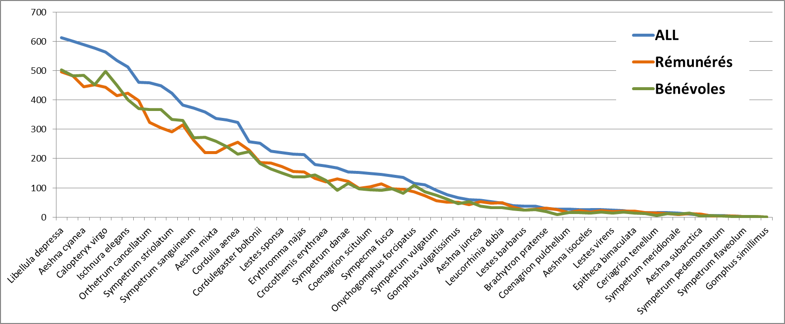
More data = more information?
Changes in observer contribution :
The contribution of volunteers compared with professionals (working in NGOs, universities, consultancies) in terms of understanding the distribution area of species.
180 professionals = 73% of species area
2000 volunteers = 73% of species area
Professionals
Volunteers
Size of distribution area (number of 5x5 km squares)
2008-2018
Dragonflies
After 2007, many more volunteers contributing better for species area knowledge but we still need data from professionals who regularly visit specific habitats
Notes:
For the more recent period, there are many more observers and they cover the distribution areas of the species much better.
# After 2008, volunteers are contributing to a better understanding of the distribution of rare species that are not dependent on a particular rare habitat. But we still need information from professionals who regularly visit specific habitats.

Slide 10
More data = more information?
Changes in observer behaviour :
Number of species observed per visit
1950-2000
> 2000
Frequency
Frequency
2-4
2-4
Before 2000, most volunteers and professionals compiled lists of species.
After 2000, this is no longer the case !
Do they target certain groups of species ?
Flora
Notes:
If we now look at the way in which observations are made, before 2000 most volunteers and professionals compiled lists of species.
# After 2000, this is no longer the case !
The vast majority of sightings are of one species or a very limited number; fewer sufficiently comprehensive lists are being compiled.
# So, do they target certain groups of species ?

Slide 11
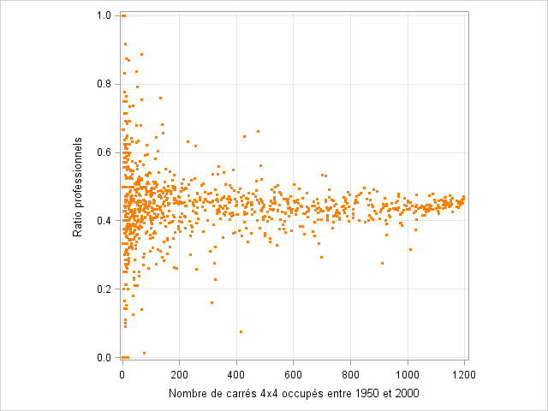
More data = more information?
Changes in observer behaviour :
1950-2000
Before 2000, professional observers accounted for 44% of the data and 35% of the observers.
Proportion of professional origin
Only in the case of rare species, some species are more often observed either by professionals or by volunteers.
No. of squares occupied per taxon
Flora
Notes:
If we look at the professional or non-professional origin of the data for Flora, overall, 44% of the data was of professional origin before the development of new technologies.
# Only in the case of rare species, certain species are more often observed by professionals than by volunteers or vice-versa.

Slide 12
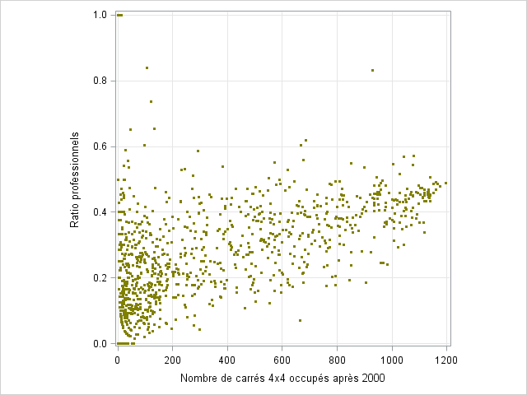
More data = more information?
Changes in observer behaviour :
> 2000
After 2000, the number of volunteers increased considerably but professionals still account for 30% of data
Proportion of professional origin
However, clearly, the rarer the species, the more often they are observed by volunteers.
No. of squares occupied per taxon
=> A major change that limits the use of data, in particular to determine whether an inventory was more or less complete and to identify absences.
Flora
Notes:
After 2000, the number of volunteers increased considerably but professionals still account for 30% of data
# However, clearly, the rarer the species, the more often they are observed by volunteers.
# This induces a major structural change that limits the use of data, in particular to determine whether an inventory was more or less complete and to identify absences.

Slide 13
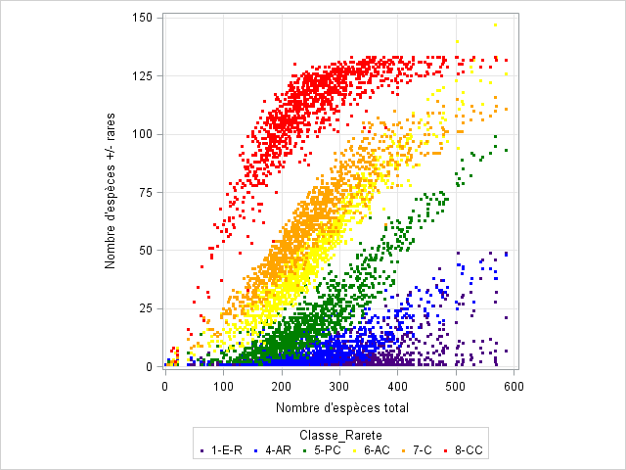
More data = more information?
Changes in observer behaviour :
Critical influence of differences in detectability in f(rarity)
There are 8 classes of rarity:
  <= 5 squares: exceptional (1-E)
  6-15: very rare (2-RR)
  16-50: rare (3-R)
  51-100: fairly rare (4-AR)
  101-250: uncommon (5-PC)
  251-500: fairly common (6-AC)
  501-750: common (7-C)
  > 750: very common (8-CC)
Number of +/- rare taxa
Total number of taxa
Notes:
Another consequence of these changes in behaviour is significant changes in the detectability of species, which is essential if we are to be able to assess their vulnerability.
This graph shows how evolves the species richness of different groups of species defined on the basis of their rarity. For example, the very common species in red are the first to be observed and quickly saturate when they have all been observed. The rarer the species, the longer it takes to observe them.

Slide 14
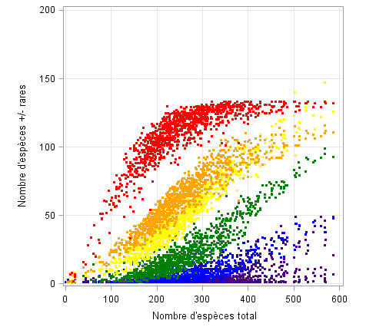
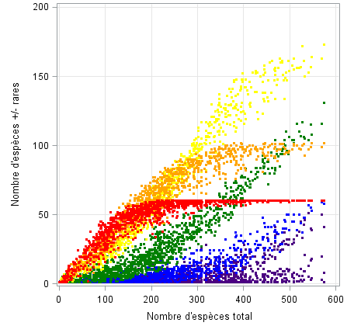
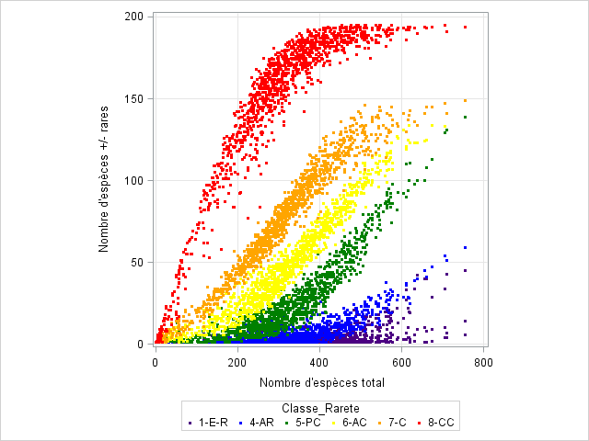
More data = more information?
Changes in observer behaviour :
Critical influence of differences in detectability in f(rarity)
Atlas (< 1980)
1980-2000
> 2000
Flora
Systematic inventory
Conservation inventory
Opportunistic inventory
We didn't sample in the same way at all!
=> This needs to be taken into account when analysing data ...
Notes:
If we apply this pattern to the different sampling periods for Flora, we see marked differences.
For the older data, the inventory was relatively systematic, with an expected distribution of the different categories of rarity.
# For the post-atlas period, inventories focused on fairly rare species, neglecting more widespread species and targeting specifically rare species.
# Since the development of new technologies, the inventories are even different, with more abundant species (because there are many more observers everywhere) but also more moderately rare species and rare species that are well monitored.
# We didn't sample in the same way at all! This severely limits our ability to assess whether a species is declining or expanding.

Slide 15
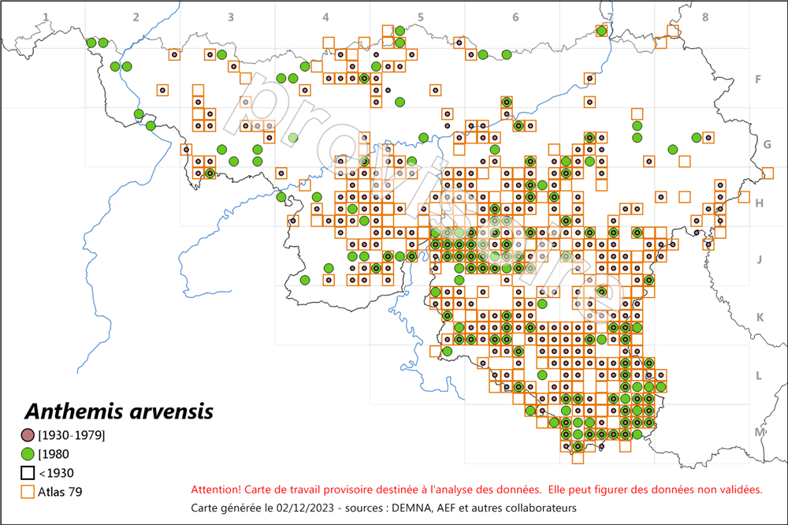
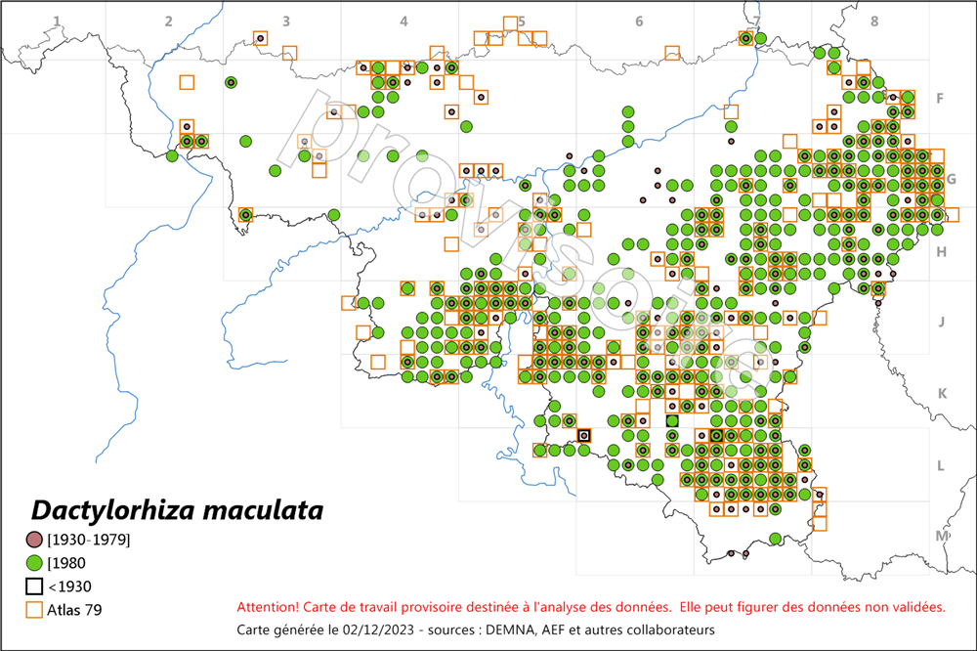
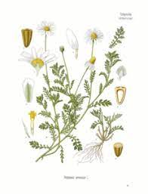
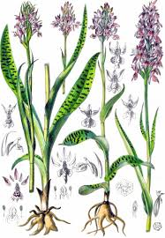
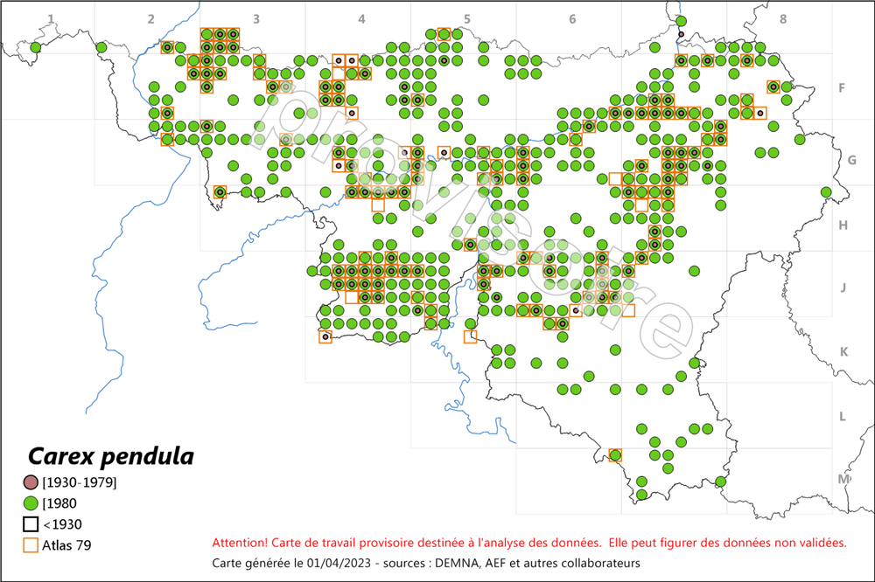
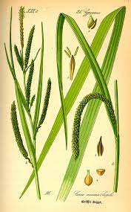
More data = more information?
Changes in observer behaviour :
It is decreasing a lot !
344 à 146 IFBL square 4x4 km
236 à 390 IFBL square 4x4 km
An increase that is only apparent ...
Detectability has changed fundamentally!
How can trends in species distribution be assessed with such a wide variation in sampling?
It is (probably) increasing
110 à 462 IFBL square 4x4 km
Notes:
Here are a few examples, starting with the case of a species that has become very rare while sampling has increased.
We are sure that this species has declined significantly.
# For the next one, we have a significant increase in the number of attendees, but there's nothing to say that this is the result of a positive change in its status. It may simply be a consequence of the increased sampling.
# For this protected species of orchid, it's even problematic. Every field naturalist knows of numerous populations that have disappeared. The increase in the number of squares is only apparent. It is reassuring about the actual size of the species' range, but not about its dynamics. We must continue to protect it.
# The detectability of species has evolved considerably and this raises questions about the methods to be used to detect threats.

Slide 16
More data = more information?
Yes, but if the data is good quality, that's even better!
Improve the quality of existing data
Structure and support data validation (taxonomy, XY, behaviour, etc.)
Standardise at least some of the inventories (species lists), in particular to monitor certain reference sites
And support proper biological inventories by professionals - we can't continue to rely on the goodwill of volunteers …
Thank you for your attention !
Notes:
Does more data mean more information?
Potentially yes, but if the quality of data is good it's even better.
As I won't be here this afternoon, I've identified 4 strategic priorities:
# Firstly, we need to improve the quality of existing data to make it more accurate.
# Secondly, it is necessary to structure and support the processes for validating data flows and to ensure that they are consistent and reliable.
# Thirdly, it is increasingly essential to standardise at least some biological inventories, particularly to monitor certain reference sites.
# Finally, it is absolutely essential to support proper biological inventories carried out by professionals. We cannot continue to rely on the goodwill of volunteers.
So, I suppose you'll have time this afternoon to discuss it.

