Slide 1
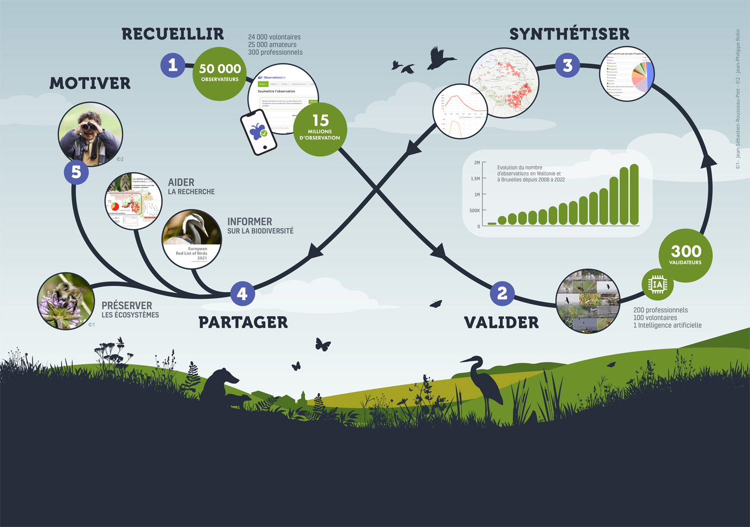


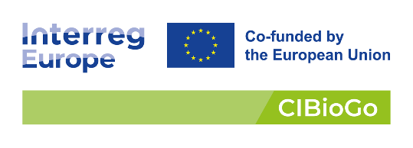

Added value and revitalization of observers networks
Jean-Sébastien Rousseau-Piot

Slide 2

Natagora is an association active in nature conservation
160 employees
1.500 volunteers
30.000 members
6.000 hectares of nature reserves
Conservation
Science
Education
Volunteering
Together with thousands of field naturalists Natagora is conducting biodiversity monitoring for more than 30 years on birds, bats, reptiles, amphibians and many other groups

Slide 3


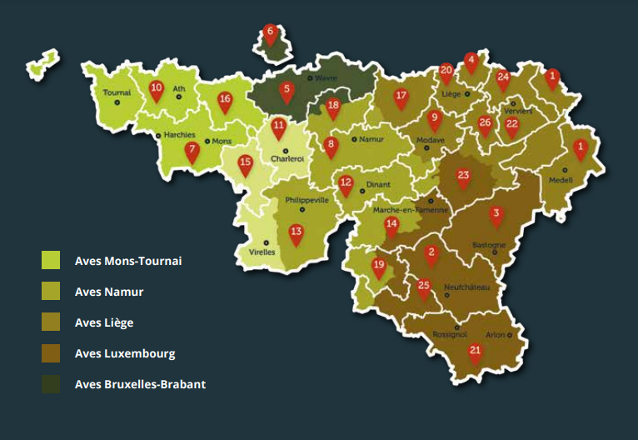

Poles and Working Groups
26 Local groups and
5 Aves sections
Pôles
Aves
Raînne
Plecotus
Groupes de travail
GT Castors
GT Hirondelles
GT Loup
GT Martinets
GT Pollinisateurs
GT Papillons de nuit
…
Notes:
Pôles = Historiquement des associations qui se sont regroupées dans Natagora -> durée dans le temps

Slide 4
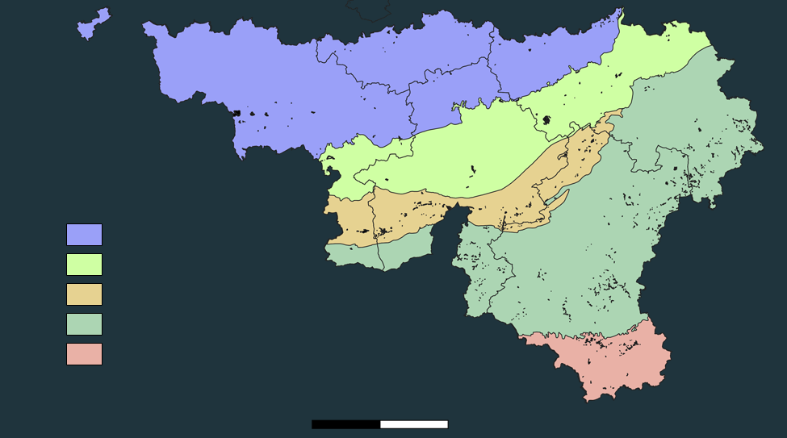
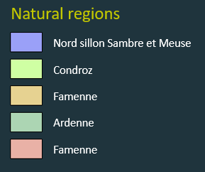
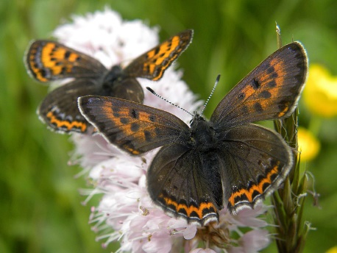

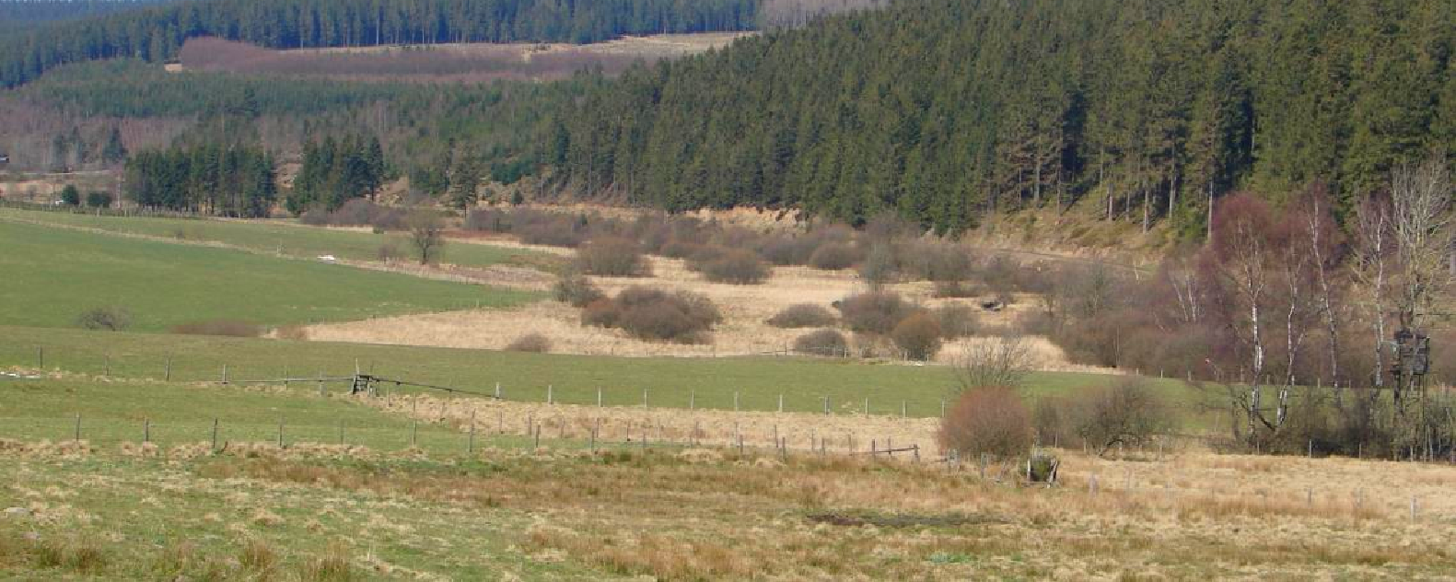
261 nature reserves covering 6000 hectares
Natural regions
Nord sillon Sambre et Meuse
Condroz
Famenne
Ardenne
Famenne
0 25 50 km

Slide 5
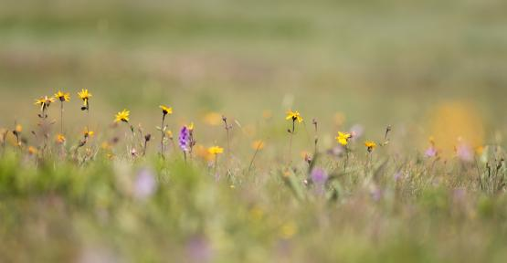
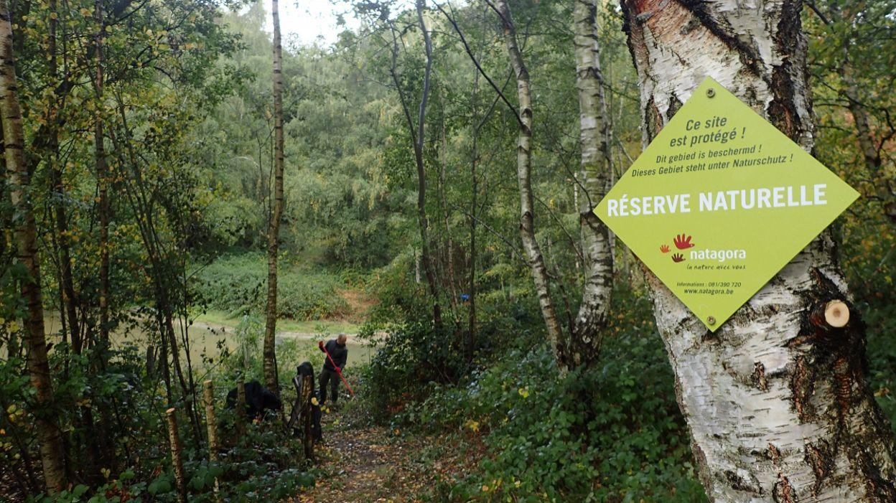
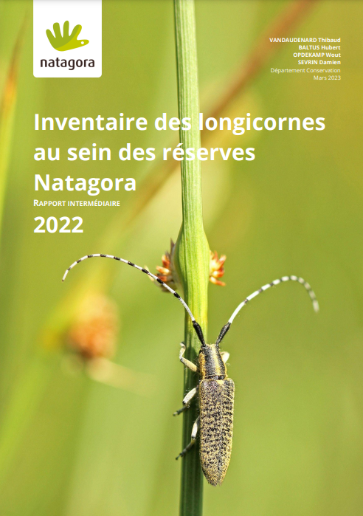
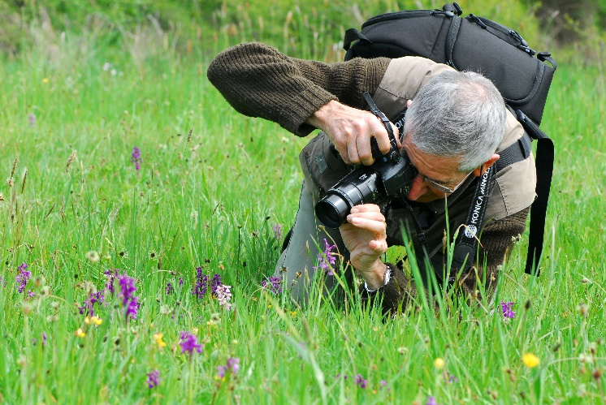
261 nature reserves covering 6000 hectares
Monitoring
Regular census of targets species of open habitats carried out by more than 200 volunteers
Observers Network

Slide 6
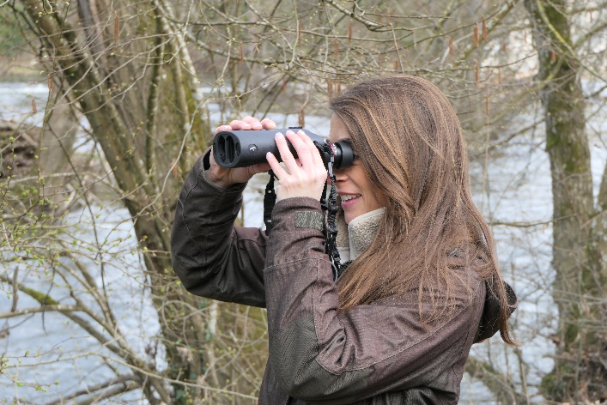
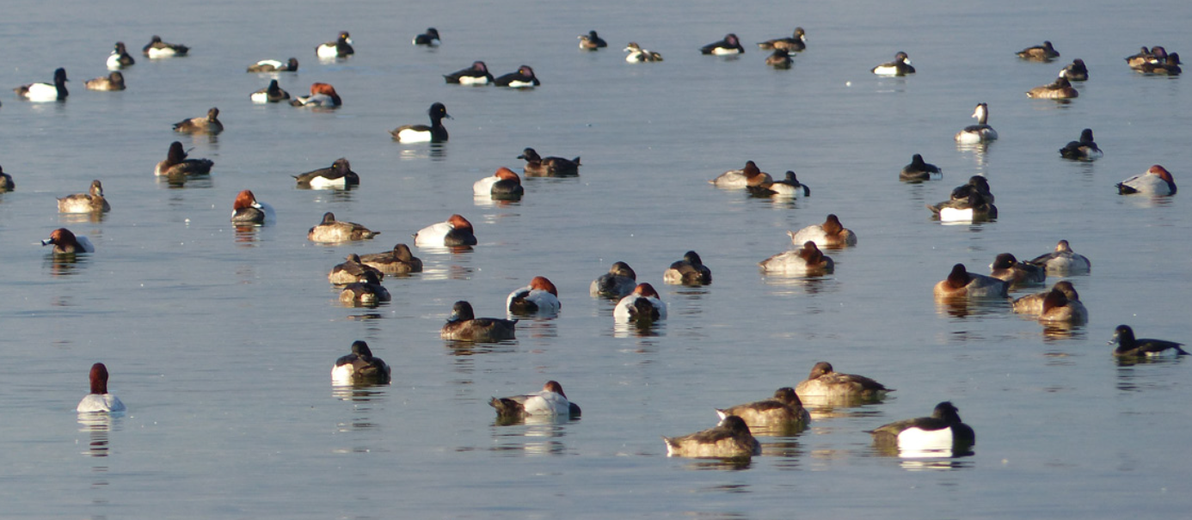
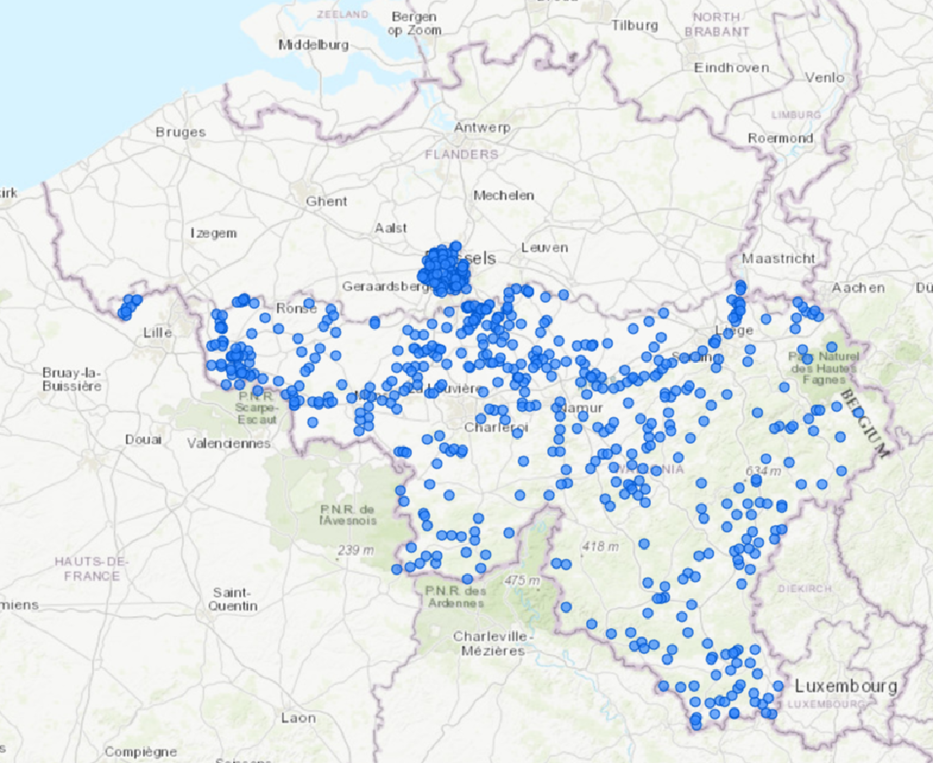
Observers Networks
International Waterbird Census (IWC) in Wallonia and Brussels : long running monitoring program, up to 200 volunteers involved each year
What is an observers network ?
Initially, a group of volunteers engaged in censusing a group of animals or plants in a coordinated way and sending their results to a centralized structured
Nowadays, it’s a bit more complicated…

Slide 7

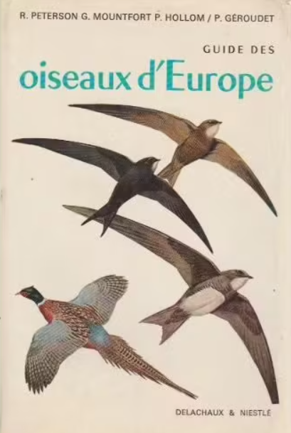
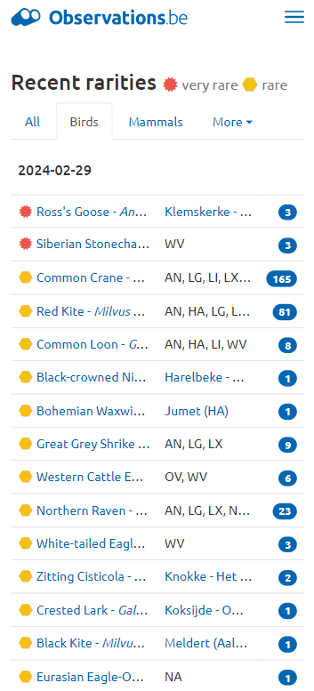

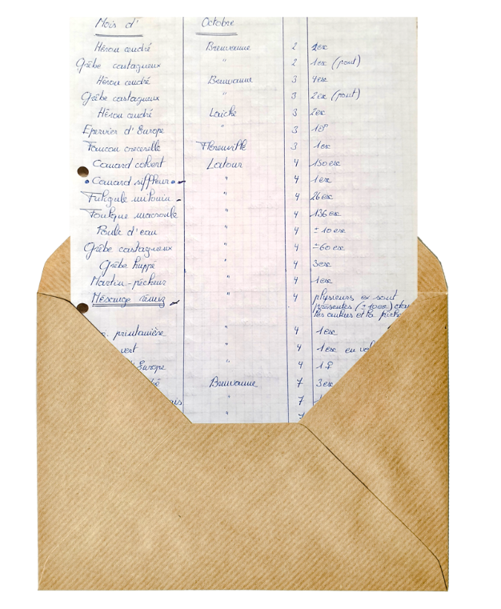
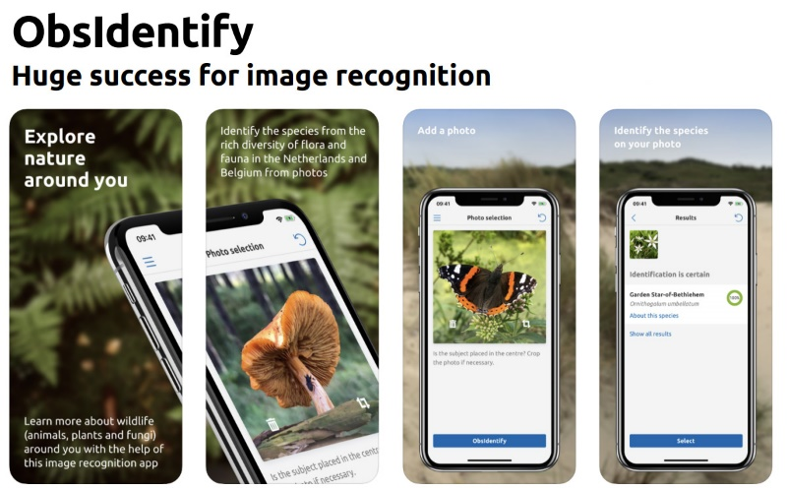

Observers Networks
1984
2024
Observers in separate groups (birds, plants…), lot of meetings, many hours of phone calls, paper lists sent by mail
Natagora uses Observation International system since 2008
With web portals like Observations.be and associated field apps an AI, aggregation of many types of observers in many groups and not necessarly coordinated

Slide 8
Evolution of the number of observers in Wallonia in the system
Different catégories of observers
Newbies
Citizens
Twitchers / listers
Volunteers in monitoring programs
Free electron geeks
Professionals
Boundaries between the categories not clear, very often an observer belongs to several categories
Notes:
I tick all the boxes
Citizens : Birds and Butterflies in Garden

Slide 9
Number of observations by species group in observations.be

Slide 10
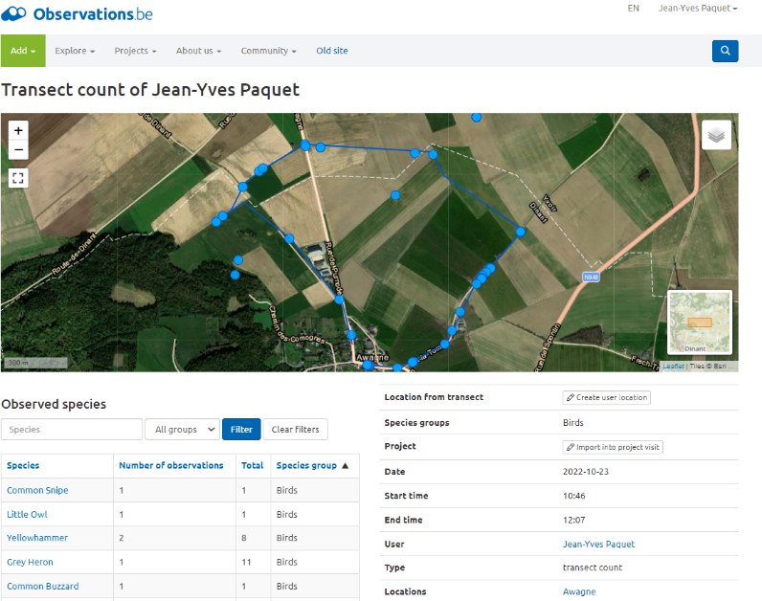
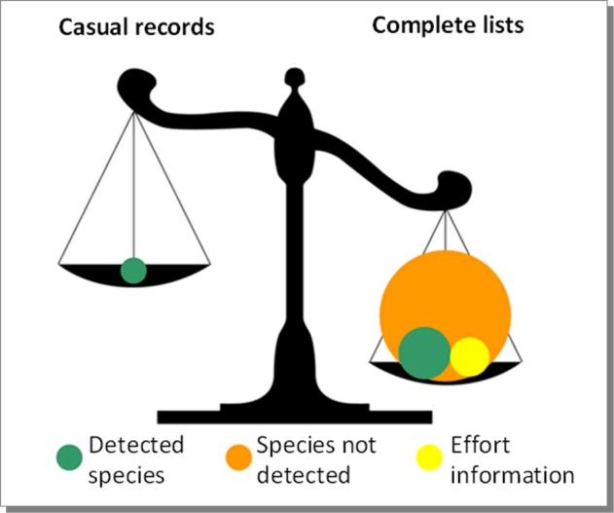
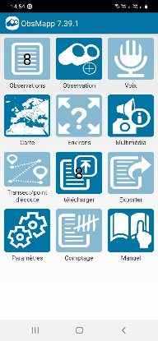
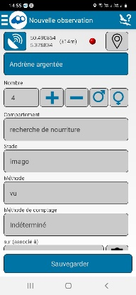
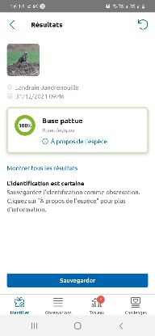
We’re using more and more the observation system for projects : lists, transects, structured projects…
The main advantages are
all the data for all groups (birds, mammals, plants, fungi…) is in a unique database with a powerfull validation system
we can build highly structured projects
Powerfull Apps for fieldwork
Help of AI
Evolution du nombre de données opportunistes, complete lists, structured projects, simple projects
Evolution of the number of observers contributing to projects throught the system
Finalement assez impossible à trouver

Slide 11
But there’s still a lot of work to do !
Convert old observers to use the system
Learn observers to use the system in a better way
Inform observers about projects
Give more feedback about results to observers
Expand the team of validators
…

Slide 12

Never lose sight that the main observer’s driver is satisfaction and never consider them as data-drones !
And satisfaction can be found throught :
discovering, learning, photographing, escaping, being alone, being in group, reconnecting, contemplating, meditating, searching, listing, twitching, competing, challenging, sharing, activism, contributing to nature conservation…
Any of these ways, some or all !

Slide 13
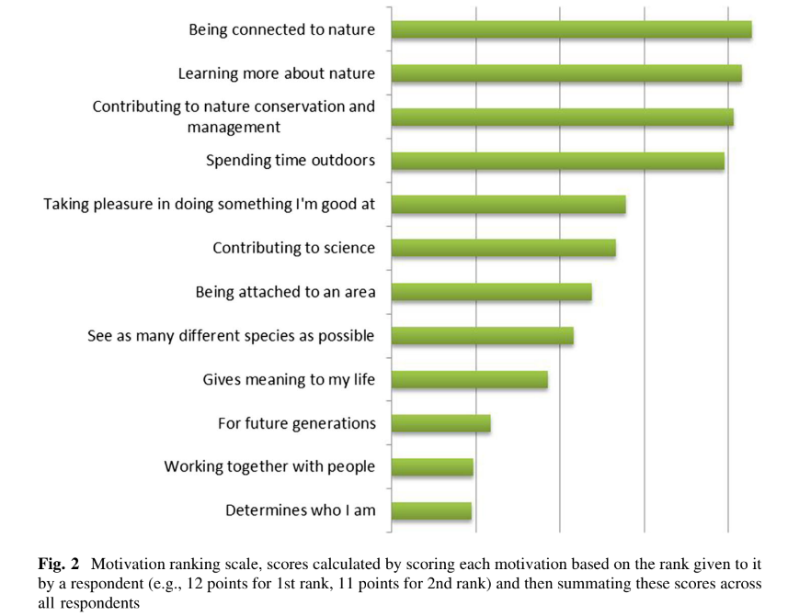
Ganzevoort, W., van den Born, R.J.G., Halffman, W. et al. Sharing biodiversity data: citizen scientists’ concerns and motivations. Biodivers Conserv 26, 2821–2837 (2017). https://doi.org/10.1007/s10531-017-1391-z

Slide 14
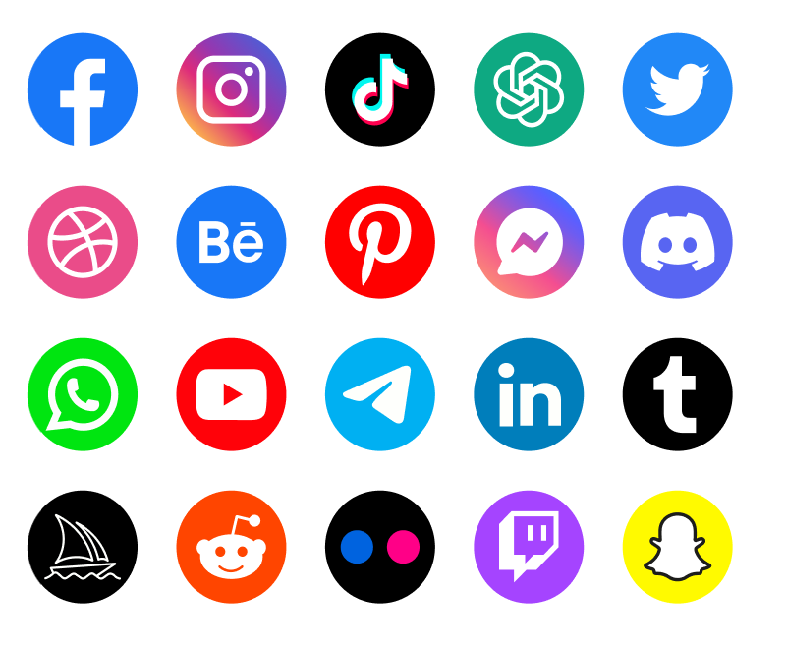
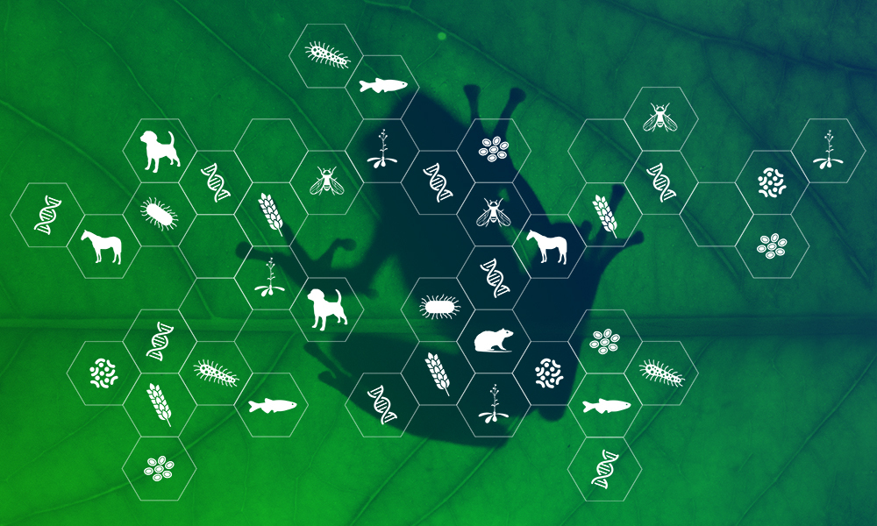
The challenge to connect with observers
How to run a network of observers in 2024 ?
Multiplication of communications channels
Main social medias are of limited use except for small private groups (WhatsApp, FaceBook)
More multidisciplinary and therefore less specialized observers
So many information about so many species sometimes leads to get lost in the web
Notes:
Deux associations qui avaient des projets similaires.

Slide 15
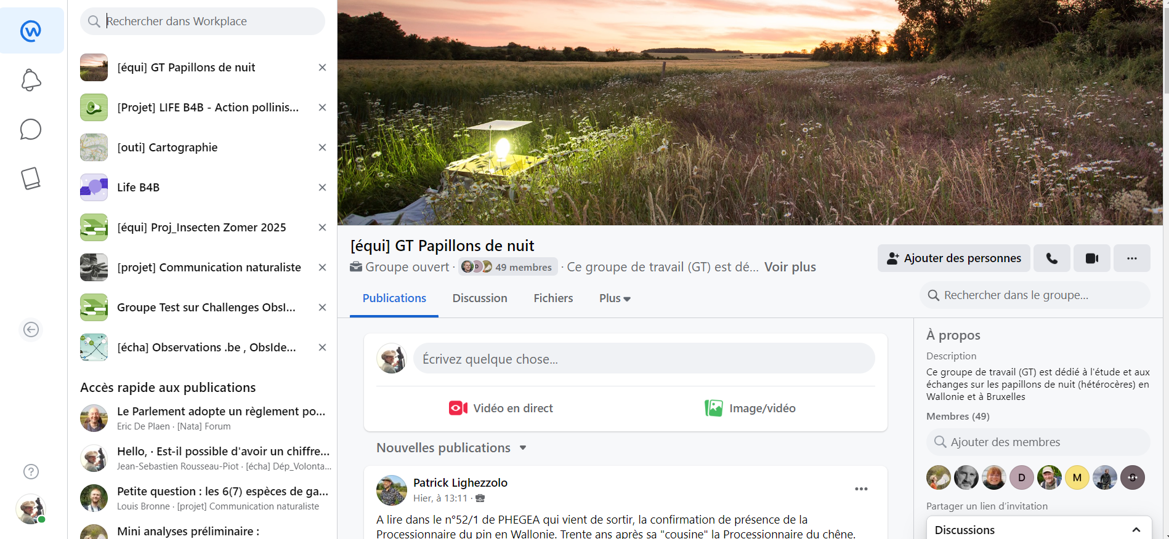
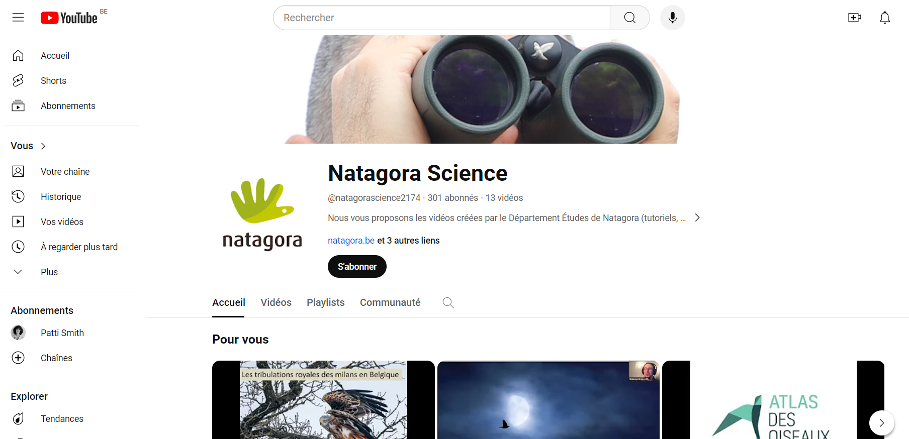
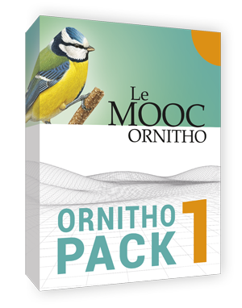
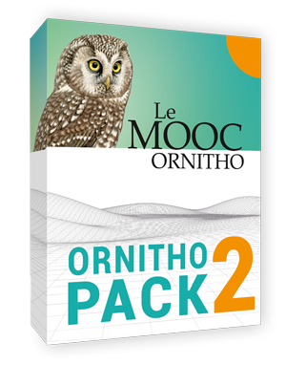
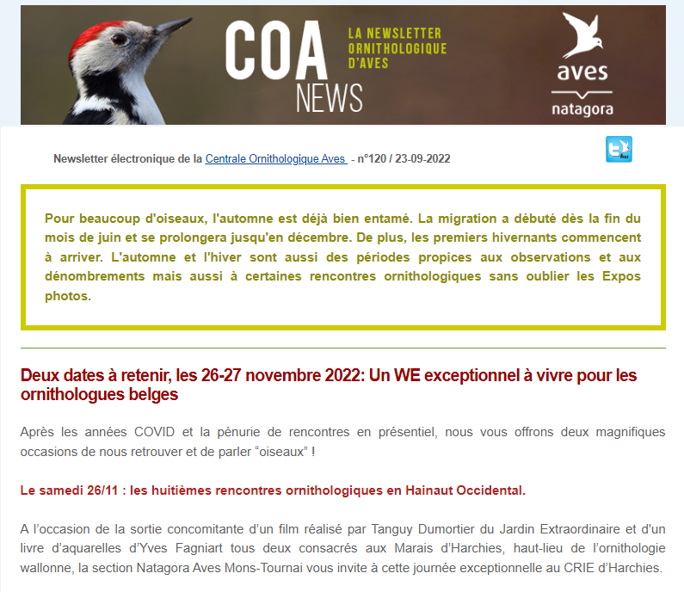
Our (partial) solutions
WorkPlace : our internal social media (kind of FB), 1675 members, staff and volunteers
Webinars and tutorials
Video meetings
Group meetings : friendly, informal (very important aspect)
Newsletters (costs !)
Courses : MOOCs + presential courses + practice in the field (NB : in our case, this leads to feminization of observers)
Deeper in the field : WE practical ornithology

Slide 16
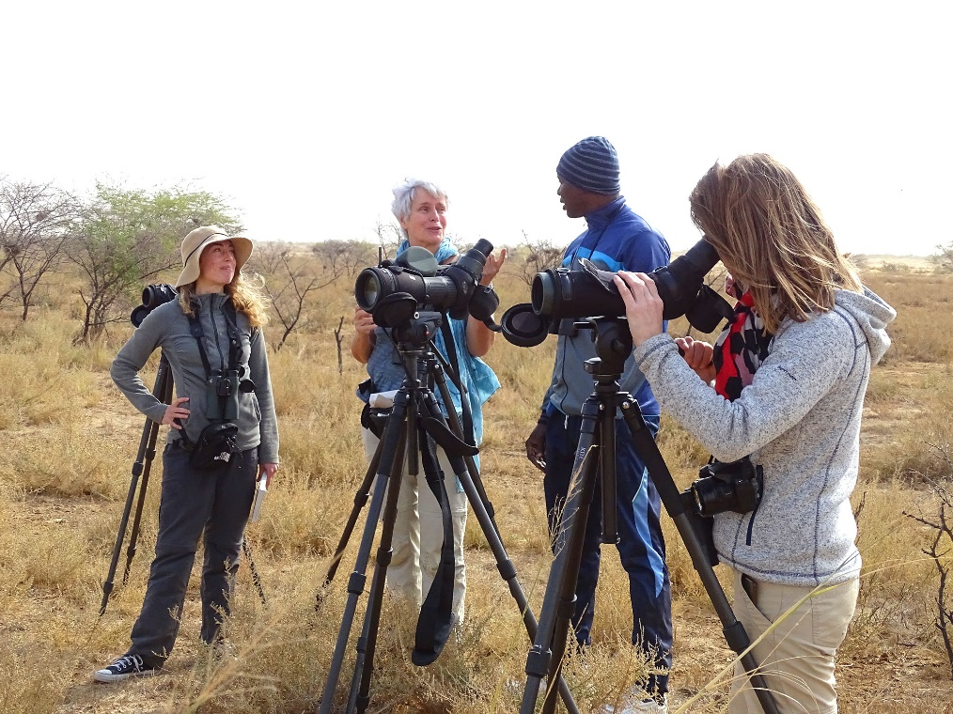
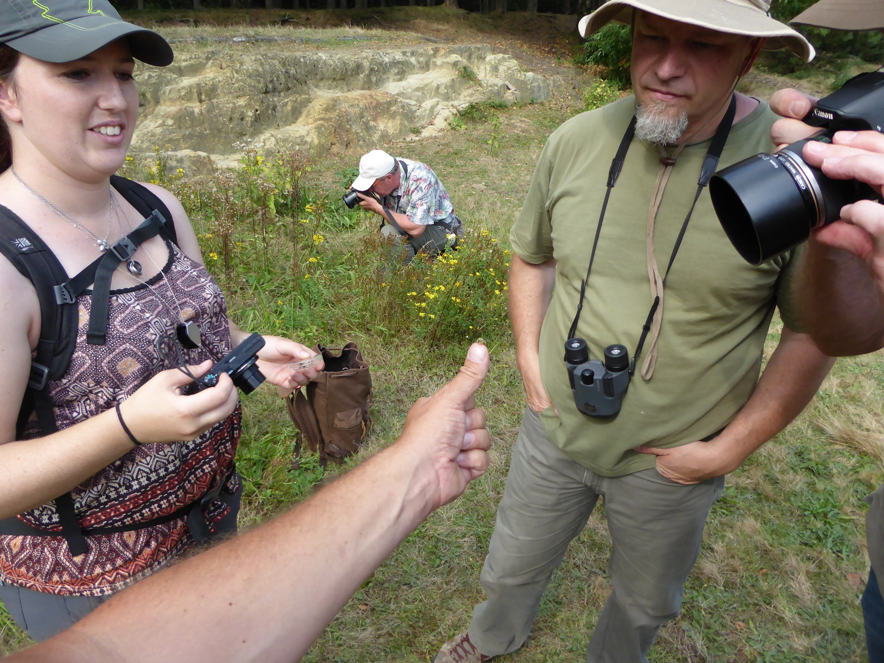
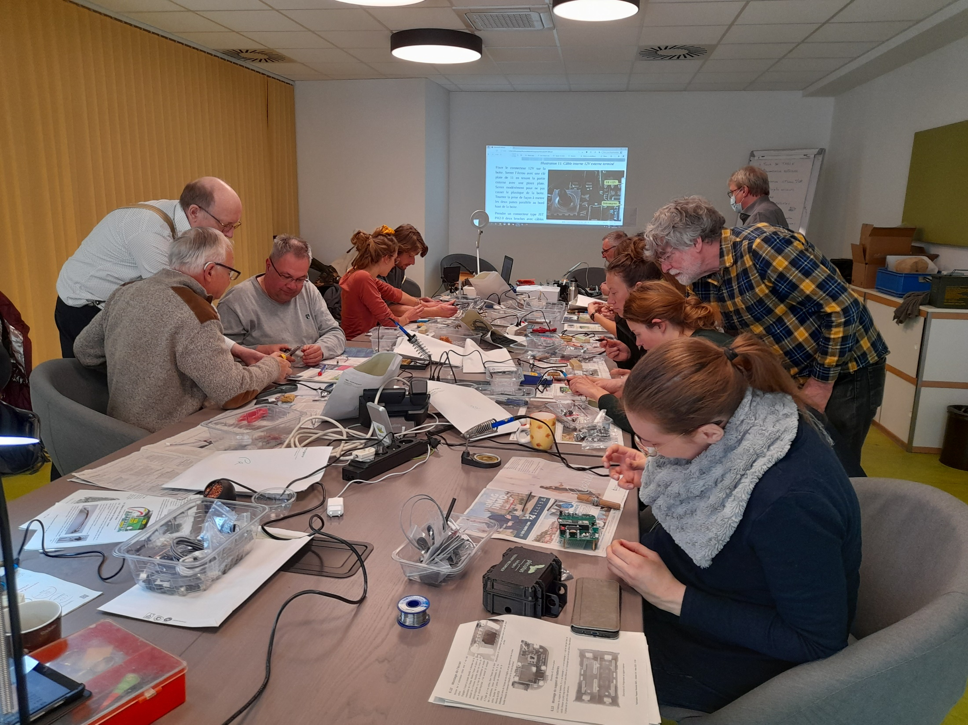
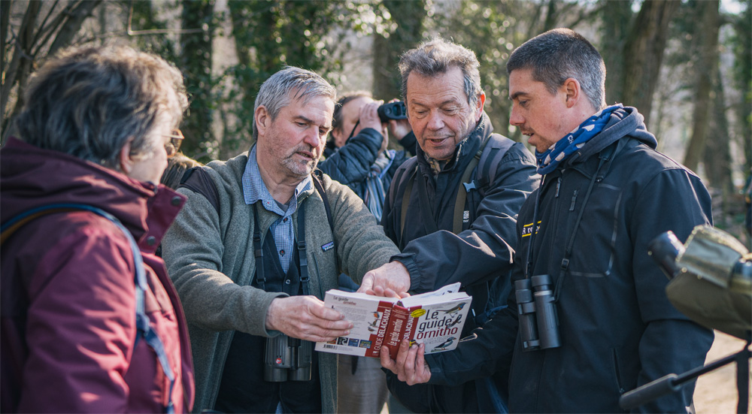

Slide 17
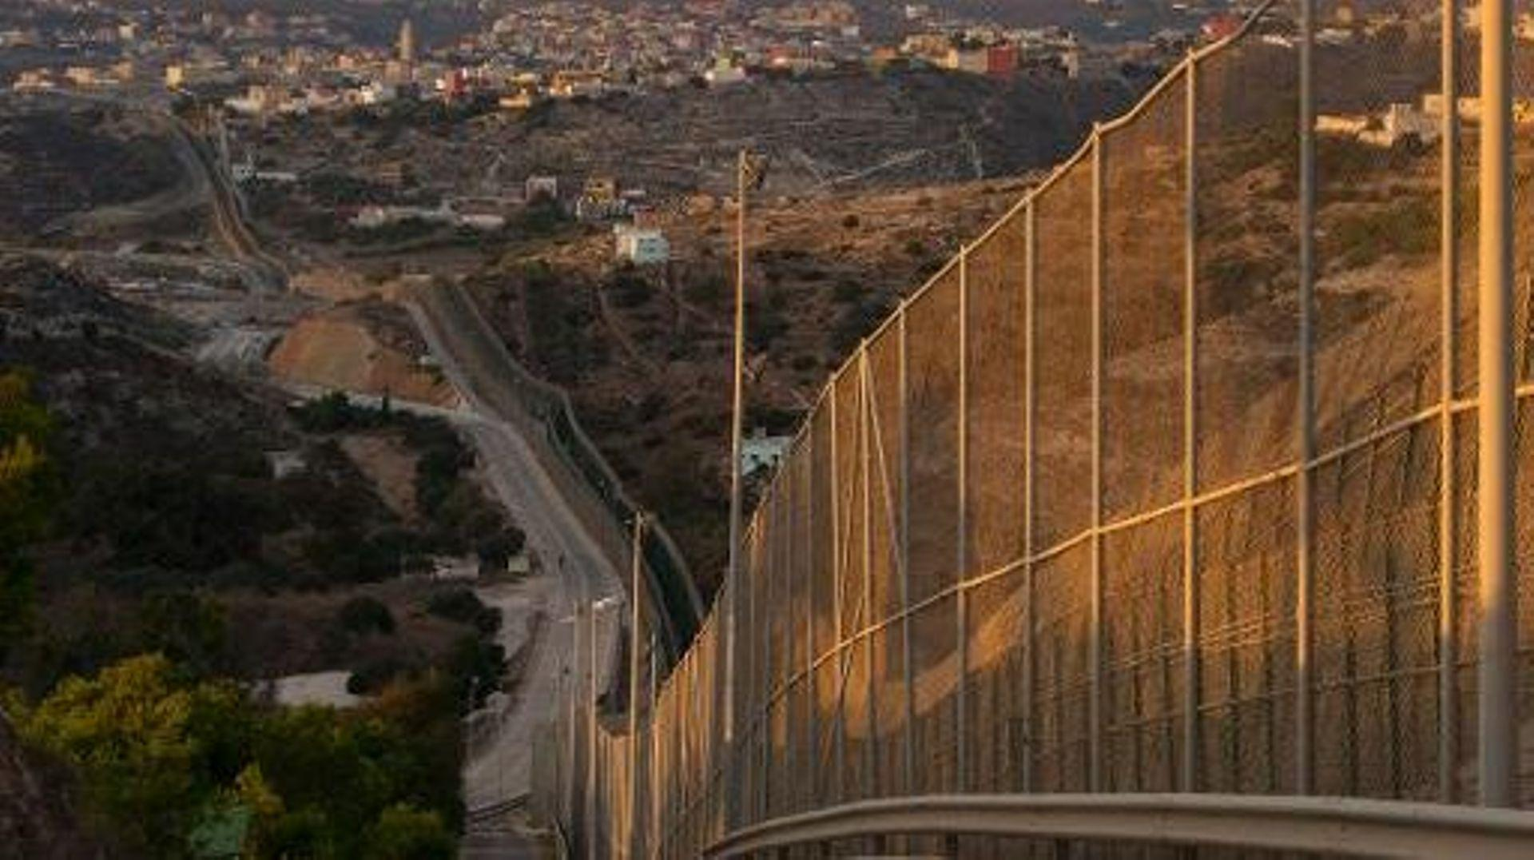
Brakes and obstacles
Legislation / Administration
Technology
Socio-economics
Fundings

Slide 18
Brakes and obstaces
Legislation / Administration
Relationship between naturalists in the field and administration not always easy
Technology
Difficulty to follow evolution of new technologies, sharp increase in costs : AI, thermal cams, sound analysis, DNA…
new issue with “big data management”
Socio-economics
Diversity of observers does not match society diversity
Both Hobbs and White (2012) and Pandya (2012) note that citizen scientists currently tend to be whiter, older and more middle-class than broader society; a similar pattern is found in volunteering in general (Measham and Barnett 2008). In some countries, there are mainly males.
Fundings
Funding for the structural aspect: observation system fee, training, validating, communication with observers… rarely obtained or really underestimated

Slide 19
Thank you for your attention !

