Slide 1
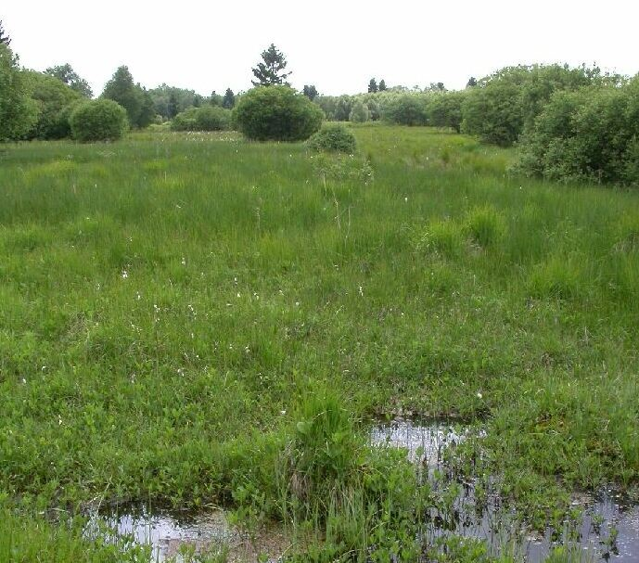
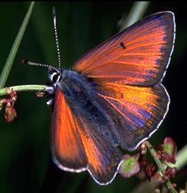
Analysis of citizen science data
How statistical modeling can help estimate trends
Philippe Goffart
DEMNA (SPW/DGARNE)
Namur, March 2024
Notes:
Good morning! So, I will talk about analysis of citizen data and illustrate potential ways to use them to estimate population trends.

Slide 2
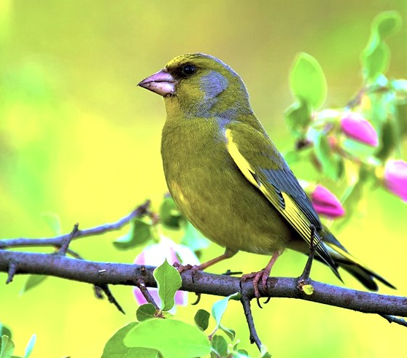
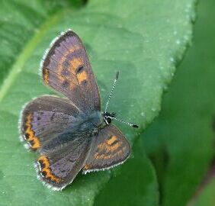
Plan
Introduction
Distinction of two types of citizen science data
For which use ?
- atlases (geographical distribution)
- monitoring (trends in time and space)
2. Use of standardized data
Bias and error sources
Example with birds
3. Use of opportunistic data
Bias and error sources
Analysis solutions
Example with a butterfly
4. Conclusions & prospects
Notes:
The main question behind this talk will be: what can we do with citizen data (despite their weaknesses highlighted by Marc Dufrêne) with the aim of monitoring biodiversity trends?
I will show this with two examples of applications carried out in Wallonia, one with standardized data dealing with birds, the other with mainly opportunistic data, concerning a butterfly species which is protected at the EU level.
In the introduction, I will also briefly mention another classical use of citizen data: the production of distribution maps and atlases.

Slide 3
Introduction
Two types of citizen science data
Standardized data
observations in a timeframe at a point / plot / transect / site (ex: birds seen during a winter week-end in your garden, butterflies counted in a transect of 15 minutes)
Opportunistic data
recordings of observations at x-y points (or in grids) at a date
Complete or partial lists… or single records (rarer species ?)
Notes:
The distinction of standardized and opportunistic data is important to make before wanting to analyze them.
In standardized data, observations are done in a timeframe at a point / plot / transect or site (for example: birds seen during a winter week-end in your garden, butterflies counted in a transect of 15 minutes)
Opportunistic data are defined as recordings of observations at points (or in grids) at a date, which consist of complete or partial lists (the observer possibly selecting only rare species).

Slide 4

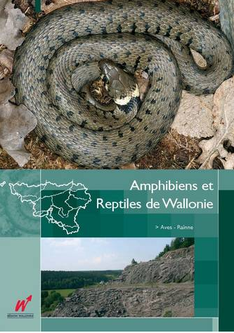

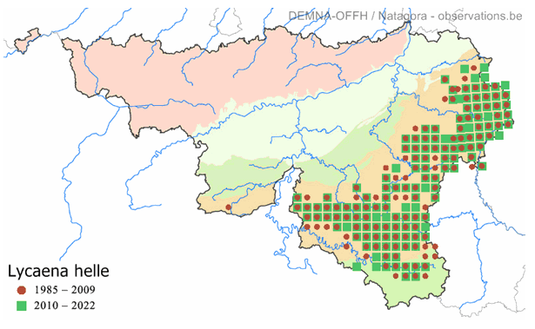
Introduction
For which use ?
Atlases : geographical distribution in a short timeframe
Opportunistic… or standardized data
Continuous atlas on our website http://biodiversite.wallonie.be/
Notes:
One of the main use of citizen data is the production of atlases and distribution maps.
We published several atlases in Wallonia, about dragonflies, amphibians and reptiles, butterflies, but also orchids, birds, ants, etc…
In parallel, distribution maps are presented on our website, which offers the possibility of regular updating.

Slide 5
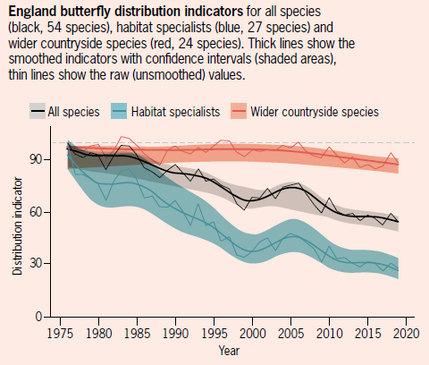
Introduction
For which use ?
Monitoring : trends in time and space
Standardized…. or opportunistic data
Fox et al. 2023.
The State of the UK’s
Butterflies 2022.
Notes:
But my goal, here, is to mainly discuss another use, namely to estimate trends in time and space. Indeed, monitoring is a crucial issue in the context of global changes. And producing curves like those showed here for butterflies in England can help to highlight threats and results of action taken in this matter.
But the question is : can we estimate reliably trends of species or group of species with citizen data ?

Slide 6
Use of standardized data
Bias and error sources in standardized data
Unbalanced observation effort between regions, sites, grids
=> geographical and temporal biases
Not all species are detected
=> detection bias (+ observer effect)
Identification errors
=> false positives
Quality compensated by quantity !(?)
Notes:
Even standardized data suffer from bias and errors.
Unbalanced observation effort between regions, sites, grids leads to geographical and temporal biases.
Not all species are detected at each visit and there are observer effects depending on their skills.
And, of course, they may be identification errors, which generates false positives.
But could lower quality data be compensated by data quantity (quantity being one of the main advantages of citizen data) ?

Slide 7
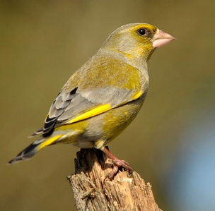
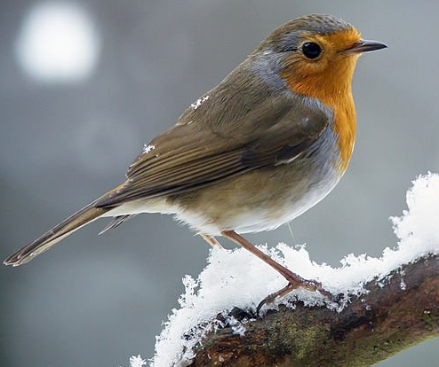
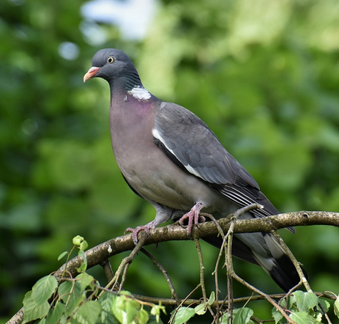
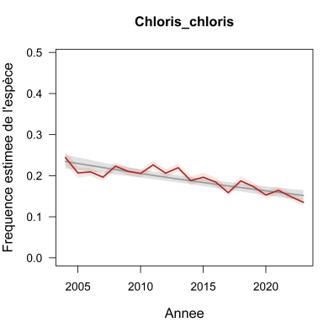
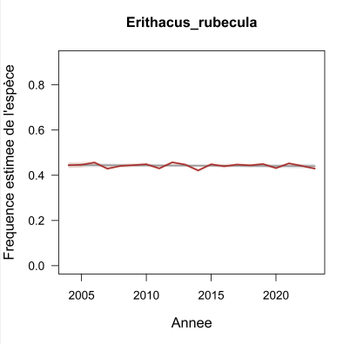
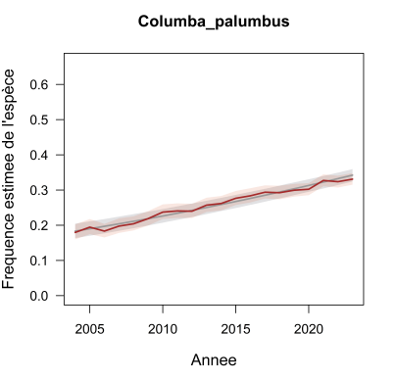
Use of standardized data
Garden bird counts in winter (Natagora)
Notes:
Here, I present you some first results of a statistical treatment done on winter bird counts in gardens throughout Wallonia for two decades. We did not use abundances of birds in gardens, but just occurrences of species and, thus, estimated their trends in frequency.
The results are quite interesting as they provide clear trends for 55 common and widespread species (with three examples shown here).
You can notice narrow confidence intervals, because the number of gardens surveyed is huge (in the thousands).
So, for common species, this kind of scheme is proving very successful and the data (more than 2 millions until now) can be analysed quite easily.

Slide 8
Use of opportunistic data
Bias sources in opportunistic data
Unbalanced observation effort between regions, sites, grids
=> geographical and temporal bias
Not all species are detected
=> detection bias (+ observer effect)
Identification errors
=> false positives
Field methods and intensity vary between observers and visits
=> methodological bias
Not all species are reported
=> reporting bias
Notes:
Now, can we say the same for opportunistic data ?
First, this kind of data suffer from the same biases and errors than standardized ones.
But two other biases add to them :
field methods and intensity vary between observers and visits, which can be called « methodological bias », and
not all species are systematically reported, generating a « reporting bias ».

Slide 9
Use of opportunistic data
Key points for analyzes
1. Abundance data are not usable
Need to work with presence/absence…
…or detection/non-detection
=> probability of presence / occupancy / detection / observation
Notes:
So, how to deal with these data biases for trend analyzes ?
I see three key points.
First : abundance data are not usable and it is needed to work with presence/absence…or, more correctly, with detection/non-detection data.

Slide 10
Use of opportunistic data
Key points for analyzes
2. Methods of observing and reporting vary between people and through time
Need to know the range of naturalist behaviour in the field
=> appropriate selection of the data
=> adaptative modelling
Notes:
Secondly, methods of observing and reporting vary between people and through time. So, it is useful to know the range of naturalist behaviour in the field to make appropriate selection subsets from the data and to adapt modeling.

Slide 11
Use of opportunistic data
Key points for analyzes
3. Search intensity vary between visits :
Duration effect
Route taken effect
Time of day effect
Weather conditions effect
People effect
Need to evaluate and take account the sampling effort when modelling
=> adaptative modelling
Notes:
Thirdly, the intensity of search varies between visits, due to the variety of durations, routes taken at sites, time of day, weather conditions and people’s skills. Thus, it is needed to evaluate and to take into account the visit sampling effort when modeling.

Slide 12
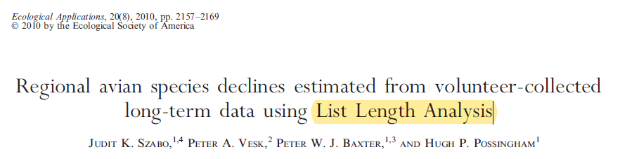
Use of opportunistic data
Modelling developments targetting opportunistic data
Principle : to use and include a « list length » variable
(= number of species seen during a visit)
as a proxy for search intensity in the model
Notes:
Fortunately, there have been interesting developments with the modeling of opportunistic data over the past two decades.
A scientific paper proposed a nice solution to the visit intensity puzzle in 2010. It consists to use the “list length” (that’s to say, the number of species seen during a visit) as a proxy of search intensity and to include it as a covariate in the model.

Slide 13
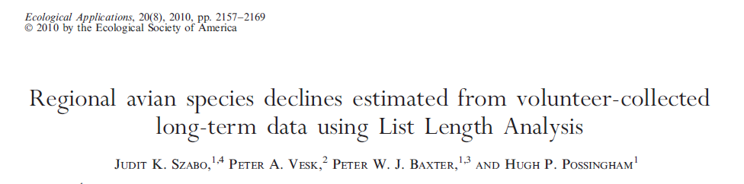
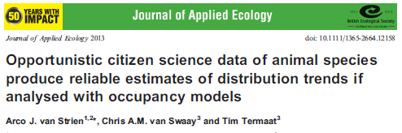
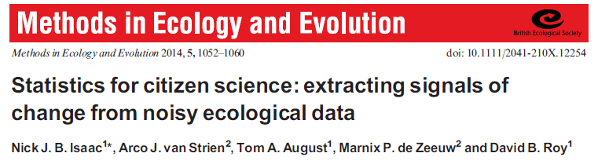
Use of opportunistic data
Modelling developments targetting opportunistic data
Notes:
Some other important papers have been published since, seeking to evaluate the reliability of different methods applied on those “so called” noisy ecological data.
They showed that distribution trends can be estimated reliably when analysed with appropriate statistical models.

Slide 14



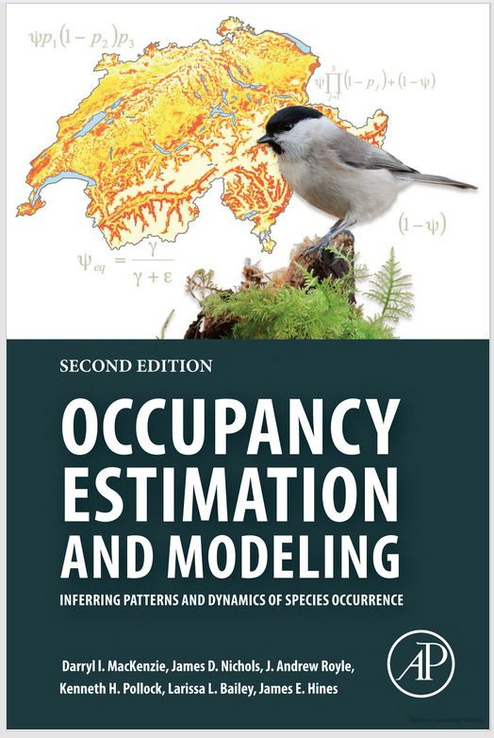

References
Kéry (2010) Korner-Nievergelt et al. (2015) Kéry & Schaub (2012)
MacKenzie et al. (2017) Kéry & Royle (2016) Kéry & Royle (2020)
Notes:
A few excellent books have also helped to enhance the statistical skills of applied ecologists, notably the titles presented here. I recommend them for enthusiastic statisticians!

Slide 15
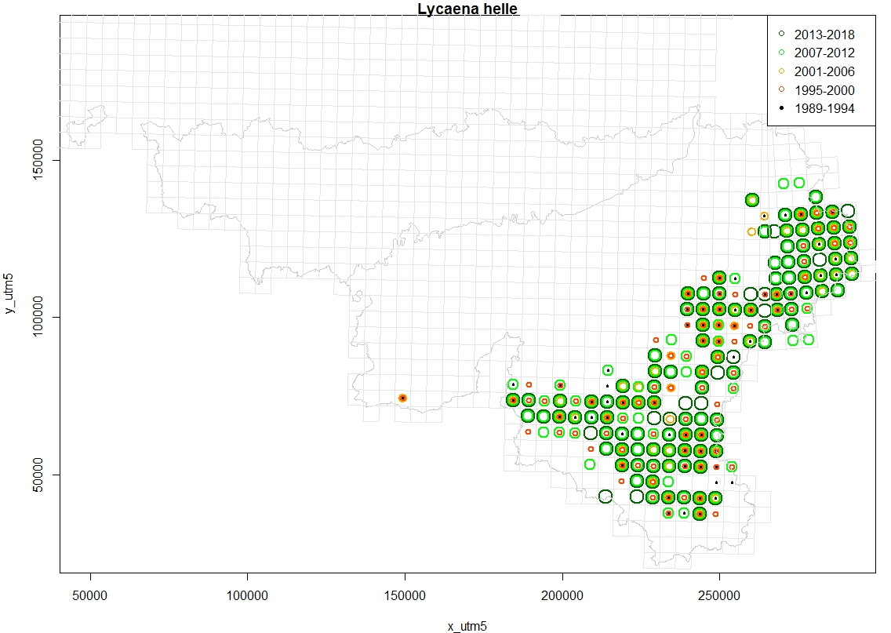

Use of opportunistic data
Violet Copper (Lycaena helle)
Notes:
Now, I will develop an example of analysis applied on the data of a nice boreo-montane butterfly, widespread in the Ardenne’s massif, where it has probably its main stronghold in Western Europe (as you can see on the maps here), hence our responsibility for its conservation.

Slide 16
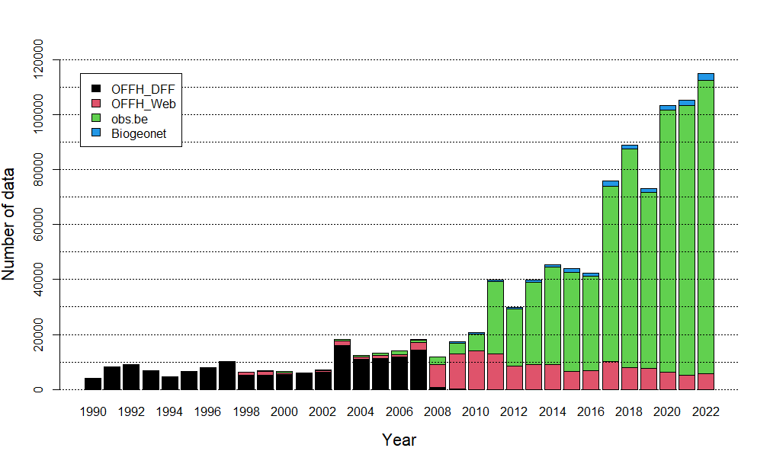
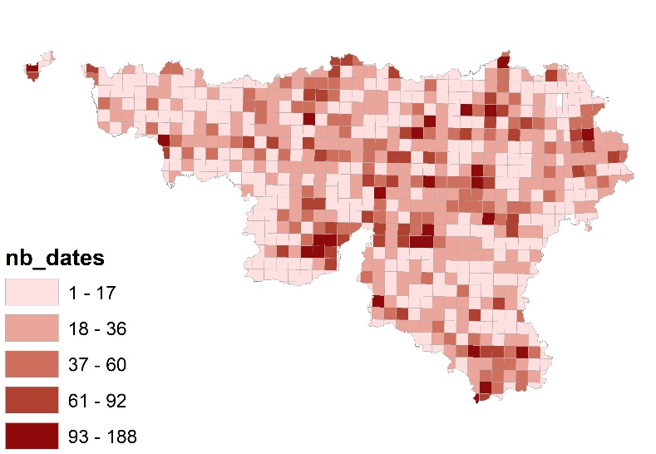
Use of opportunistic data
Butterfly data from 1990 to 2022 (Lycaena working group)
Number of visit dates
by grid of 25 km² in 2021
Notes:
So, we tried to mine in our available database, totalling more than 1 million butterfly data ! Here is the temporal distribution of them, since the early nineties. An impressive increase can be seen over the last decade, with the introduction of web portals where naturalists can record their observations.
The map shows you the disparities of sampling effort between grids in a given year.

Slide 17
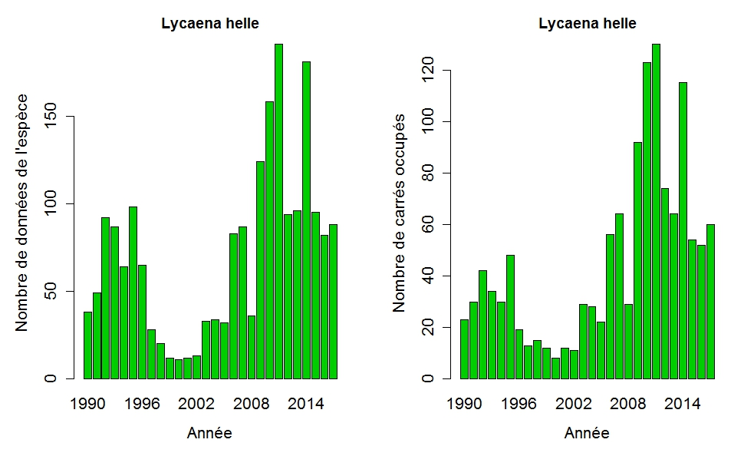

Use of opportunistic data
Violet Copper (Lycaena helle) data
Notes:
A similar pattern can be found for our target species, with the number of data per year, on the left, and the number of 1 km² grids where the butterfly was found per year, on the right.
Looking naively to these graphs, this could suggest that the species is expanding, but one may suspect that this is an effect of increasing sampling effort. Thus, to see the real trend, it is necessary to model data in a relative way.

Slide 18
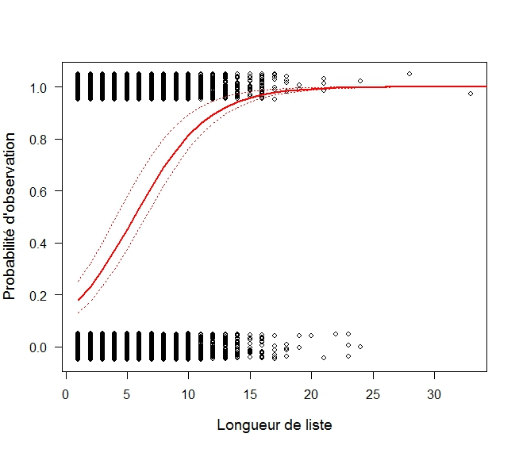
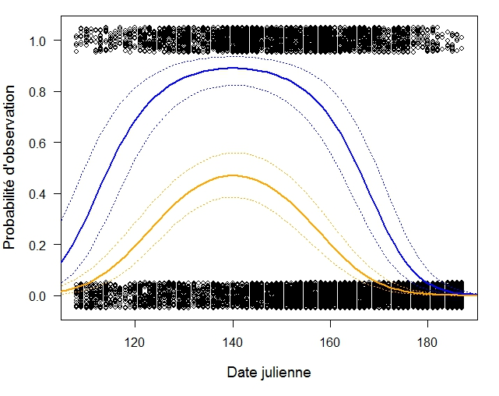
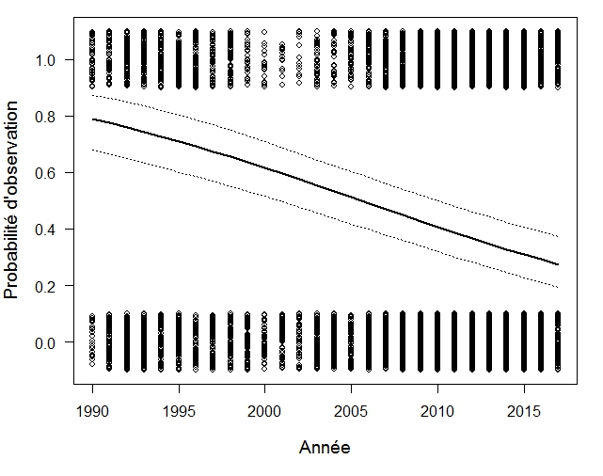
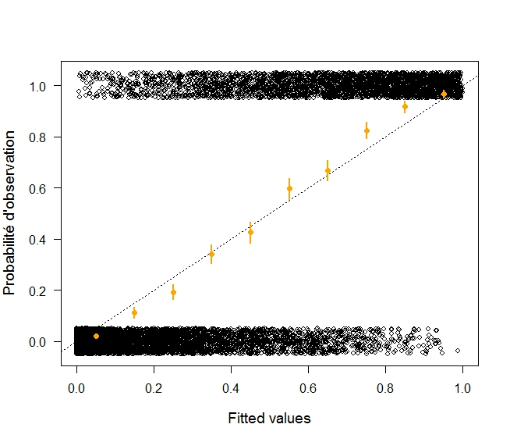
Use of opportunistic data
« List-length analysis » (GLMM)
(L. helle data from 1990 to 2018)
Notes:
To do this, we have modeled here the proportions of detections and non detections through time, with the « List Length » analysis.
This model takes into account (and so control) the intensity of the visit, and we can see that the probability of detection increases significantly with the number of species seen during visits (first graph).
But the model takes also into account the visit date, and of course the probability of observation increases until the peak period and then decreases (second graph).
The resulting « year trend » appears on the third graph and we see that it is declining significantly. This means that when visiting suitable grids at the right time of the year in the Wallonia range, the probability to detect the butterfly approximately halved within two decades. This can be explained by the disappearance of the species on some grids or just the decrease of its abundance in other grids.
The last graph gives a diagnosis of the model that predicts quite well the observed data, as shown by the orange points aligned along the diagonal.

Slide 19
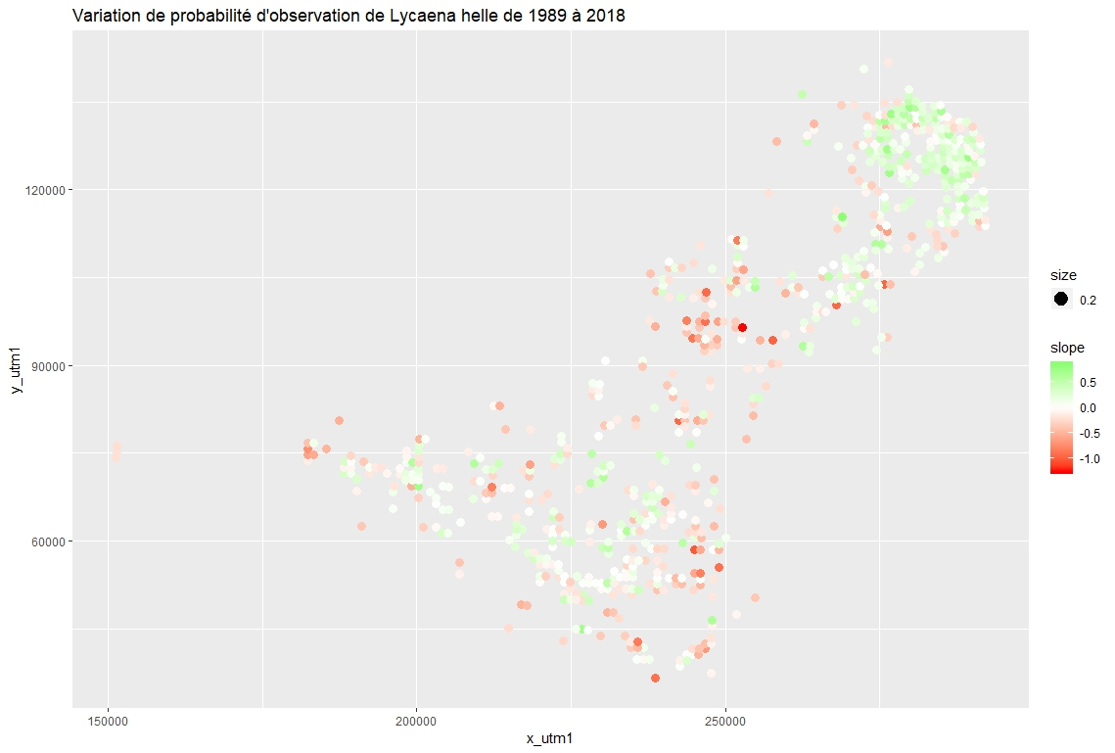
Use of opportunistic data
« List-length analysis » (GLMM)
(L. helle data from 1990 to 2018)
Notes:
The « year trend » was previously the average trend across Wallonia, but the model can also give information about the trend at the level of each 1 km square grid, as shown here, with the deviations from the average, colored red where the slope is even steeper… and green when less steep.

Slide 20
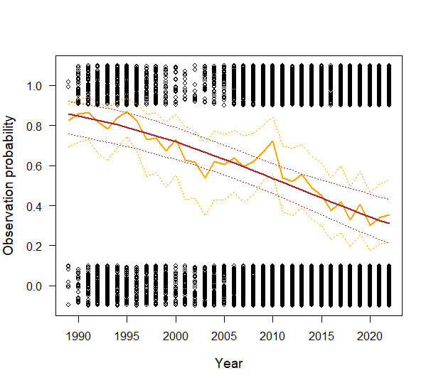
Use of opportunistic data
« List-length analysis » (GLMM)
(L. helle data from 1989 to 2018)
Notes:
In addition, it is possible to make refinements such as this one, allowing interannual variations around the average “year trend”, which is more realistic for insects.

Slide 21
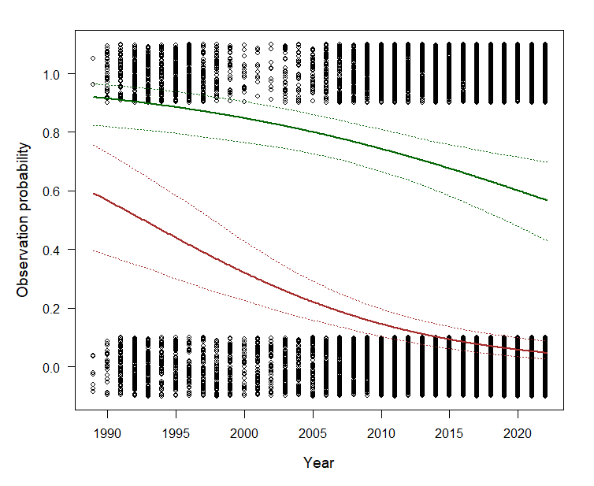
Use of opportunistic data
« List-length analysis » (GLMM)
(L. helle data from 1989 to 2018)
Notes:
We tried also to see if there was an altitude effect on « year trend », as this butterfly is linked to cold climate regions and that climate change could explain part of the decline. The new model seems to validate the hypothesis, as the decline appears stronger and sooner at 300 meter a.s.l. than at 600 m.

Slide 22
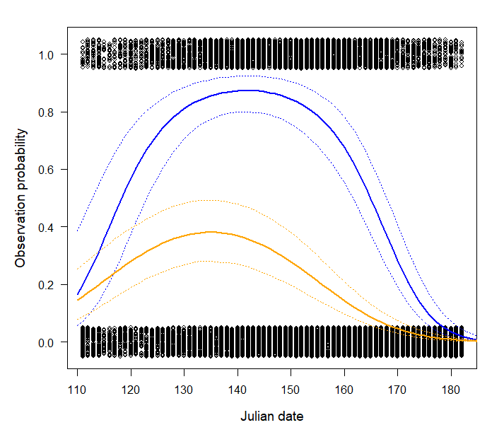
Use of opportunistic data
« List-length analysis » (GLMM)
(L. helle data from 1989 to 2018)
Notes:
Finaly, it is also possible, with the same modeling, to search for a phenological shift within the three decades interval.
This confirms that the peak of observation probability appears earlier in the year on average in twenty-two (2022) than in nineteen-ninety (1990).

Slide 23
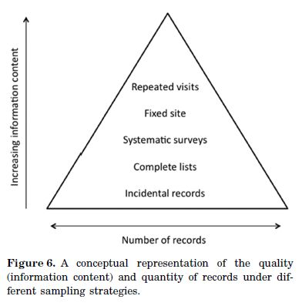
Conclusions & prospects
Hierarchy of data types for trend monitoring
(Isaac & Pocock 2015, Biol. J. Linn. Soc.)
Notes:
I would conclude by saying that, both opportunistic and standardized data, can provide interesting insights into trends, at least if we select appropriately the data and use adapted statistical methodologies.
Moreover, I am quite convinced that, in a sense, quantity can compensate for lower quality… as it is shown in this graph proposing a hierarchy of data types with increasing information content, going upwards, but decreasing records quantity.

Slide 24
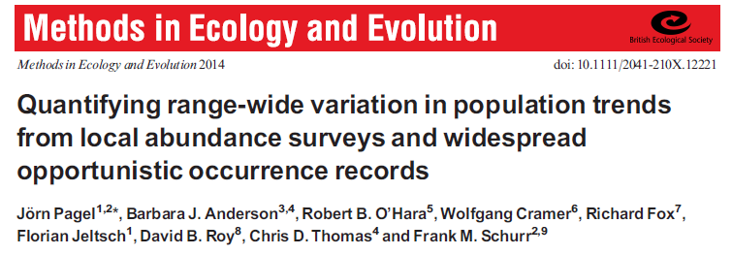
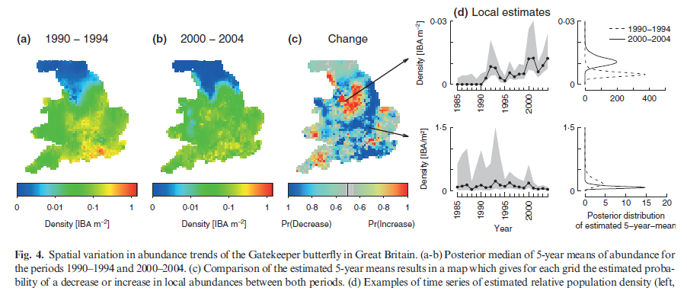
Conclusions & prospects
Modelling method development : Integrated models
Notes:
Finally, it is worth mentioning that statistical modeling is improving at an impressive rate and new techniques are developed every year that allow for better estimates of large-scale trends.
One promising avenue is notably the growing field of « Integrated models », which can exploit different datasets in a single joint hierarchical modeling. Thanks to this approach, it is for example possible to combine information from detection/non-detection opportunistic data and standardized counts on certain sites.
This kind of models provide generally better estimates than those obtained from these datasets used separately.

Slide 25
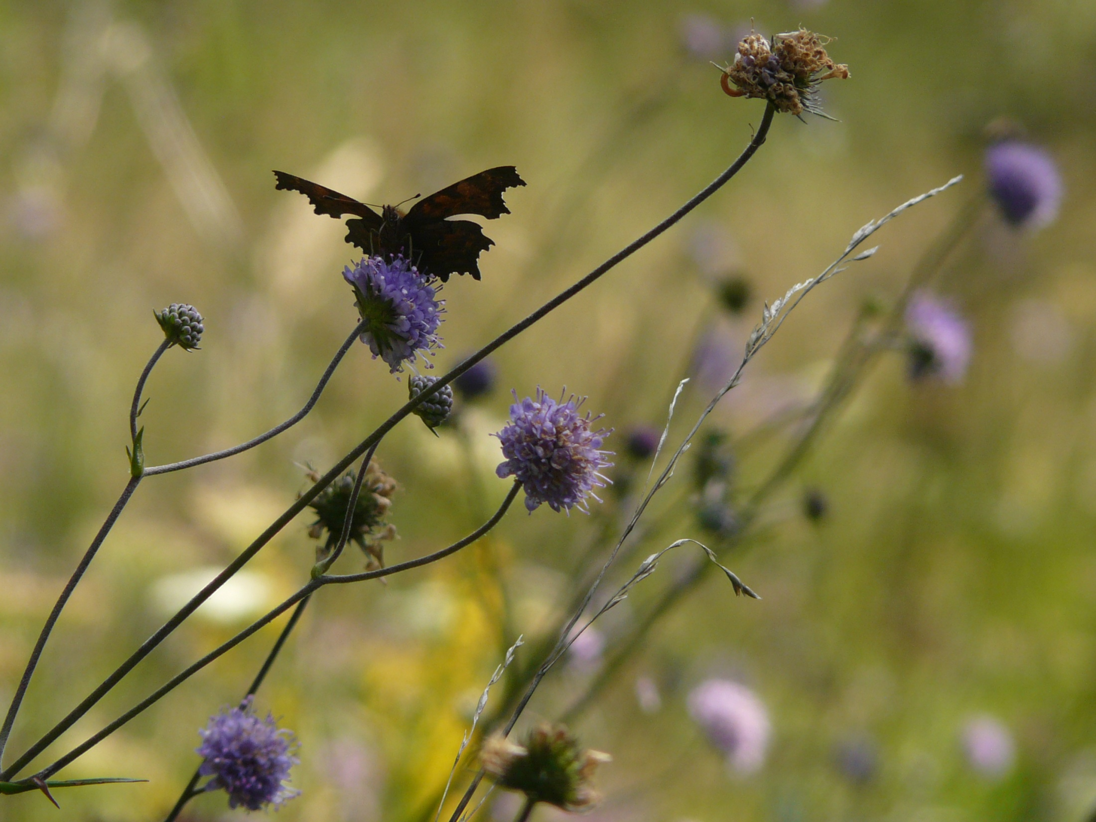
Thanks for your attention !
Notes:
Thank you for your attention. I’m waiting for your questions.

