Slide 1


Validating mammal observations: the Agouti platform and the Walloon Wolf Network as examples
Alain LICOPPE Département de l’Etude du Milieu naturel et agricole

Slide 2
Biological data workflow
planning
validation
analysis
use
assessment
collection
Mammals
Camertrap networks
Opportunistic sightings

Slide 3
Biological data workflow
planning
validation
analysis
use
assessment
collection
Mammals
Camertrap networks
Opportunistic sightings

Slide 4
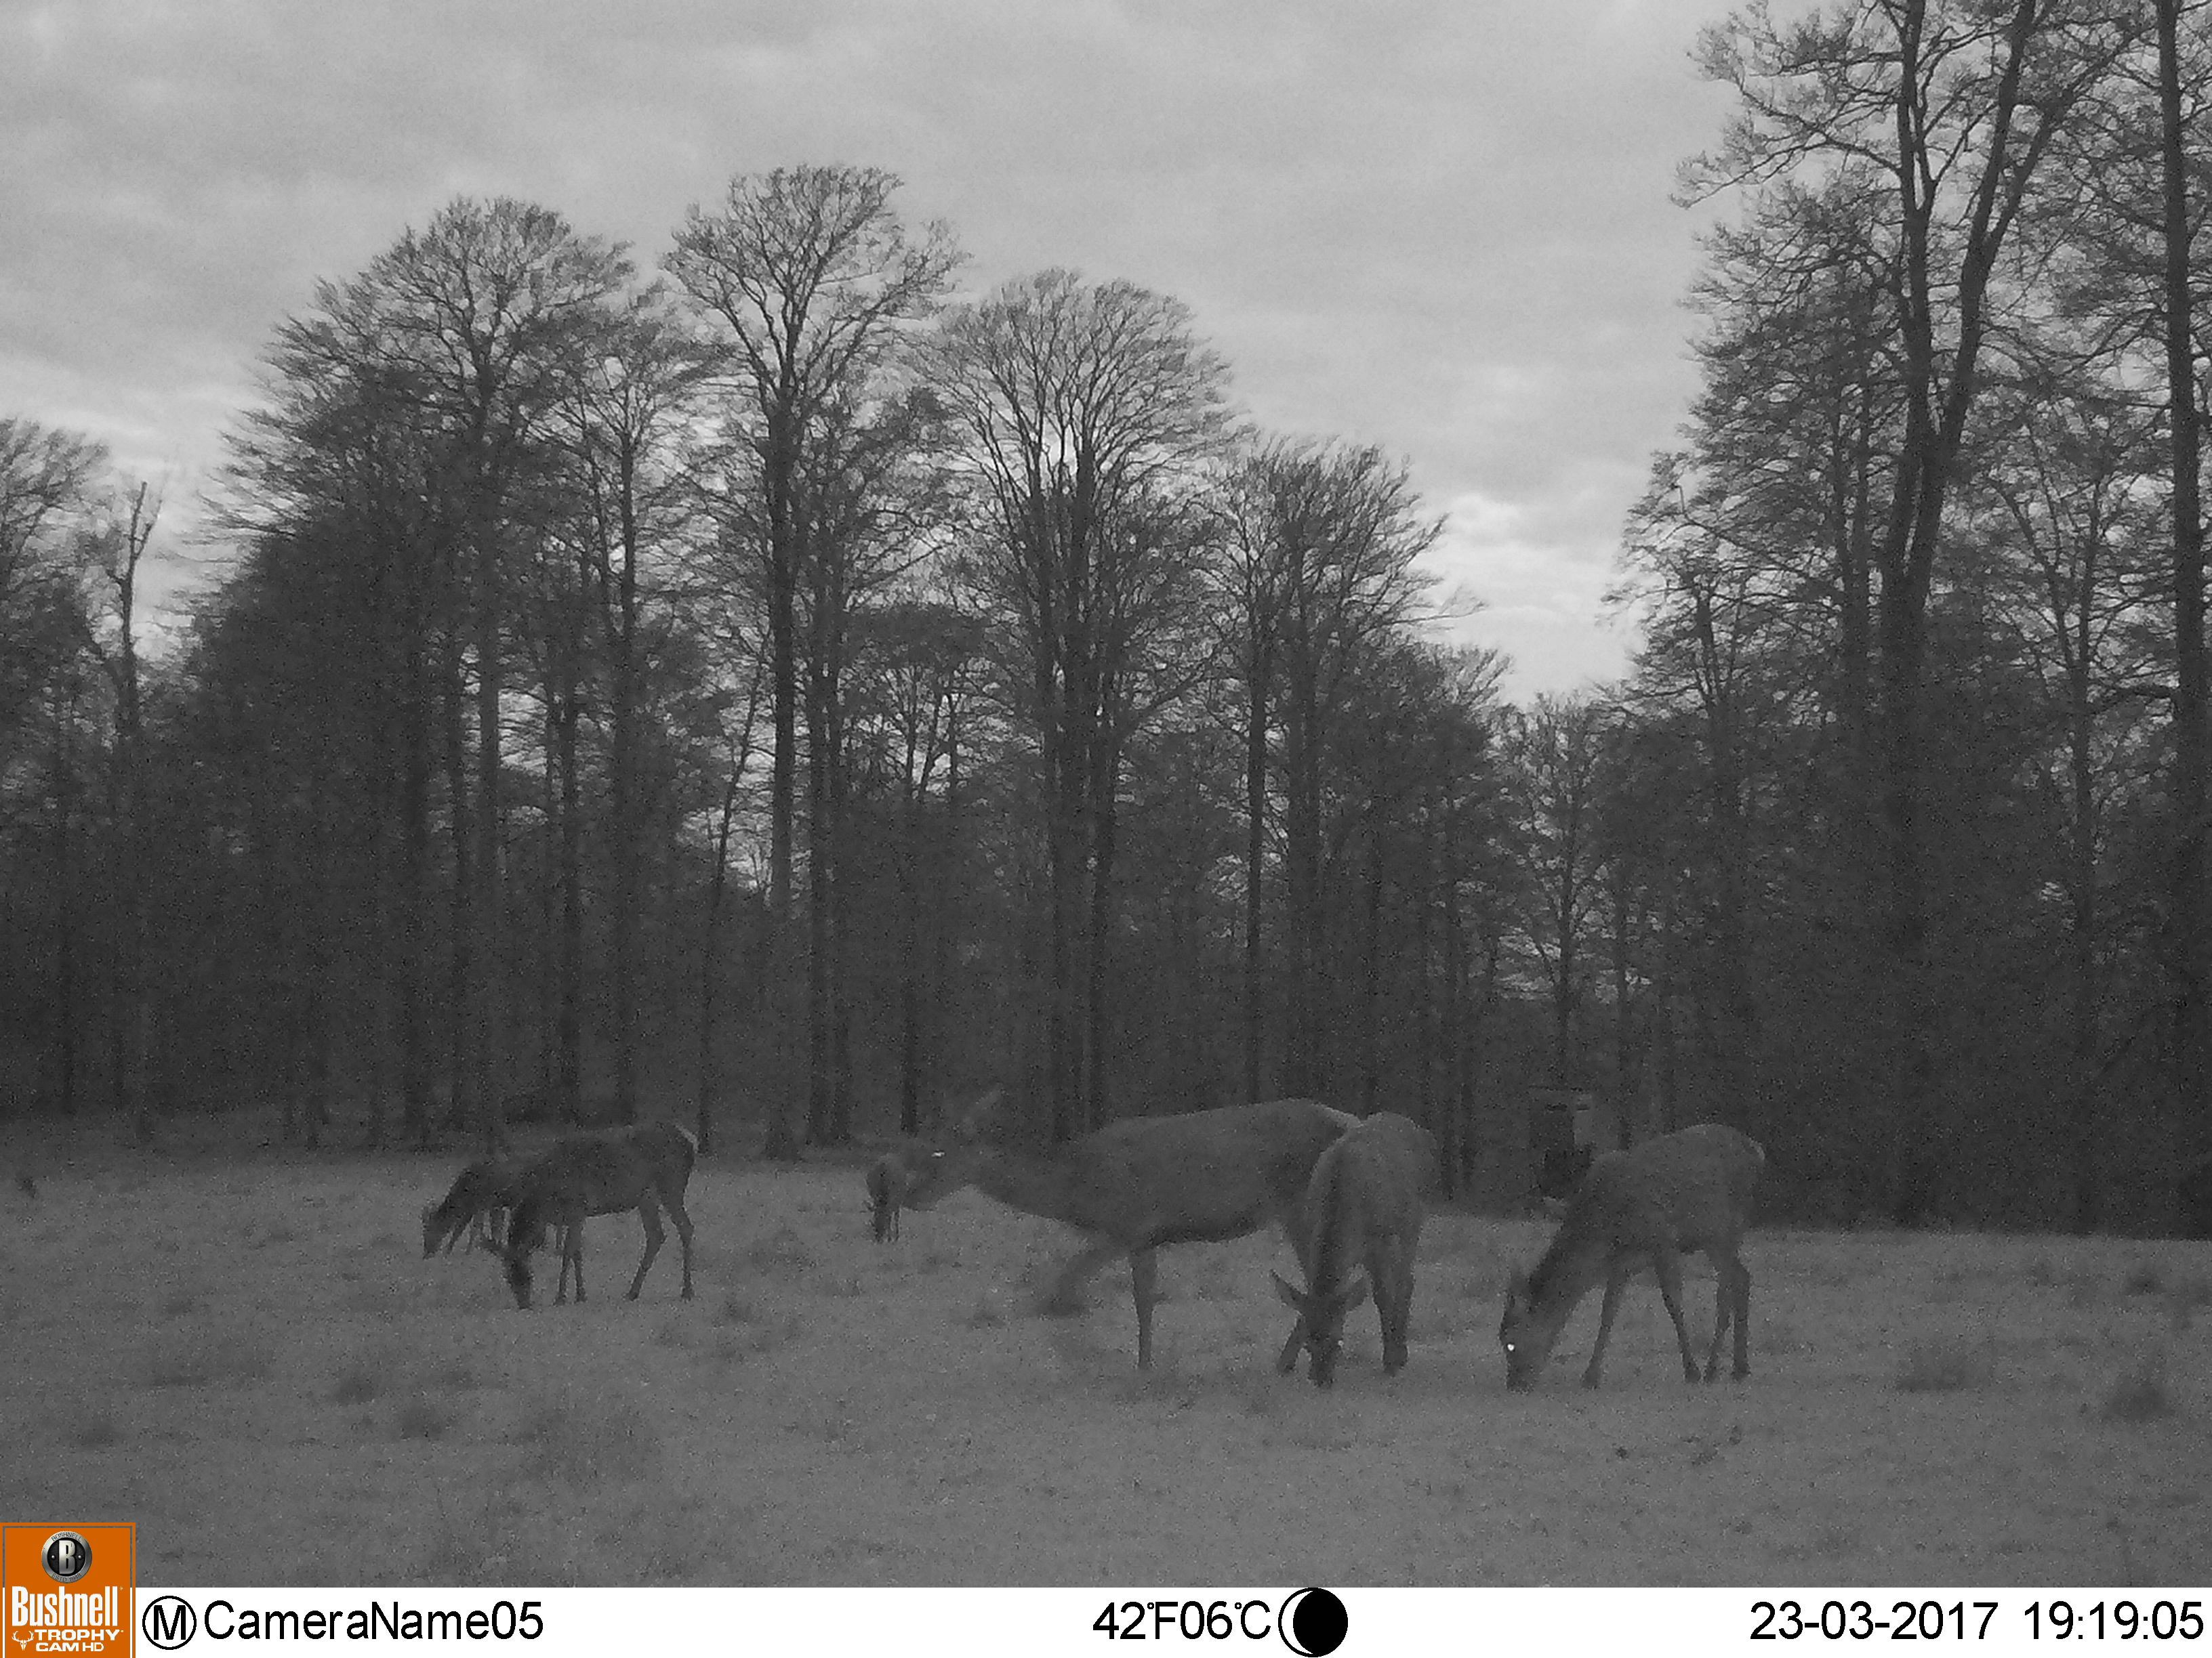
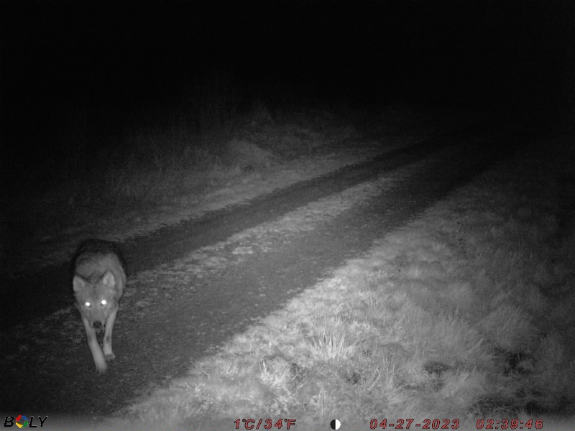
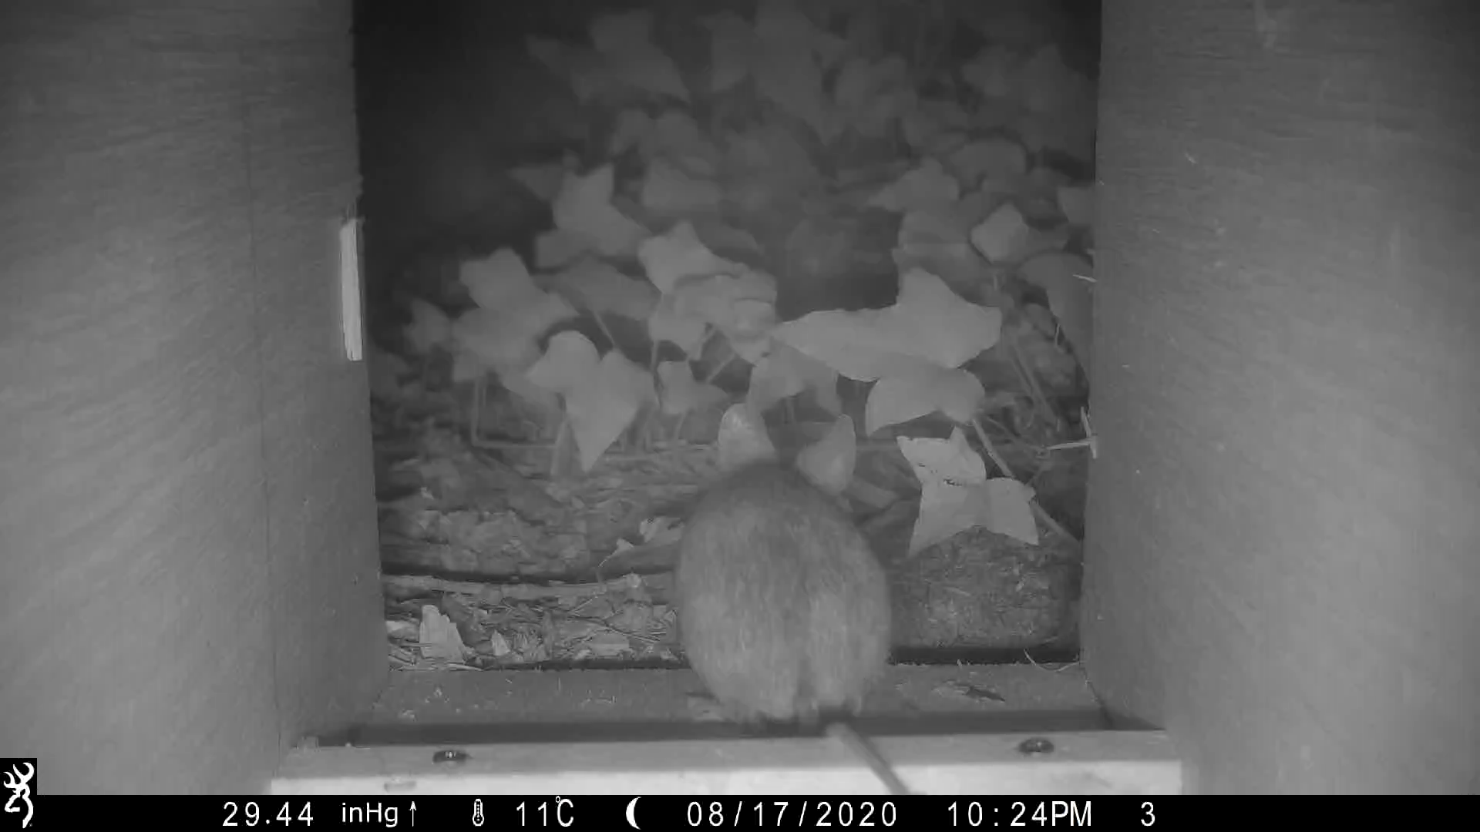
Focus on mammal species
Nocturnal
Elusive
All sizes

Slide 5
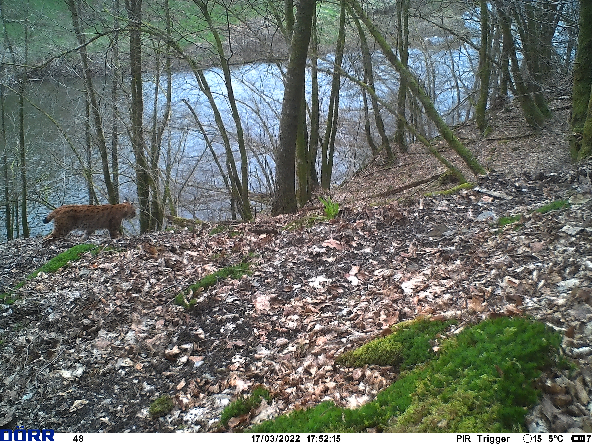
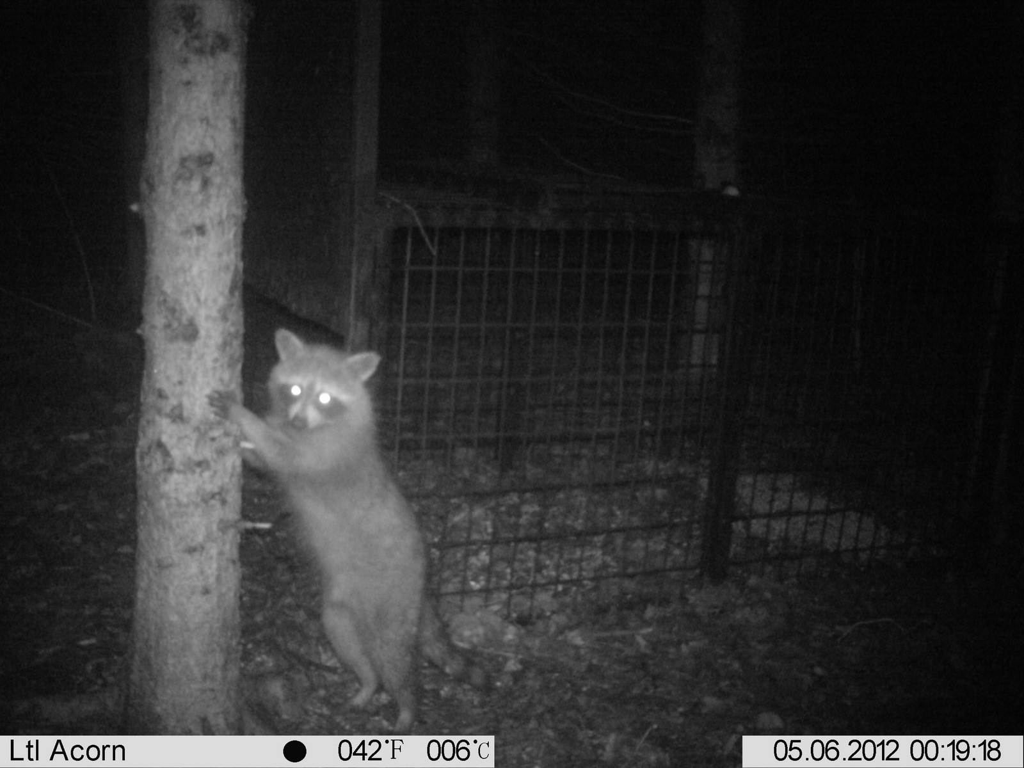
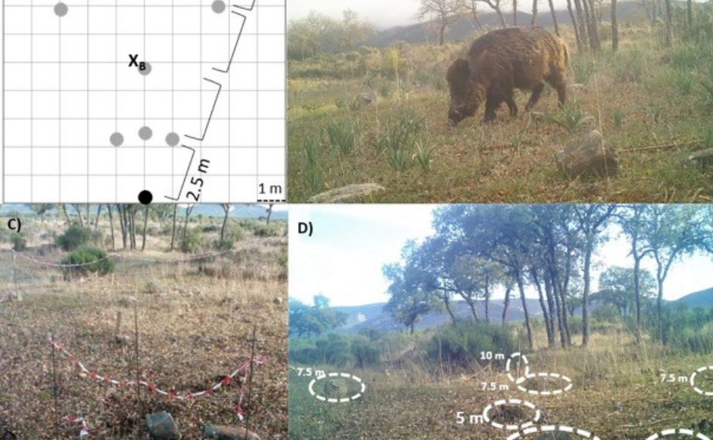

Focus on mammal species
Natura 2000
Invasive
Game

Slide 6
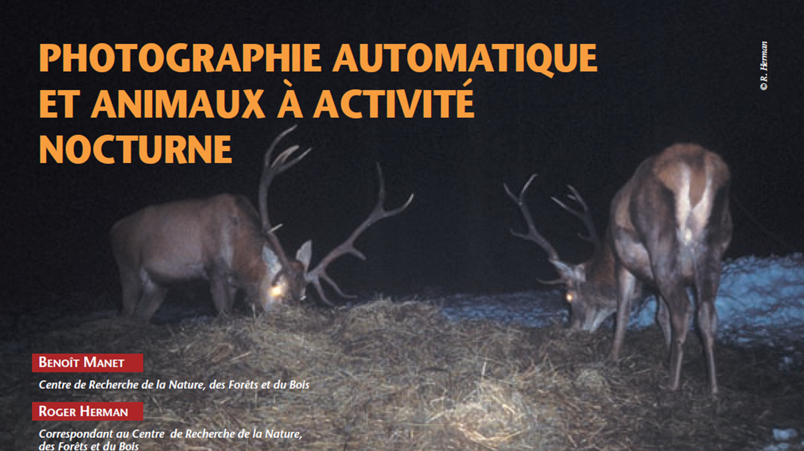
Monitoring by cameratraps
Simple to use
Non invasive
Technological evolution
Low costs
Allows validation

Slide 7
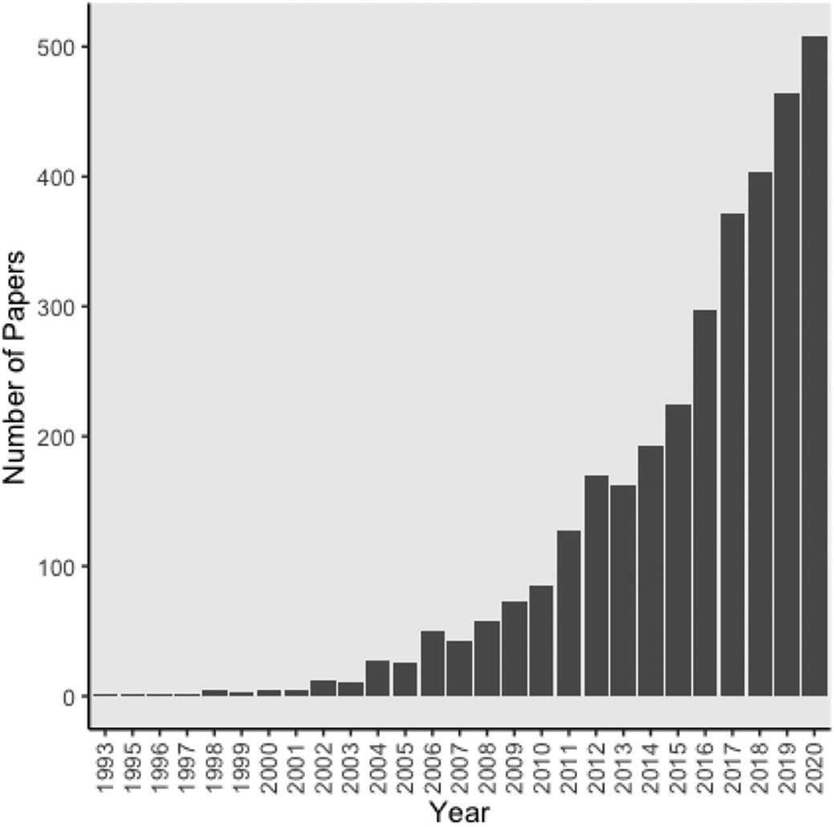
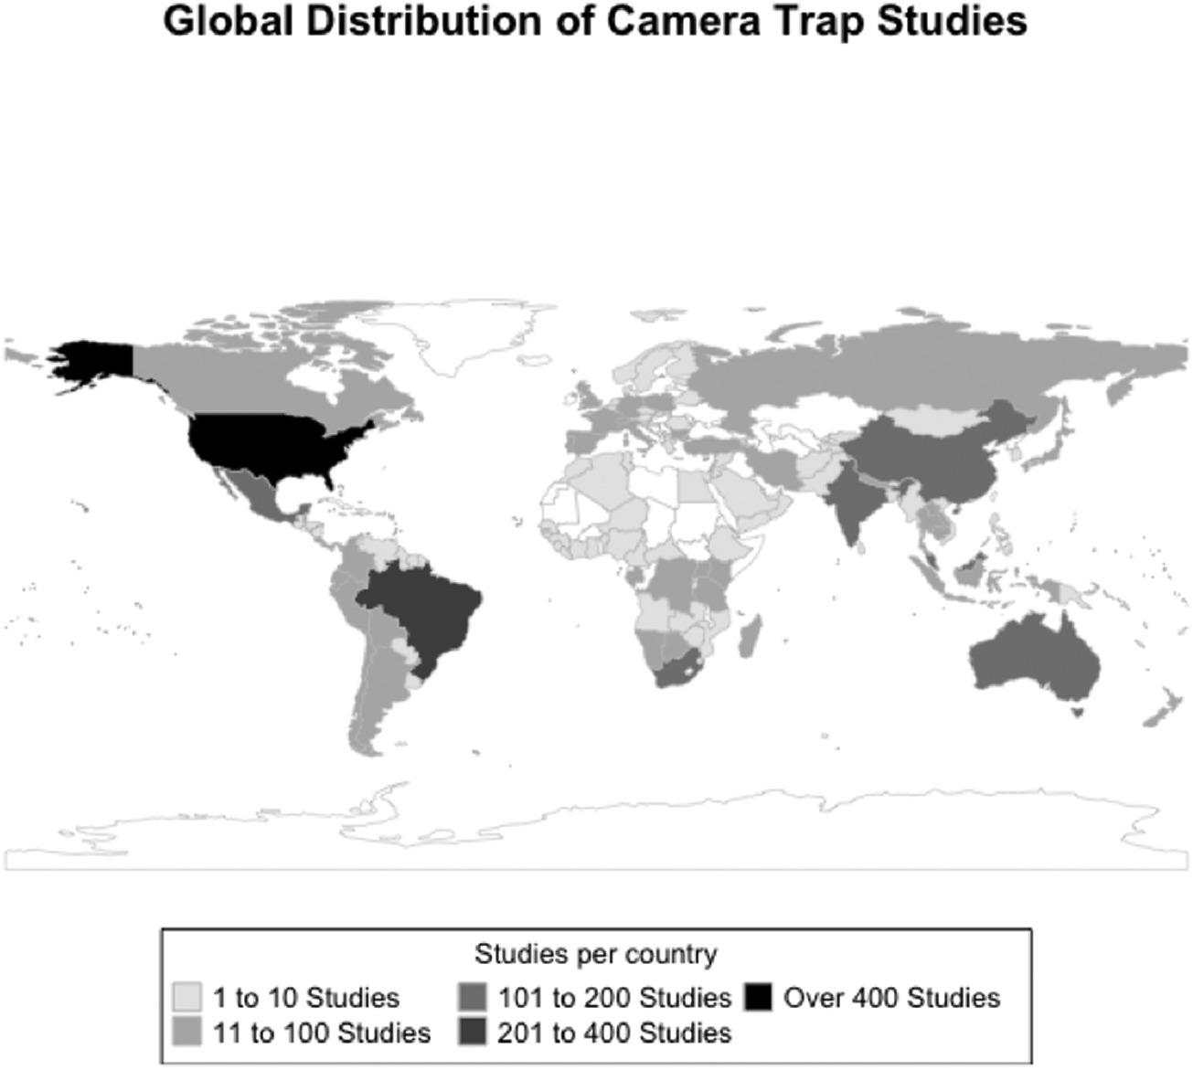
Monitoring by cameratraps
Review: COVID-19 highlights the importance of camera traps for wildlife conservation research and management. Blount et al 2021

Slide 8
Monitoring by cameratraps
Taxa | Percent of total articles
Mammal | 82.9
Bird | 5.9
Multiple taxa | 5.7
Herpetofauna | 1.7
Insect | 0.2
Within mammal order diversity | Percent of mammal category
Carnivore | 45.9
Multiple Orders | 26.8
Ungulate | 13.2
Rodent | 5.5
Primate | 4.3
Marsupial | 1.8
Other | 2.3
Review: COVID-19 highlights the importance of camera traps for wildlife conservation research and management. Blount et al 2021

Slide 9
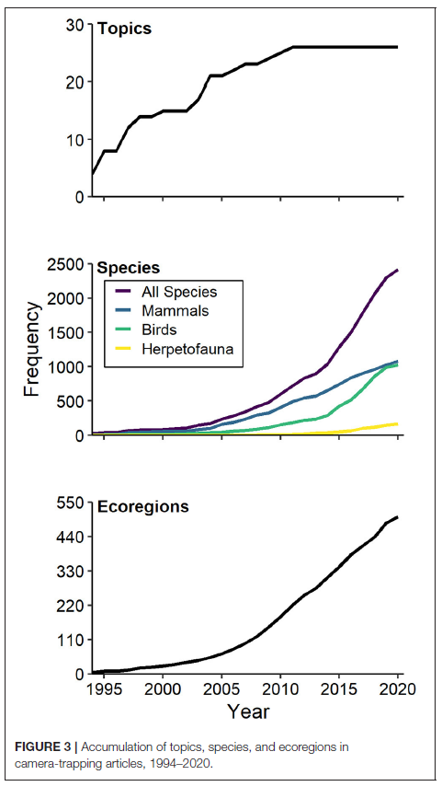
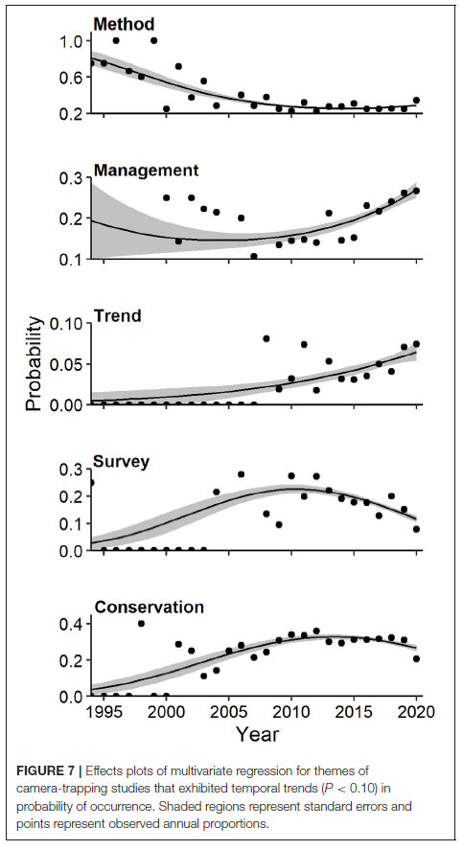
Monitoring by cameratraps
Next-Generation Camera Trapping: Systematic Review of Historic Trends Suggests Keys to Expanded Research Applications in Ecology Delisle et al 2021 and Conservation

Slide 10

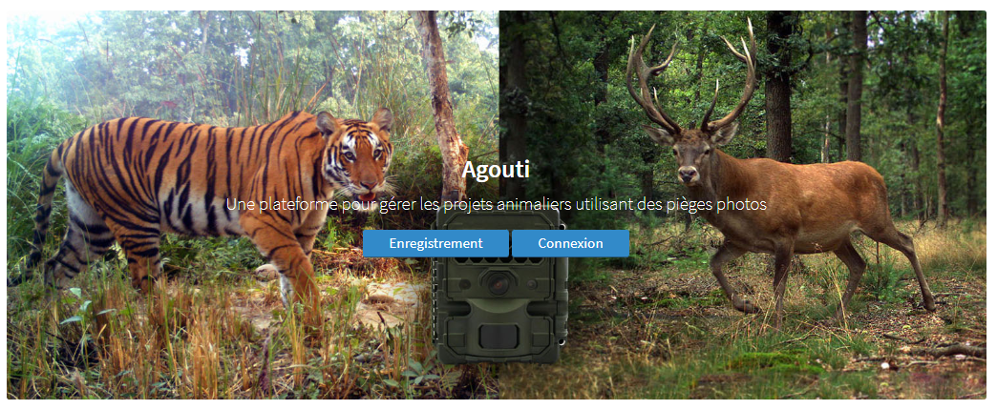





Agouti.eu
A platform for the organization, processing and storage of camera-trap imagery

Slide 11
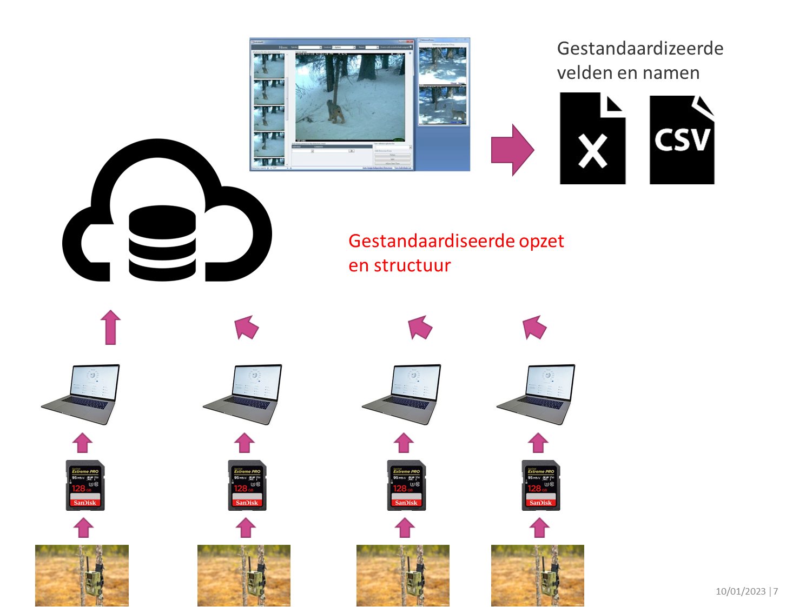
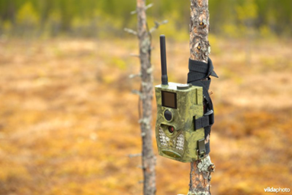

Agouti PROJECT
Standardized fields and names
Standardized design and structure
From :
To:

Slide 12
Agouti.eu
Project and sampling design
Cameras in the field
Import into agouti
Annotation
Export

Slide 13
Agouti.eu
Project and sampling design
Cameras in the field
Import into agouti
Annotation
Export
What is the main issue ?
Project based on a geographical area, a species ? …
Definition of the number of cameras, the sampling design, …
Definition of the collaborators and their roles

Slide 14
Agouti.eu
Project and sampling design
Cameras in the field
Import into agouti
Annotation
Export
Based on the same procedure for each collaborator
The operators require authorizations according to the nature of the ownership
Each owner is able to manage his own cameras
Can be managed by volunteers

Slide 15
Agouti.eu
Project and sampling design
Cameras in the field
Import into agouti
Annotation
Export
After collection of SD cards in the field
Files are uploaded to the Agouti platform
Requires a special access
Can be allowed to reliable volunteers for their own cameras

Slide 16
Agouti.eu
Project and sampling design
Cameras in the field
Import into agouti
Annotation
Export
The pictures are visualized in sequences on an esay to use interface
Volunteers or AI for a first annotation
Validation can be conducted by experienced operators
VALIDATION REQUIRED

Slide 17
Agouti.eu
Project and sampling design
Cameras in the field
Import into agouti
Annotation
Export
Data are stored on a cloud located at Wageningen University
Exports can be made for the entire project or limited to some cameras
The file format is supported by many platforms (GBIF)
Many R packages can manage this file format

Slide 18
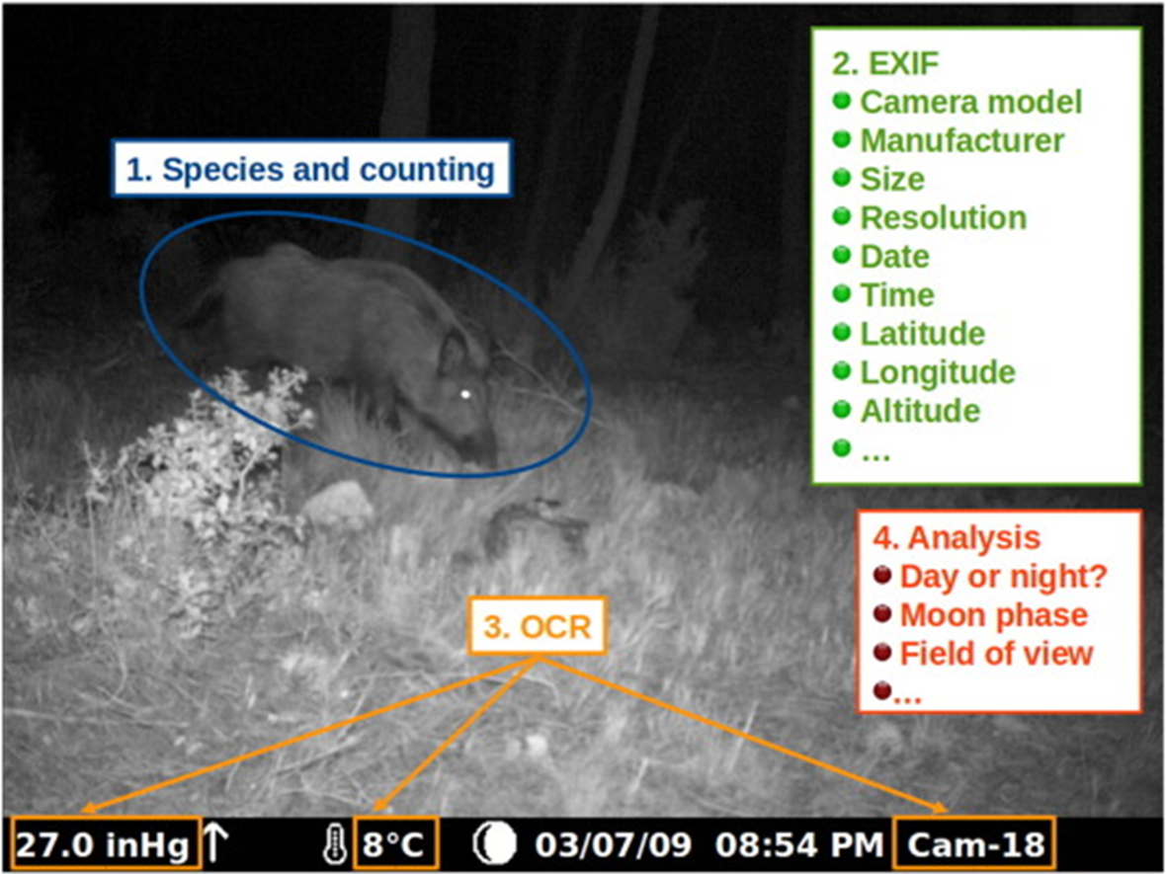
Validation tools for the metadata
Data automatically retrieved
Optical character recognition (OCR)
Exchange image File format (EXIF)

Slide 19
Validation tools for the identification
Setting user access rights
Role | Description
Admin | This role is reserved for Agouti’s technical staff.
Principal investigator | Person responsible for the project.
Project coordinator | Daily manager of the project. Typically handles users and oversees processing.
Taxonomic expert | Expert at identifying animals.
Photo processor | Can only upload new deployments, annotate sequences and browse deployments assigned to the user.
Volunteer | Least permissive role, can only annotate already imported deployments but not upload new material or browse deployments.
View only | Can only view deployments, sequences and annotations in the project but not change anything.

Slide 20
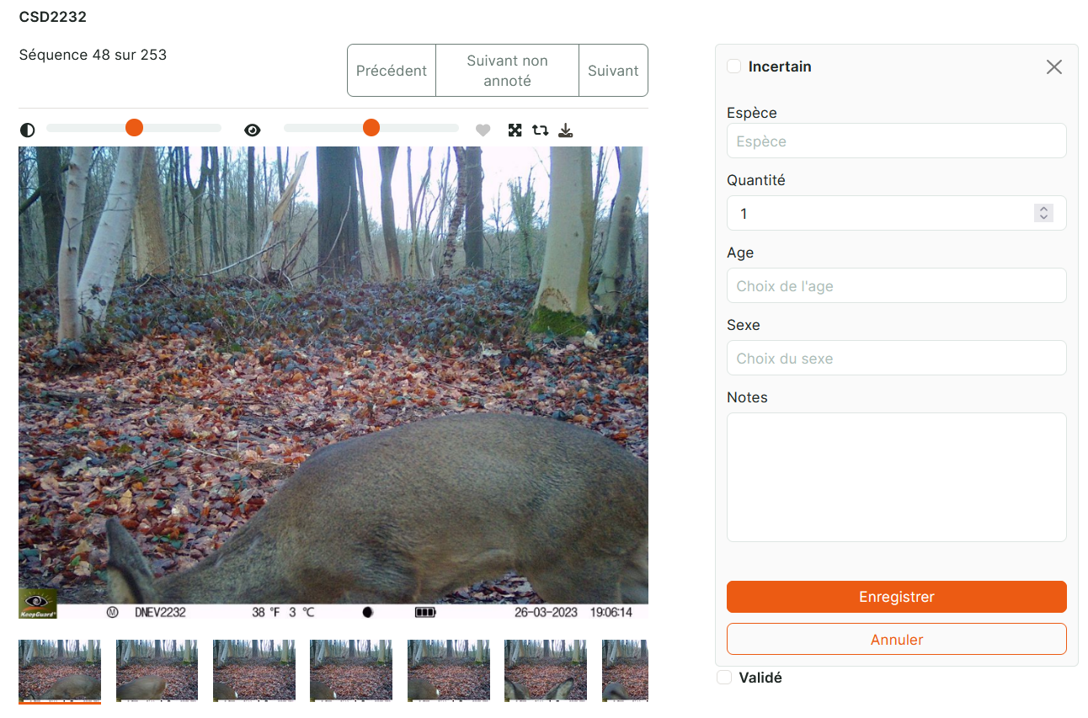
Validation tools for the identification
Artificial intelligence (AI)
Crowd sourcing via Zooniverse
Basic image recognition controlled by:
Principal investigator
Taxonomic expert

Slide 21
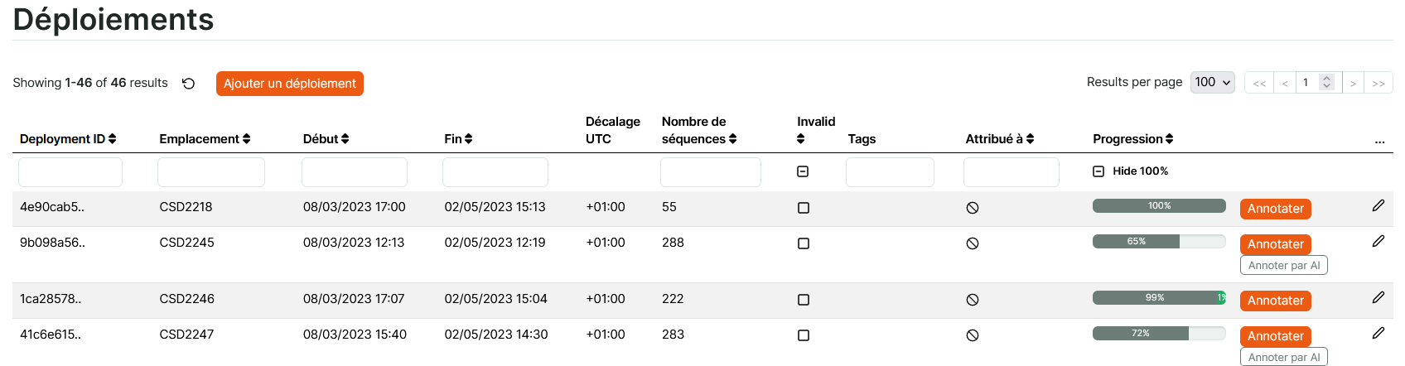
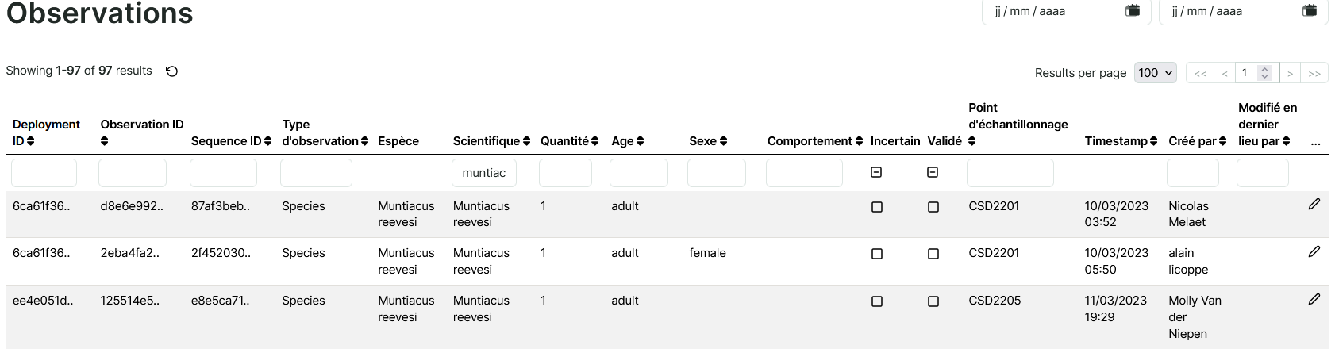
Check based on the empty sequences
Check based on a species
of concern and uncertainty

Slide 22
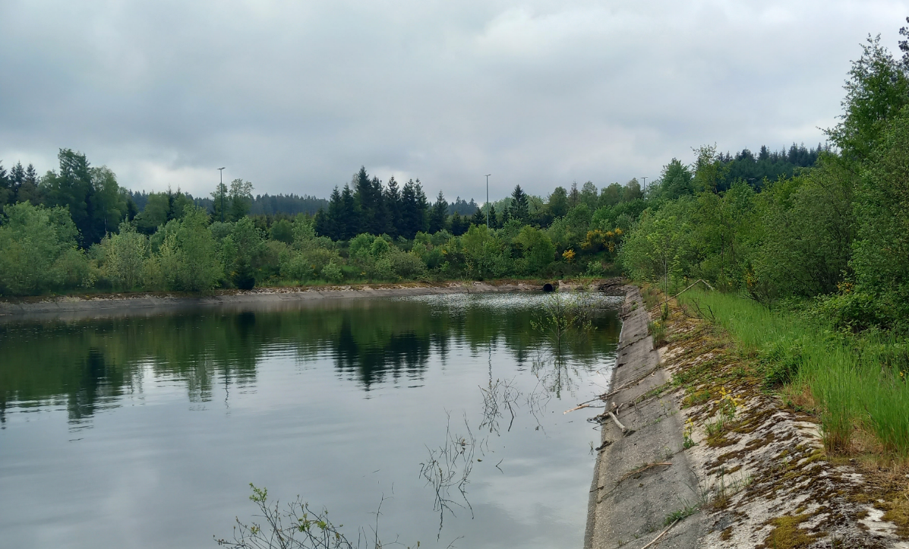
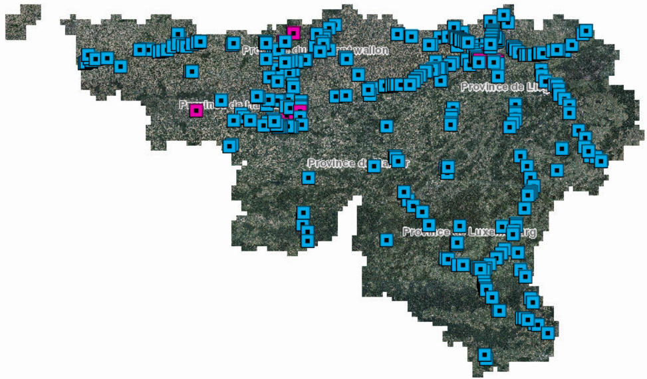
An example of collaborative project
Administration of Roads and Infrastructures SPW-MI
Surveilllance of storm drains for maintenance
Focus on beaver
Need for an expertise in mammals
Administration of Nature and Environment SPW-ARNE
Regional mammal survey
Need for biological data and accessible land

Slide 23
Collaborative agouti project : « storm drains »
Project and sampling design
Cameras in the field
Import into agouti
Annotation
Export
Regional scale +- 300 sites – SPW MI
Protocol for camera installation – SPW ARNE
Camera investment and installation – SPW MI
Uploading SD cards on Agouti – SPW MI
Image annotation – SPW ARNE
Data visualization access – SPW MI
Export, analysis and report – SPW ARNE

Slide 24
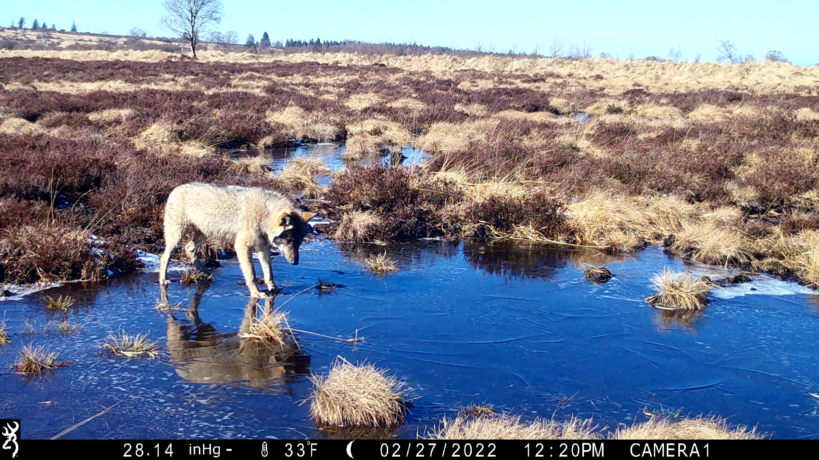



Wolf monitoring in Wallonia (BE)
© Dylan Delvaux
GeCoLAB

Slide 25

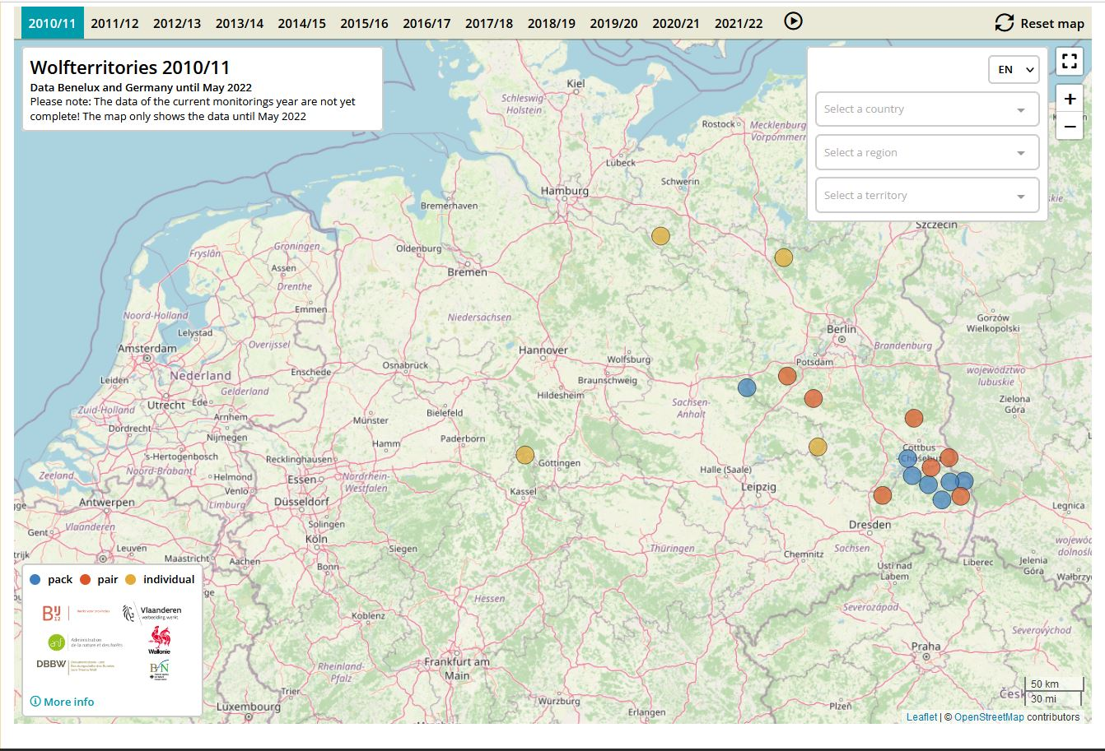

7 packs
7 pairs
6 established individuals
2010-2011

Slide 26
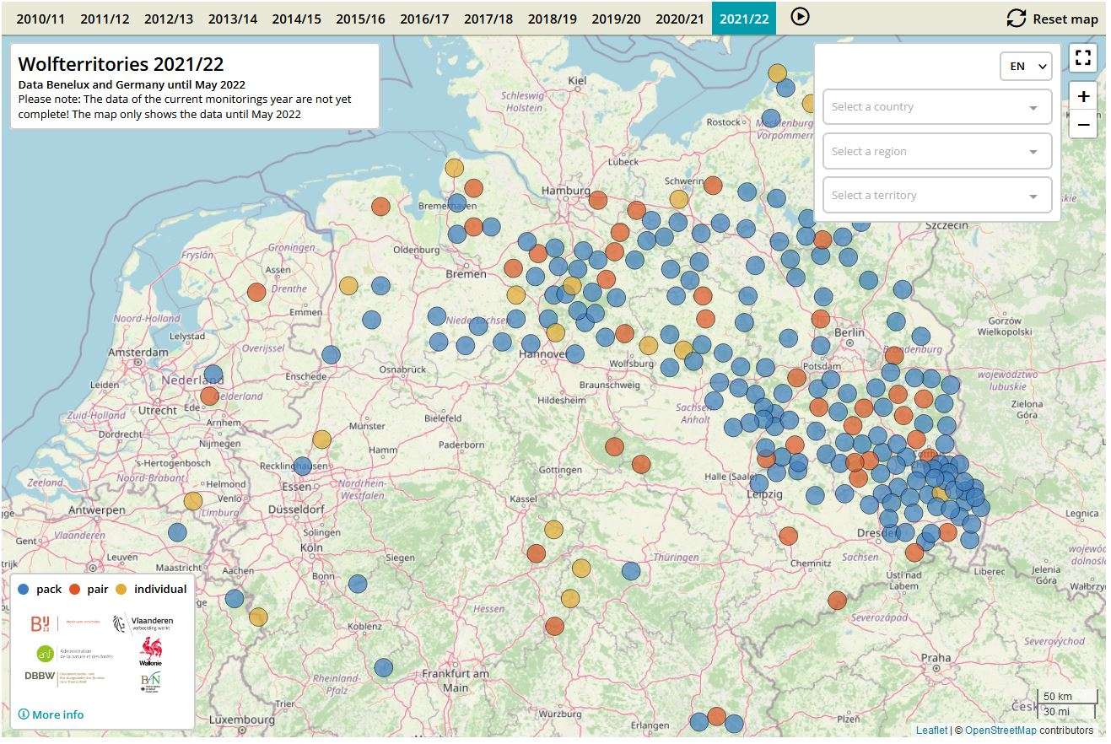
164 packs
45 pairs
23 established individuals
2021-2022

Slide 27
Recent history of wolf management in Wallonia
06.2016 Training in OFB-France
05.2017 Wolf network
11.2017 Adaptation of the legislation
06.2020 Management Plan
06.2020 Natagriwal
2023 Wolf fencing team BE-Wallonia
08.2016 First DNA evidence of wandering wolf
06.2018 First established wolf
05.2021 First pack in the High Fens
05.2022-04.2023 12 wandering wolves
05.2023 Three packs in the High Fens

Slide 28
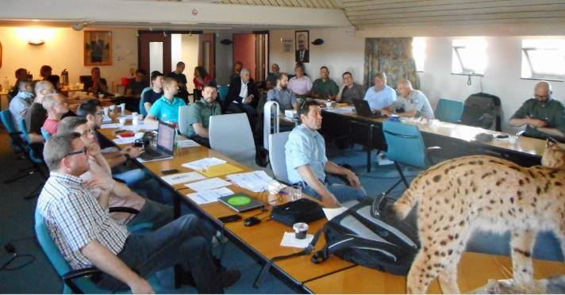
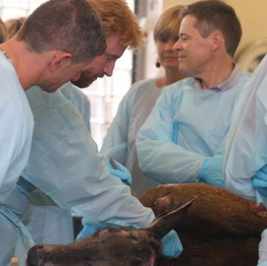
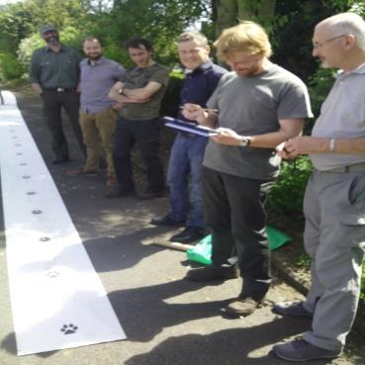
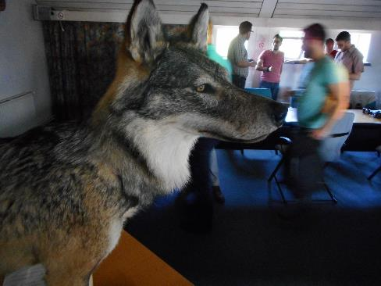
The Wolf Network:
Organization of the collection and validation of data
Hot topic -> Need for scientific information
Need for a transparent and correct dissemination of information (medias,…)
Establishing the Wolf Network (2017)
60 trained people
A single multi-partner platform for data collection, centralization and validation

Slide 29











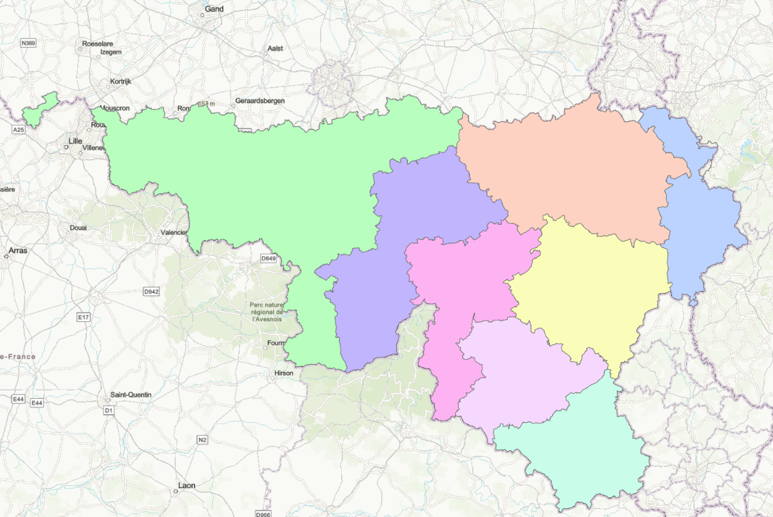




Walloon Wolf Network = multi-partner platform
Forestry Administration

Slide 30
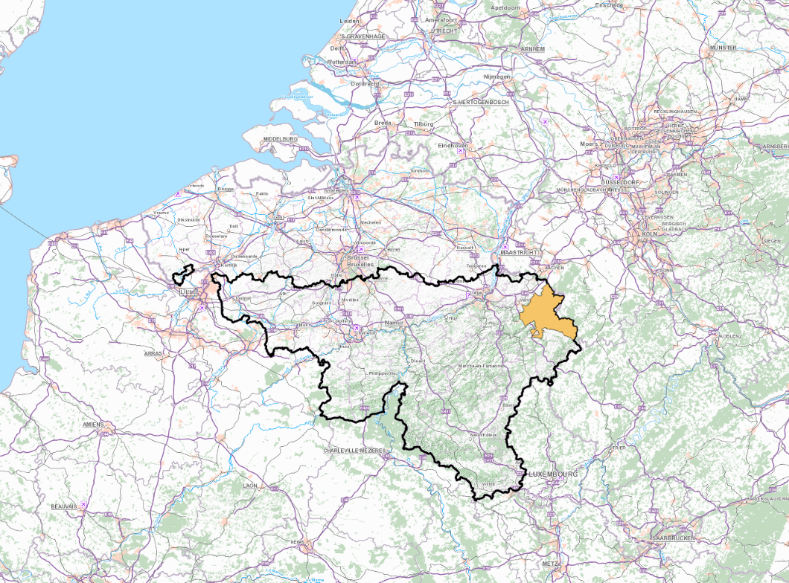
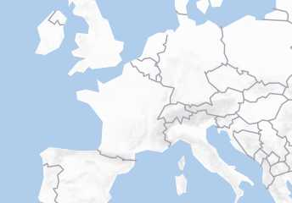
Status of the wolf population 2023
Established wolves
1 Area of permanent wolf presence (2021)
3 territories
3 packs
Wandering wolves
Intensive
monitoring
Opportunistic
monitoring

Slide 31
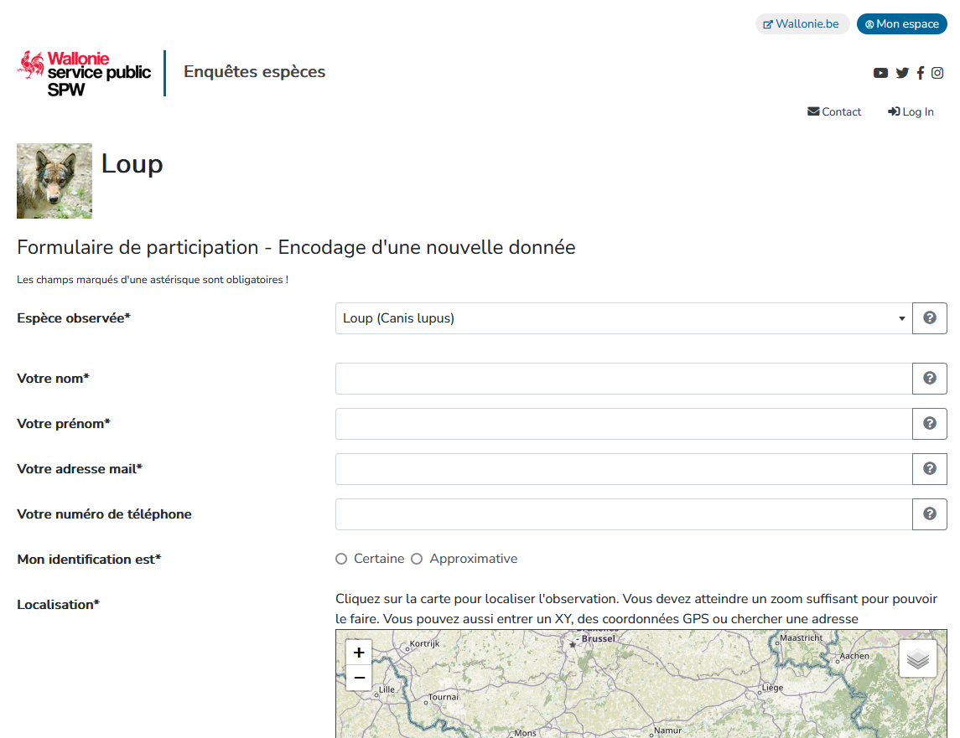
Opportunistic data collection
Wolf Network
Citizen
Phone call (non-stop)
Online form
www.reseauloup.be

Slide 32
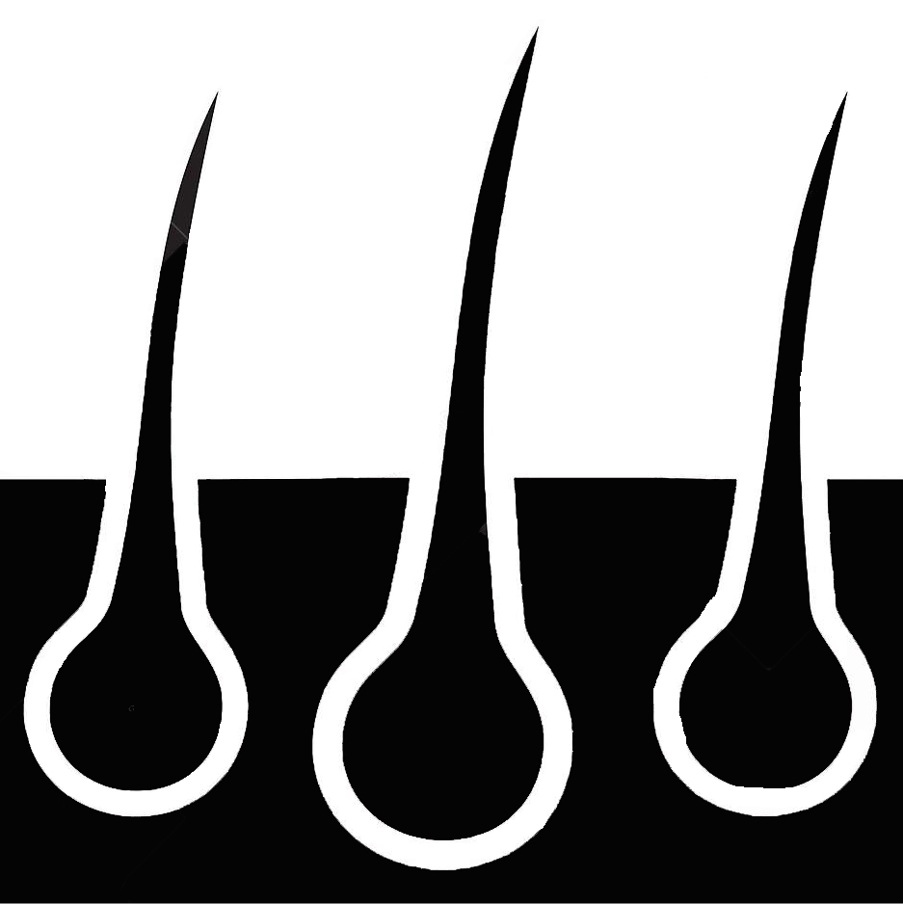

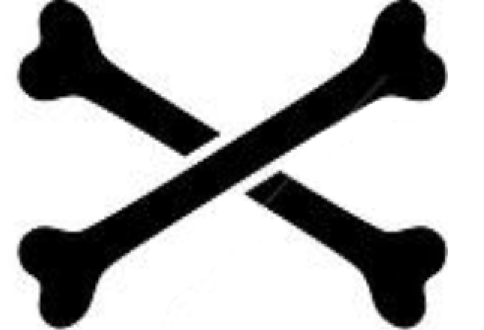




Data collection
Nature of the data
Visual sightings
Observation testimony
Image anaysis
Tracks
Howling
Scats/urine/blood
Hair
Wolf carcass
Prey
Domestic
Wild

Slide 33
Data validation
Nature of the data
Visual sightings
Observation testimony
Image anaysis
Tracks
Howling
Scats/urine/blood
Hair
Wolf carcass
Prey
Domestic
Wild
Use of the standardized method to characterize an observation based on its verifiability (SCALP*)
C1 hard facts
C2 confirmed indications
C3 unconfirmed indications
possible
likely
unlikely, undefined or impossible
F False
*Status and conservation of the alpine lynx population (SCALP) project

Slide 34
Data validation
Nature of the data
Visual sightings
Observation testimony
Image anaysis
Tracks
Howling
Scats/urine/blood
Hair
Wolf carcass
Prey
Domestic
Wild
Collaboration with a Genetics Lab
eDNA
Possible distinction btw wolf and dog (haplotype)
Scalp C1
When PCR negative (e.g. 38% of the saliva samples) then use of the forms for validation

Slide 35
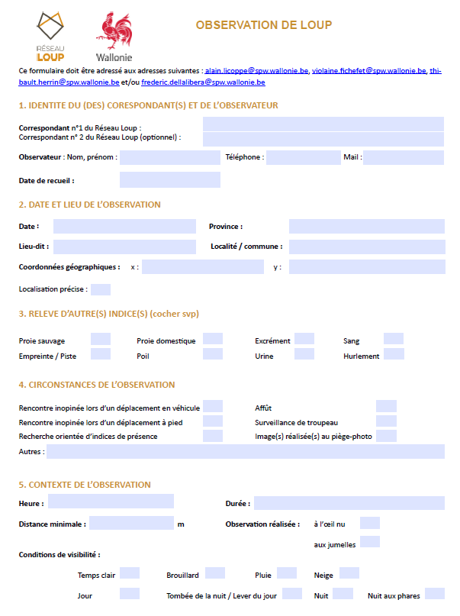
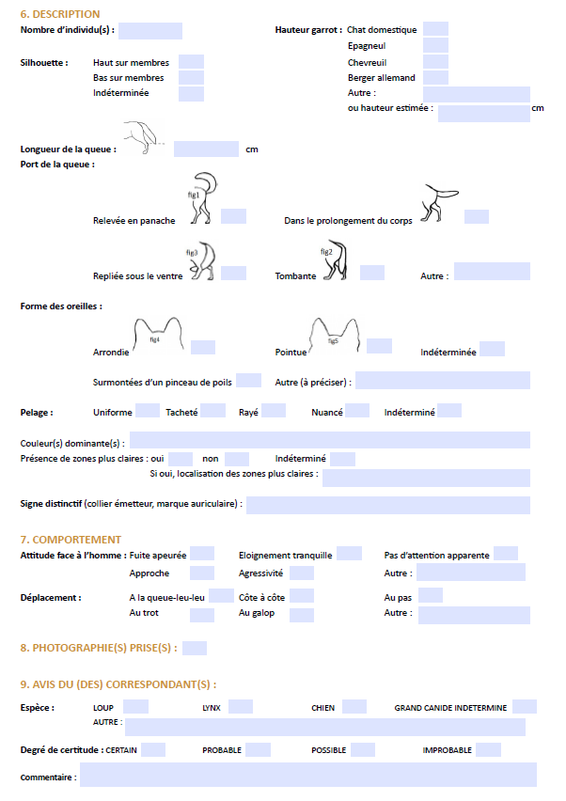
Data validation
Nature of the data
Visual sightings
Observation testimony
Image anaysis
Tracks
Howling
Scats/urine/blood
Hair
Wolf carcass
Prey
Domestic
Wild
One specific form adapted to the data
Ex Visual sighting – relevant criteria to check

Slide 36
Data validation
Nature of the data
Visual sightings
Observation testimony
Image anaysis
Tracks
Howling
Scats/urine/blood
Hair
Wolf carcass
Prey
Domestic
Wild
Expert-based validation
5 experts by simple majority :
C2, C3 possible or likely
Other C3 and F

Slide 37
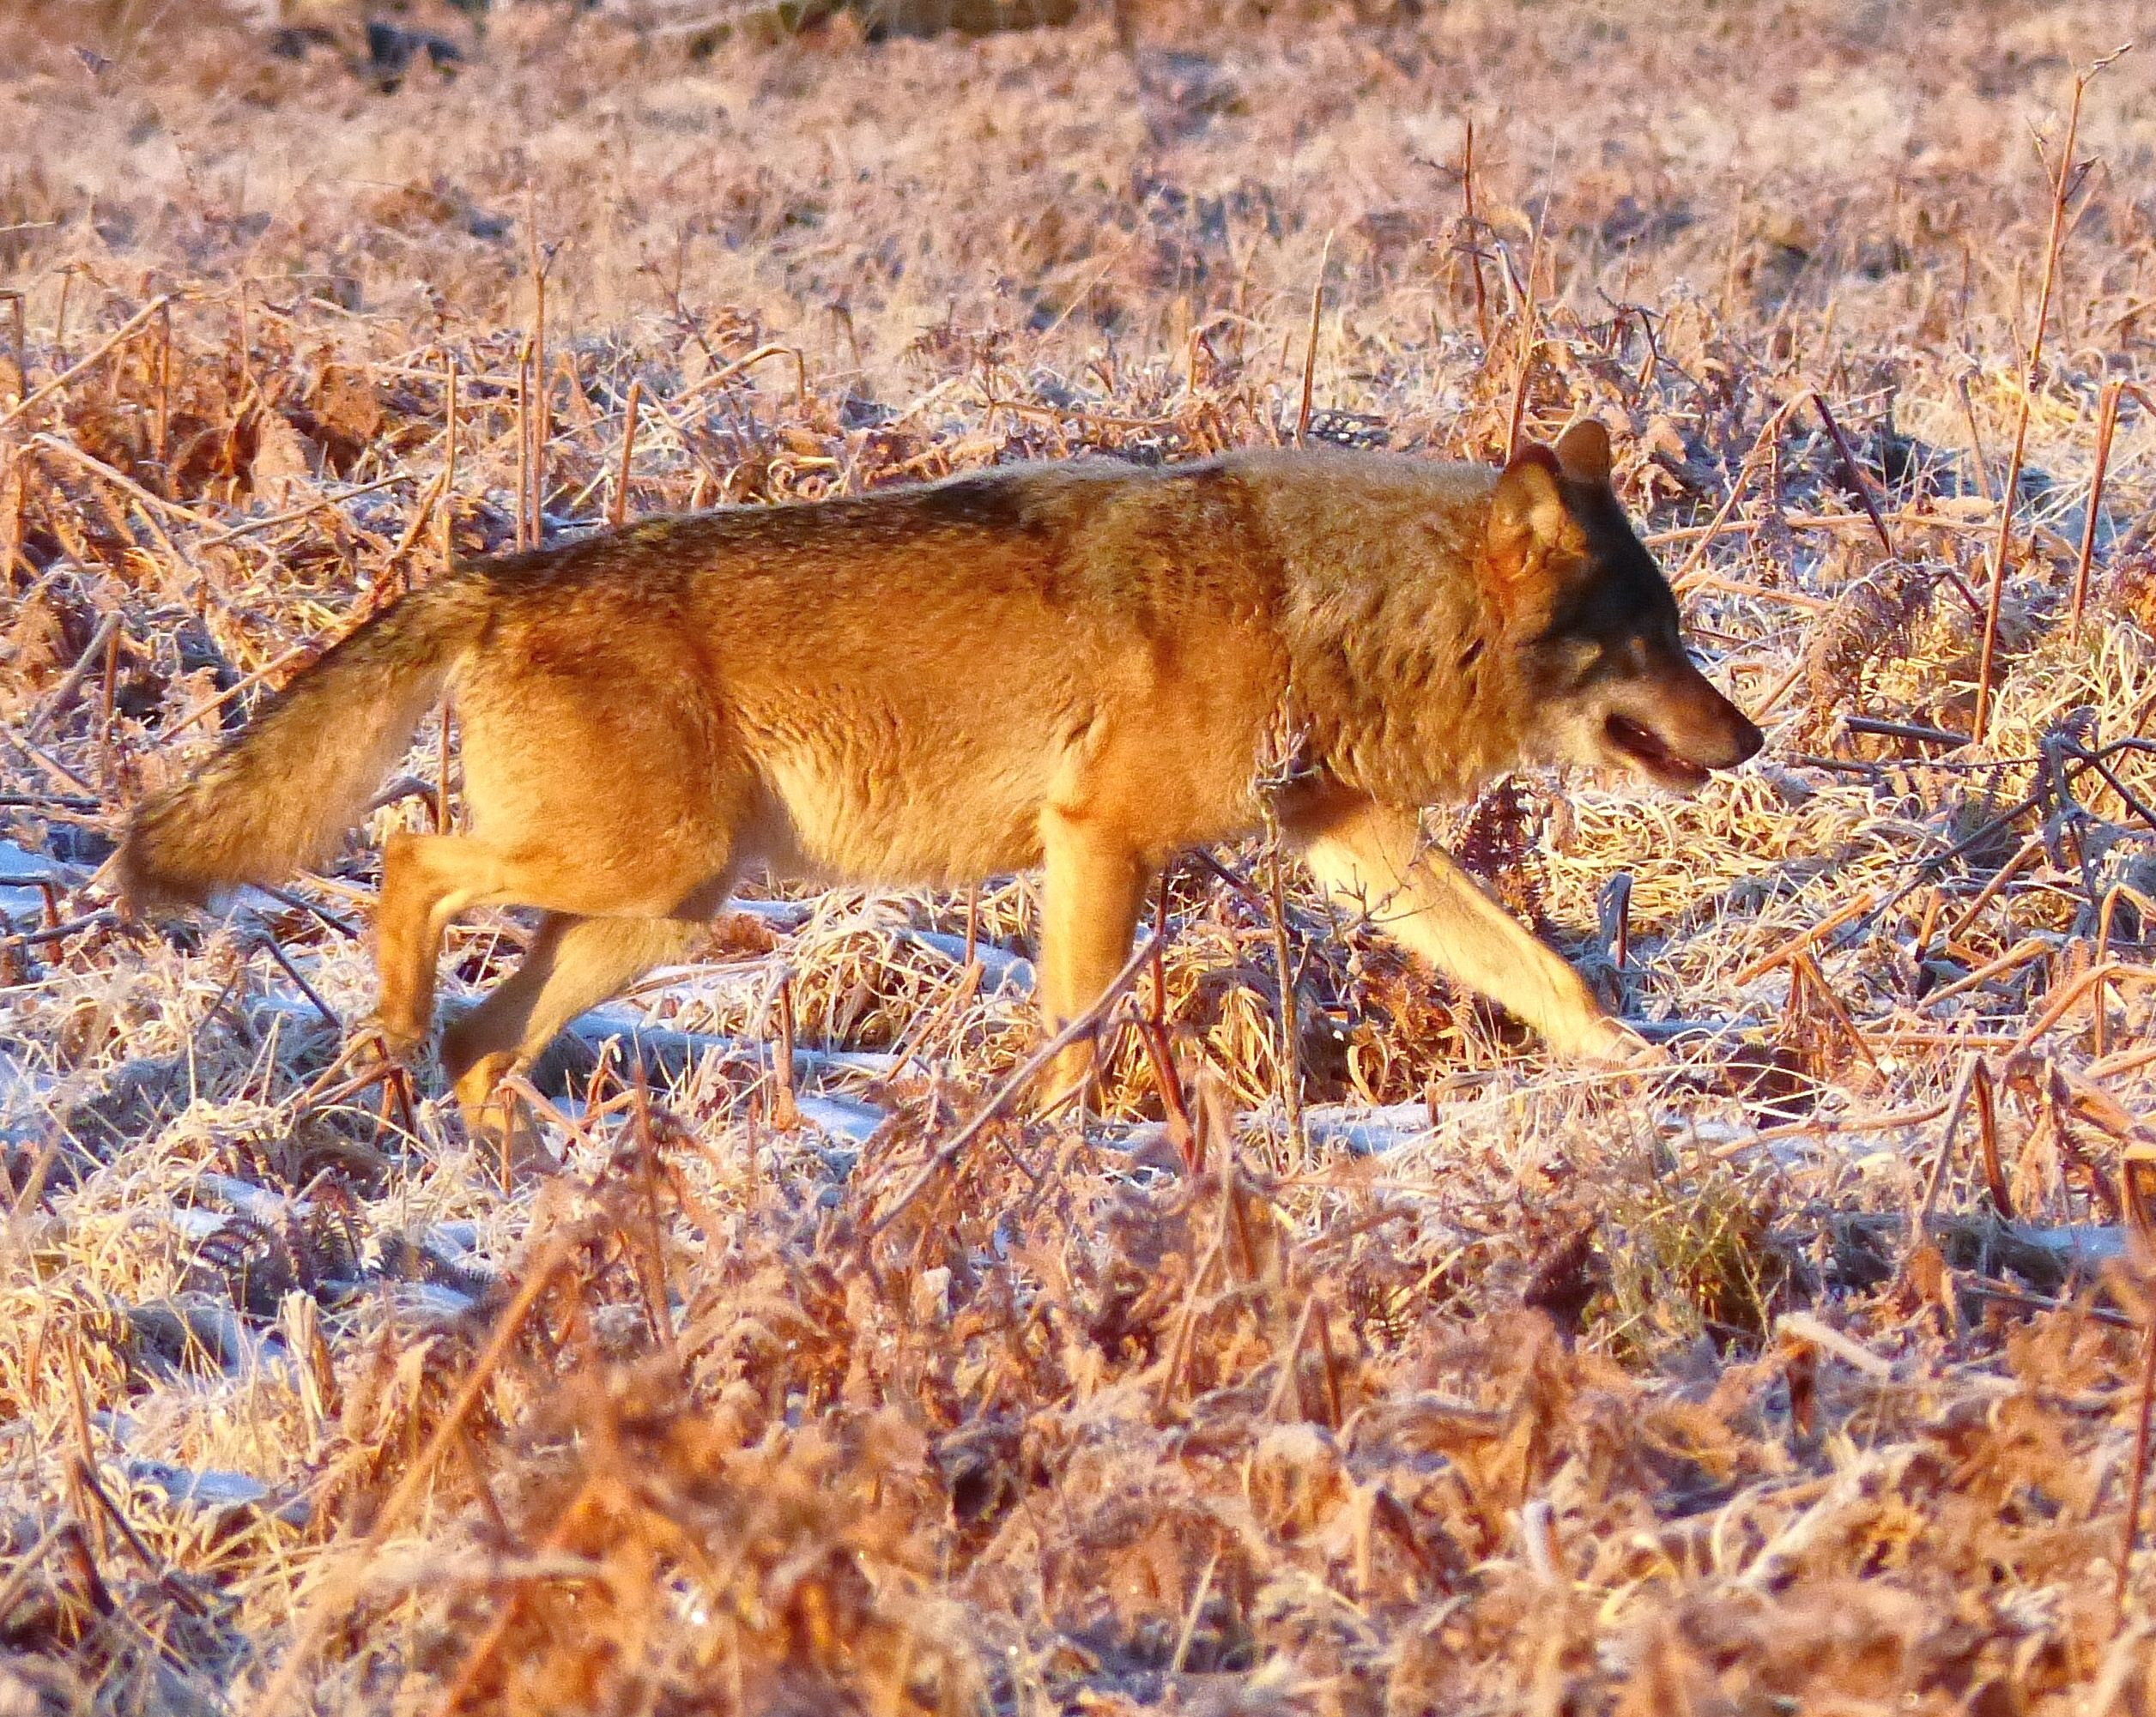
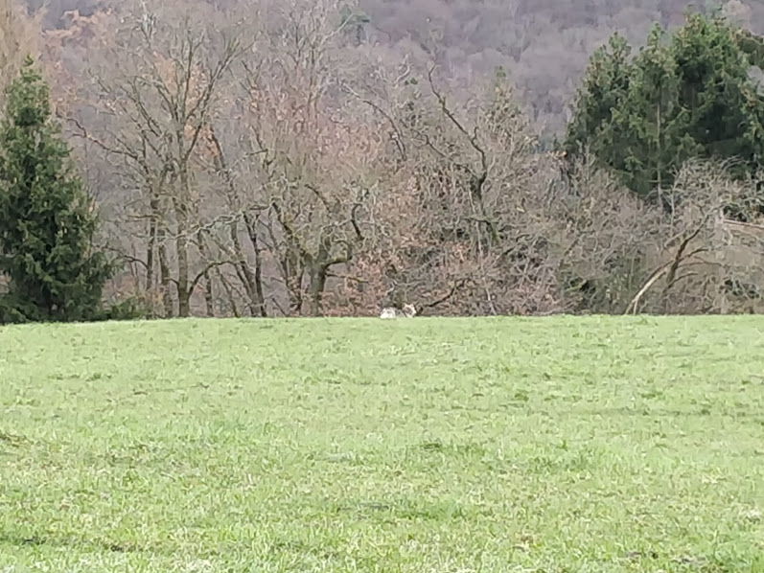
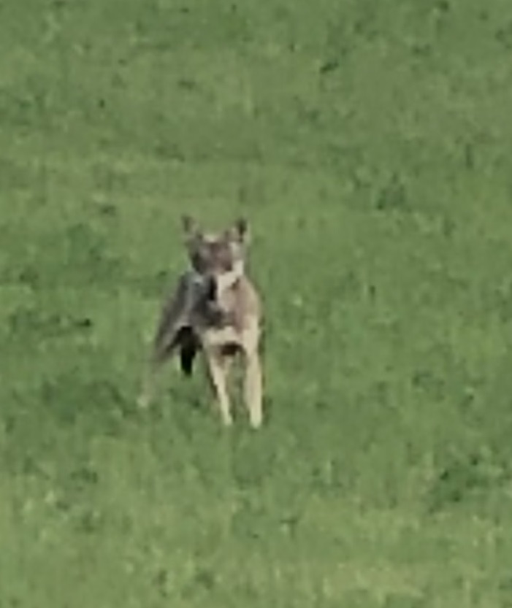
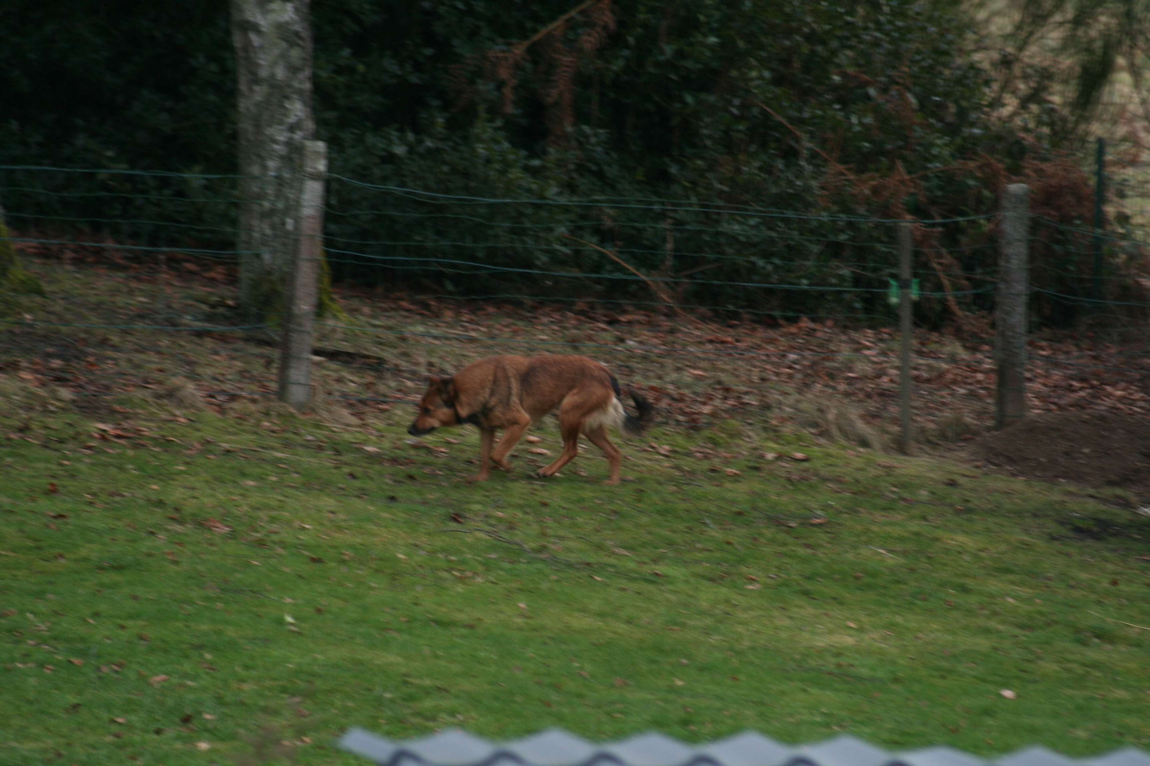
Examples of SCALP for pictures
Running investigation
C3
undefined
C3
possible
C1-C2
F

Slide 38
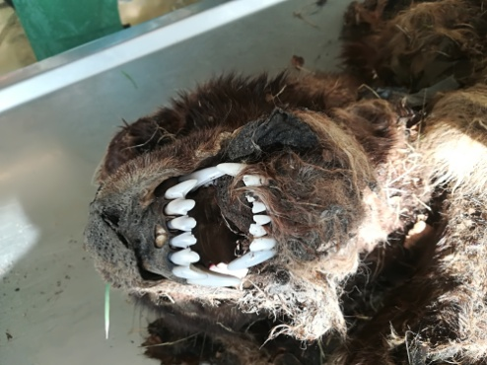



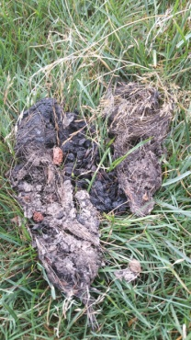
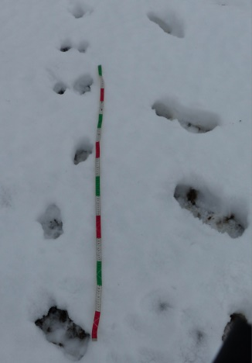
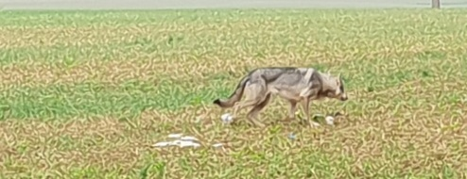
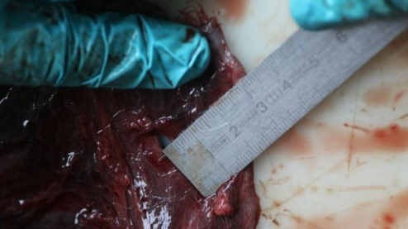
Evolution of the Wolf data

Slide 39
Nature of the wolf data (reseauloup.be)
Permanent Presence Area PPA of Wolf 600 km²
n = 2459
Outside PPA (Wallonia)
16.000 km²
n=878

Slide 40
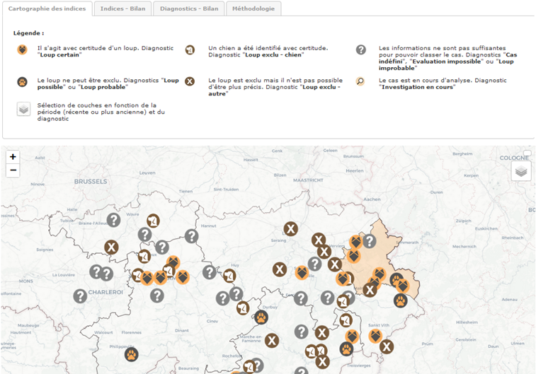
Nature of the wolf data (reseauloup.be)

Slide 41
Conclusions
Cameratrap networks allow to collect a large amount of data
Agouti platform provides validation tool based on
Automatic collection of metadata
AI and Collaborative cross-validation for specied identification
Opportunistic data of rare and elusive species can be validated through
eDNA
trained people with adapted tools (forms)

