Slide 1




Open and FAIR Biodiversity Data in Wallonia : why and how to join global initiatives ?
Atelier Interreg CiBioGo
19th march 2024
Ecolys Suarlée
Maxime Coupremanne
Belgian Biodiversity platform
SPWARNE-DEMNA-DNE

Slide 2

Open and FAIR Biodiversity Data in Wallonia : why and how to join global initiatives ?
Connecting the Walloon Region to a global OPEN and FAIR biodiversity data network
Open/FAIR Data principles
GBIF
Belgian context
SPWARNE-DEMNA
Challenge or opportunity ?
Data sharing missions
Limitations
Opportunities
Use the infrastructure to build collaborative dataflows : TrIAS & RIPARIAS
Take-home message

Slide 3
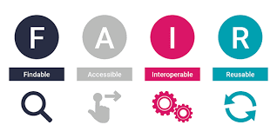
Open Data : ‘Data that can be freely used, re-used and redistributed by anyone’
Open science is a movement that seeks to make scientific research and the data it produces accessible to everyone and at all levels of society.
➔New way of conducting research and disseminating its results, with openness, collaboration, and transparency at its core.
Philosophy – way of working
Not only science but also management & decision making
Continuous concept

Slide 4
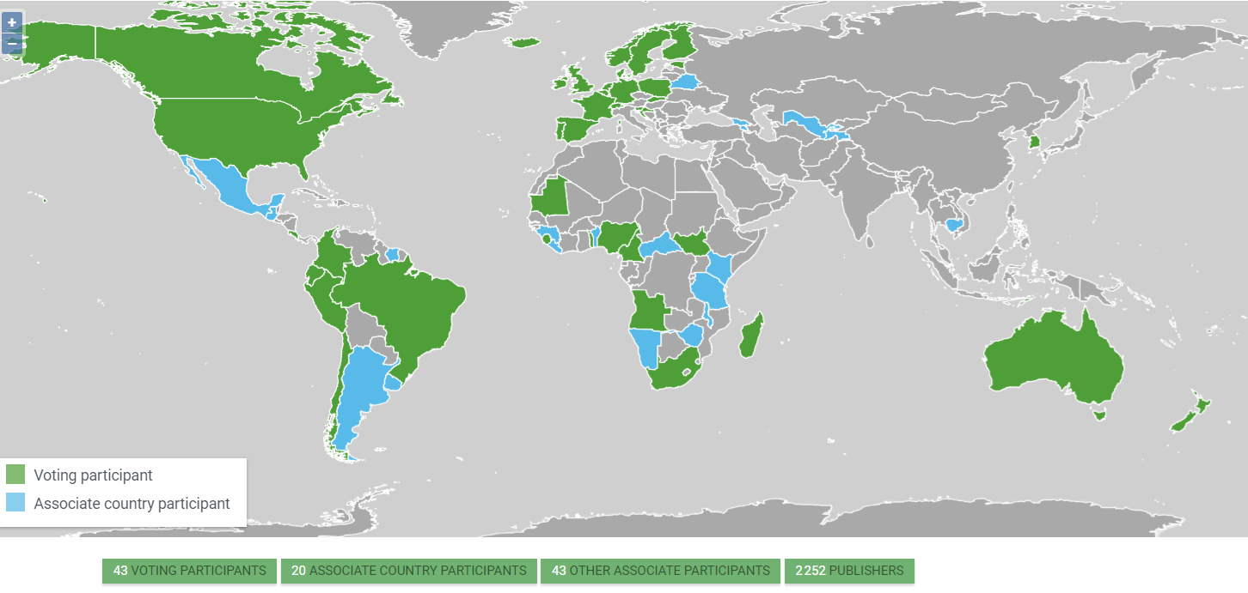
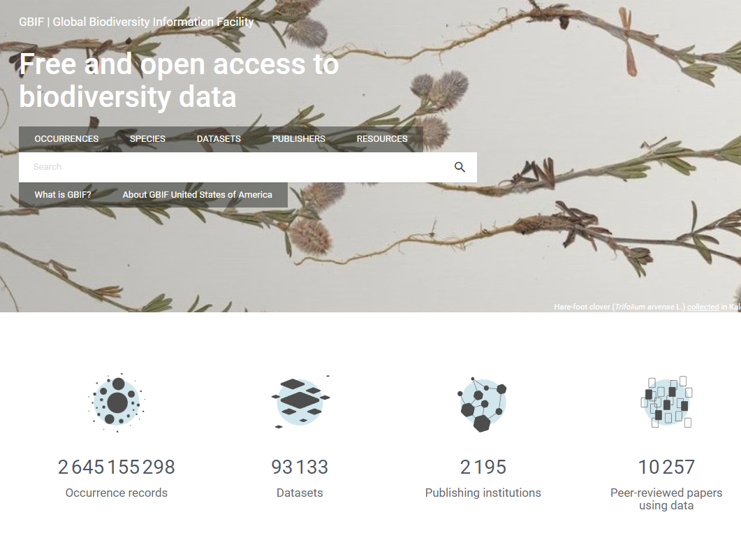



Global Biodiversity Information Facility
Biodiversity data infrastructure
Free and Open acess to biodiversity data for
anyone, anywhere
Network of participating countries &
organisations
Federation of publishers
Primary distribution data (raw)
Data Ownership of publishing institutions
(licences)
NH collections, observations, eDNA derived
occurrences, camera traps…
Implemented in Eu programs, Biodiversa+
GBIF network, 2024. www.gbif.org

Slide 5
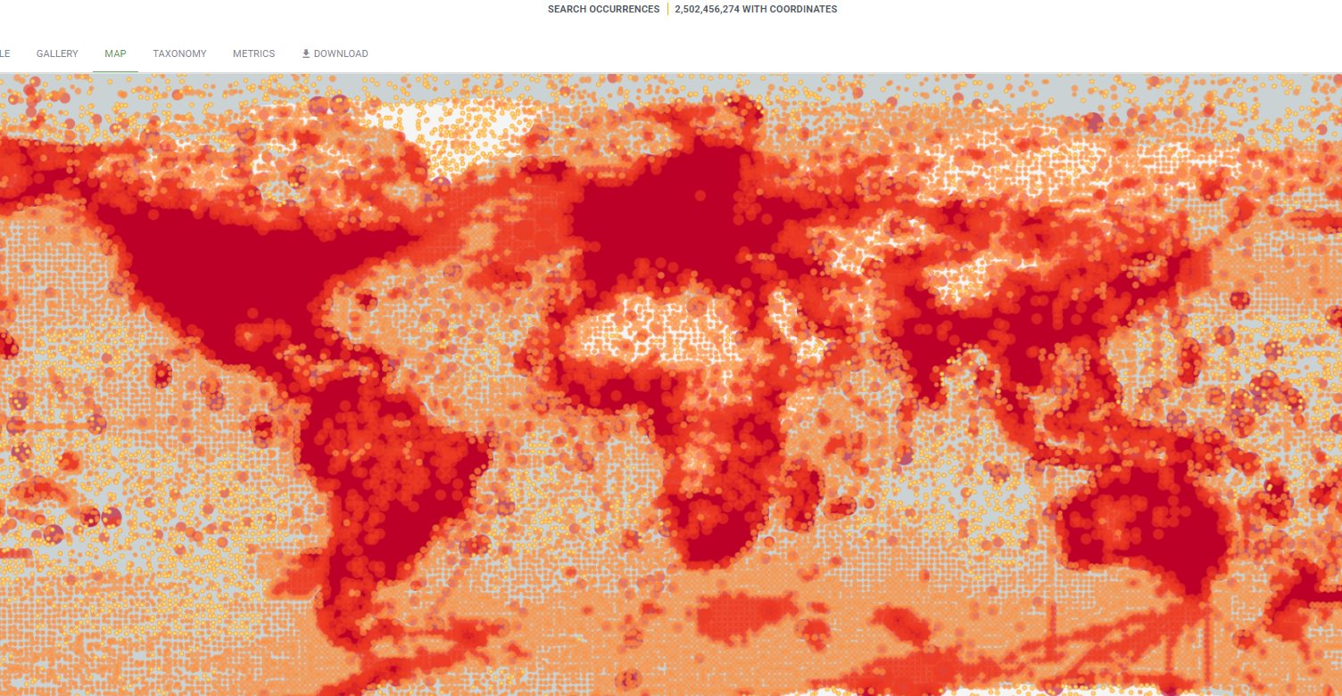

GBIF data access
GBIF Portal
Webservices
R package
Python
Digital Object identifiers
Individual Downloads
Datasets
Use GBIF data and functionnalities in automated processes
(analyses, workflows)
Use The GBIF API to find any common names for Tracheophyta (in your browser) : https://api.gbif.org/v1/species/7707728/vernacularNames

Slide 6
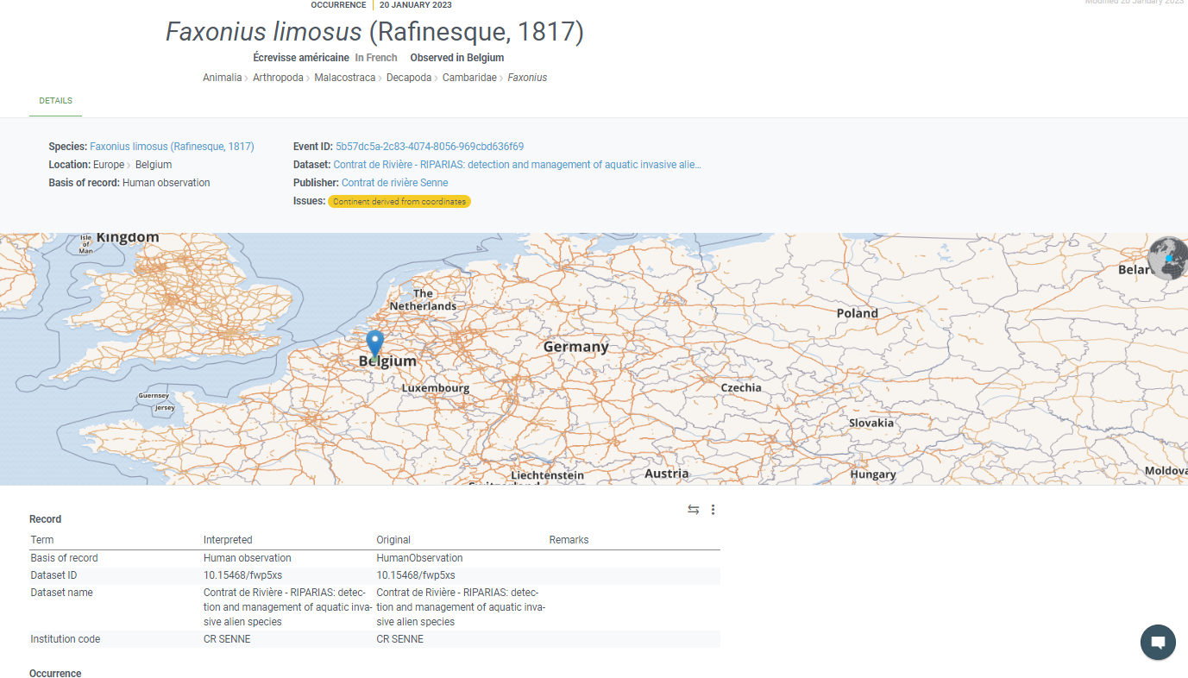

Slide 7
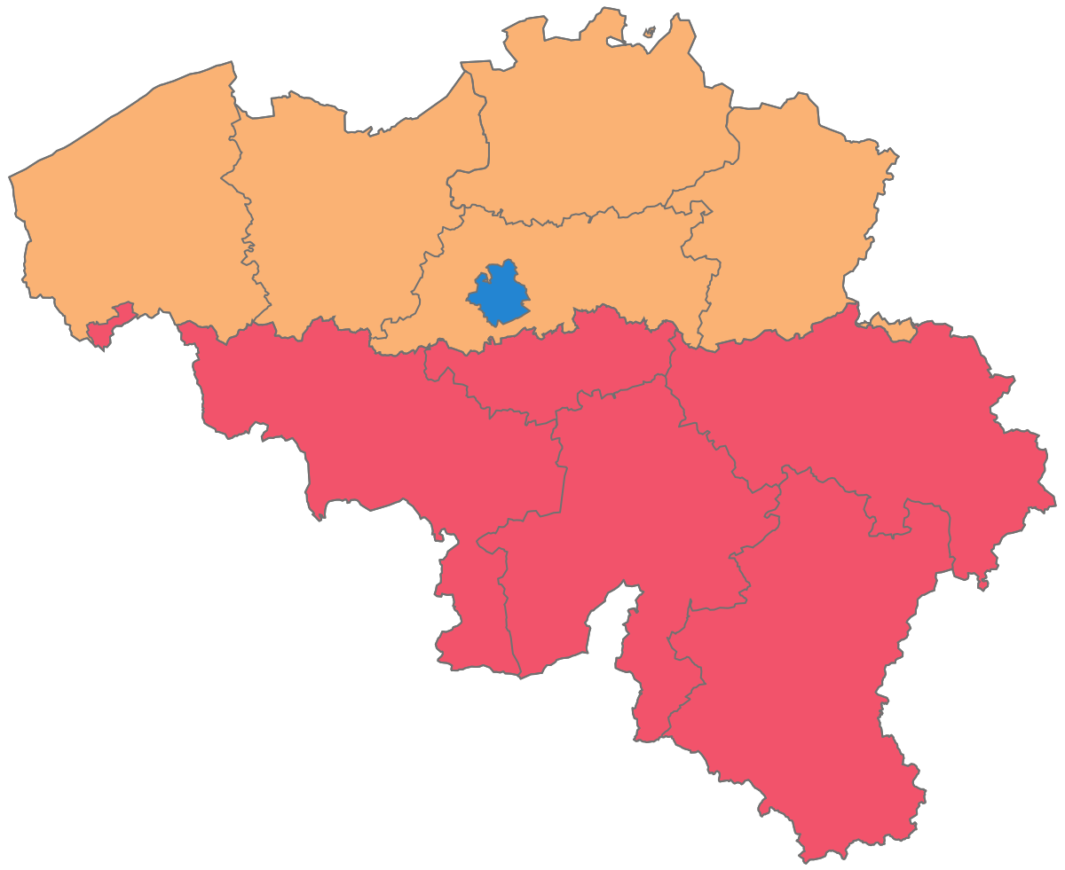



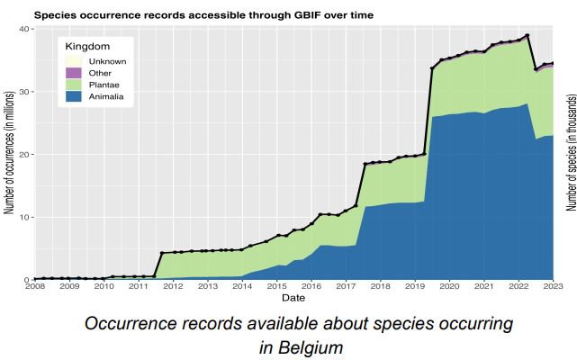

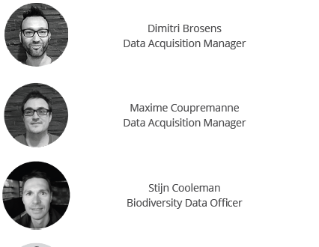
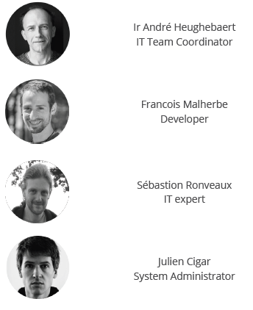
Belgium
GBIF Participant country
2001
Financial contribution, voting right
Endorses a node, national focal point
Divided country
Belgian Biodiversity Platform
Federal Belgian Science Policy Office (BELSPO)
Focal point for biodiversity-oriented international organizations
Distributed team
“Decision making on biodiversity issues is grounded on sound evidence and takes place through collaboration between actors”
GBIF Node :
ITs - Data officers
Federal (RBINS,BELSPO) and Regional institutes (DEMNA,INBO)
Participate to the global network
Promote use of GBIF & other Open Data services
Support Community

Slide 8



SPWARNE-DEMNA
Regional Institute for Study of Nature and Agriculture
Acquisition, validation, enhancement and dissemination of socio-economic and environmental data
Species, Habitats, Sites of biological interest
European obligations
Scientific Expertise
© SPW/DEMNA
Already acting as a regional biodiversity data center !
➔ Encoding systems
➔ Coordinating observer networks
➔ Data aggregation and exchange routines with partners
➔ Data collection
➔ Data & information dissemination
➔ Use of the data for science & decision making

Slide 9
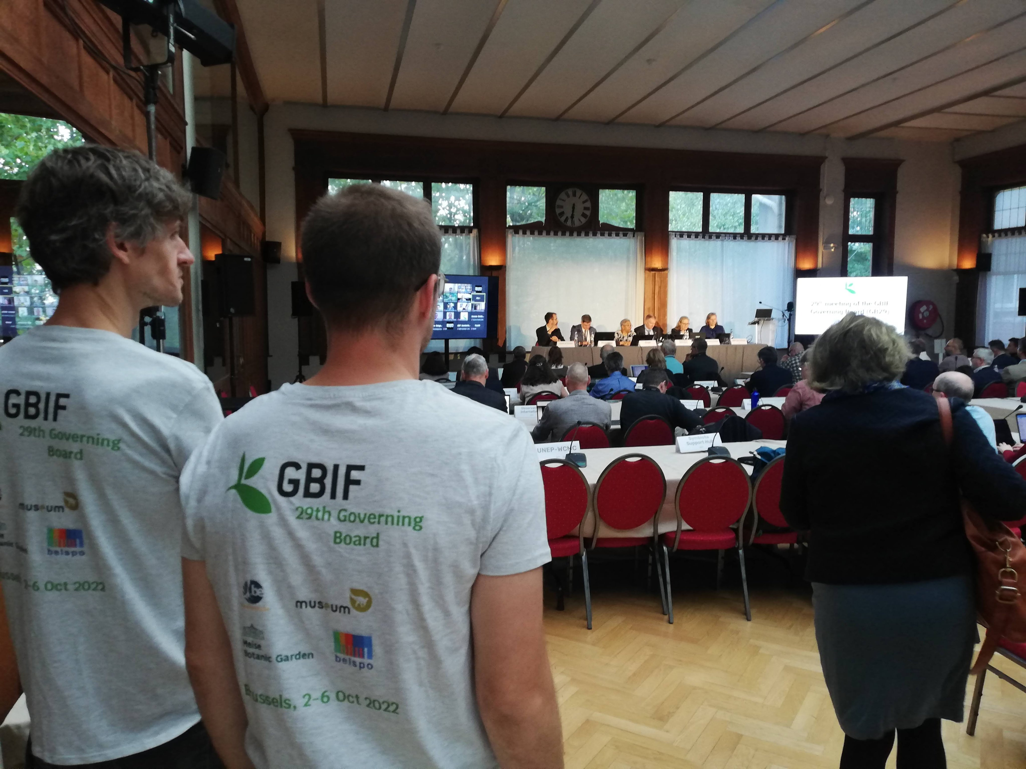


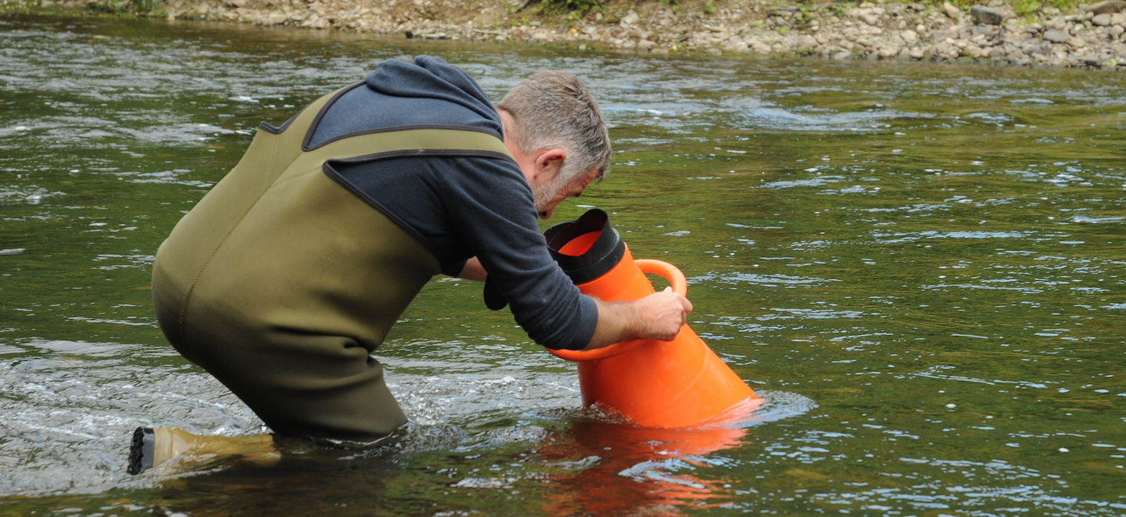
Linking Open data principles to our reality...
Global network
Strategies -priorities- principles
Top-down request
Already working communication channels to duplicate
Extra work
Lose of ownership
Limited resources
Not independant internet network, protective
Ongoing digitization of administration
Deep review of many processes and tools
Obligations, administrative context
Challenge or Opportunity from our perspective?
Regional administration
Reality - implementation
© SPW/DEMNA

Slide 10


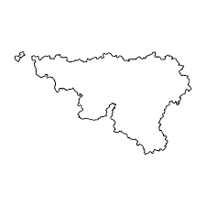






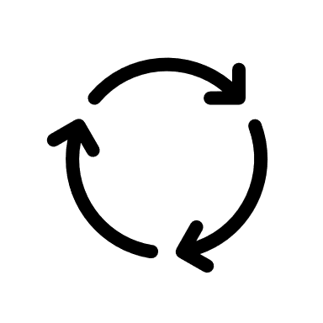








Information sharing
Biodiversity data life cycle (simplified)
Citizen
Decision makers
Stakeholders
Core missions
Spread data generators
Cleaning-formatting-validation
Data analysis & use
Data sharing (raw)
Various formats and sharing conventions
Gathering
Divided biodiversity data generators network
Different formats, standards, sharing conventions
Data cleaning, formatting and validation
Gathering
Raw data != information
Distinct targeted canals : Geoportal, biodiversite.wallonie, requests
Heavy work and tools developments for years, working well
Scientists
Students
Engineering office
Stakeholders
Reporting

Slide 11
Information sharing
How GBIF can support us in our missions?
Citizen
Decision makers
Stakeholders
Core missions
Spread data generators
Cleaning-formatting-validation
Data analysis & use
Data sharing (raw)
Various formats and sharing conventions
Gathering
(young)Scientists
Engineering offices
Stakeholders
Reporting
Citizen scientists
Data centralisation
Data dissemination

Slide 12
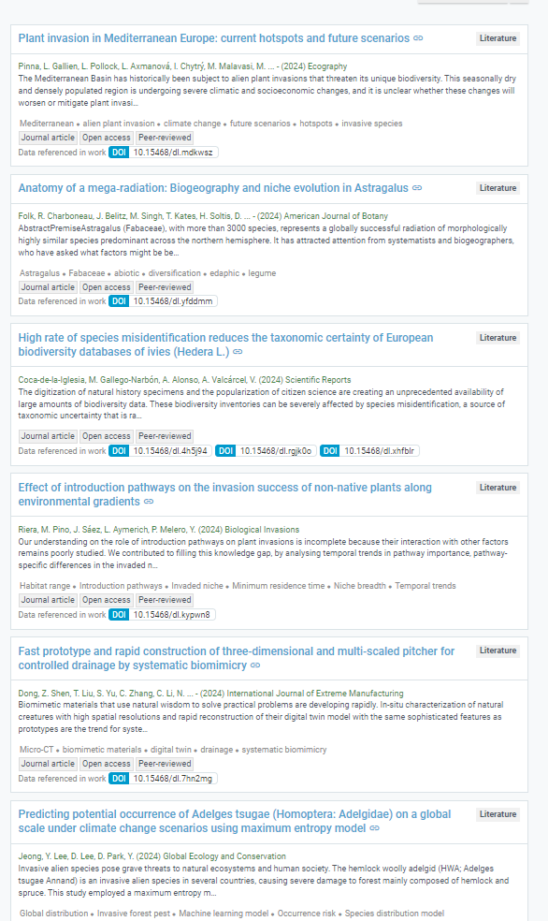
Opportunities
Lower the charge of data dissemination procedures
Free service vs on request
Well described metadata reducing communication needs
Reach other communities at broader scales
Reusability
Possible to set up real-time data upload
Prepare and export data a single time

Slide 13
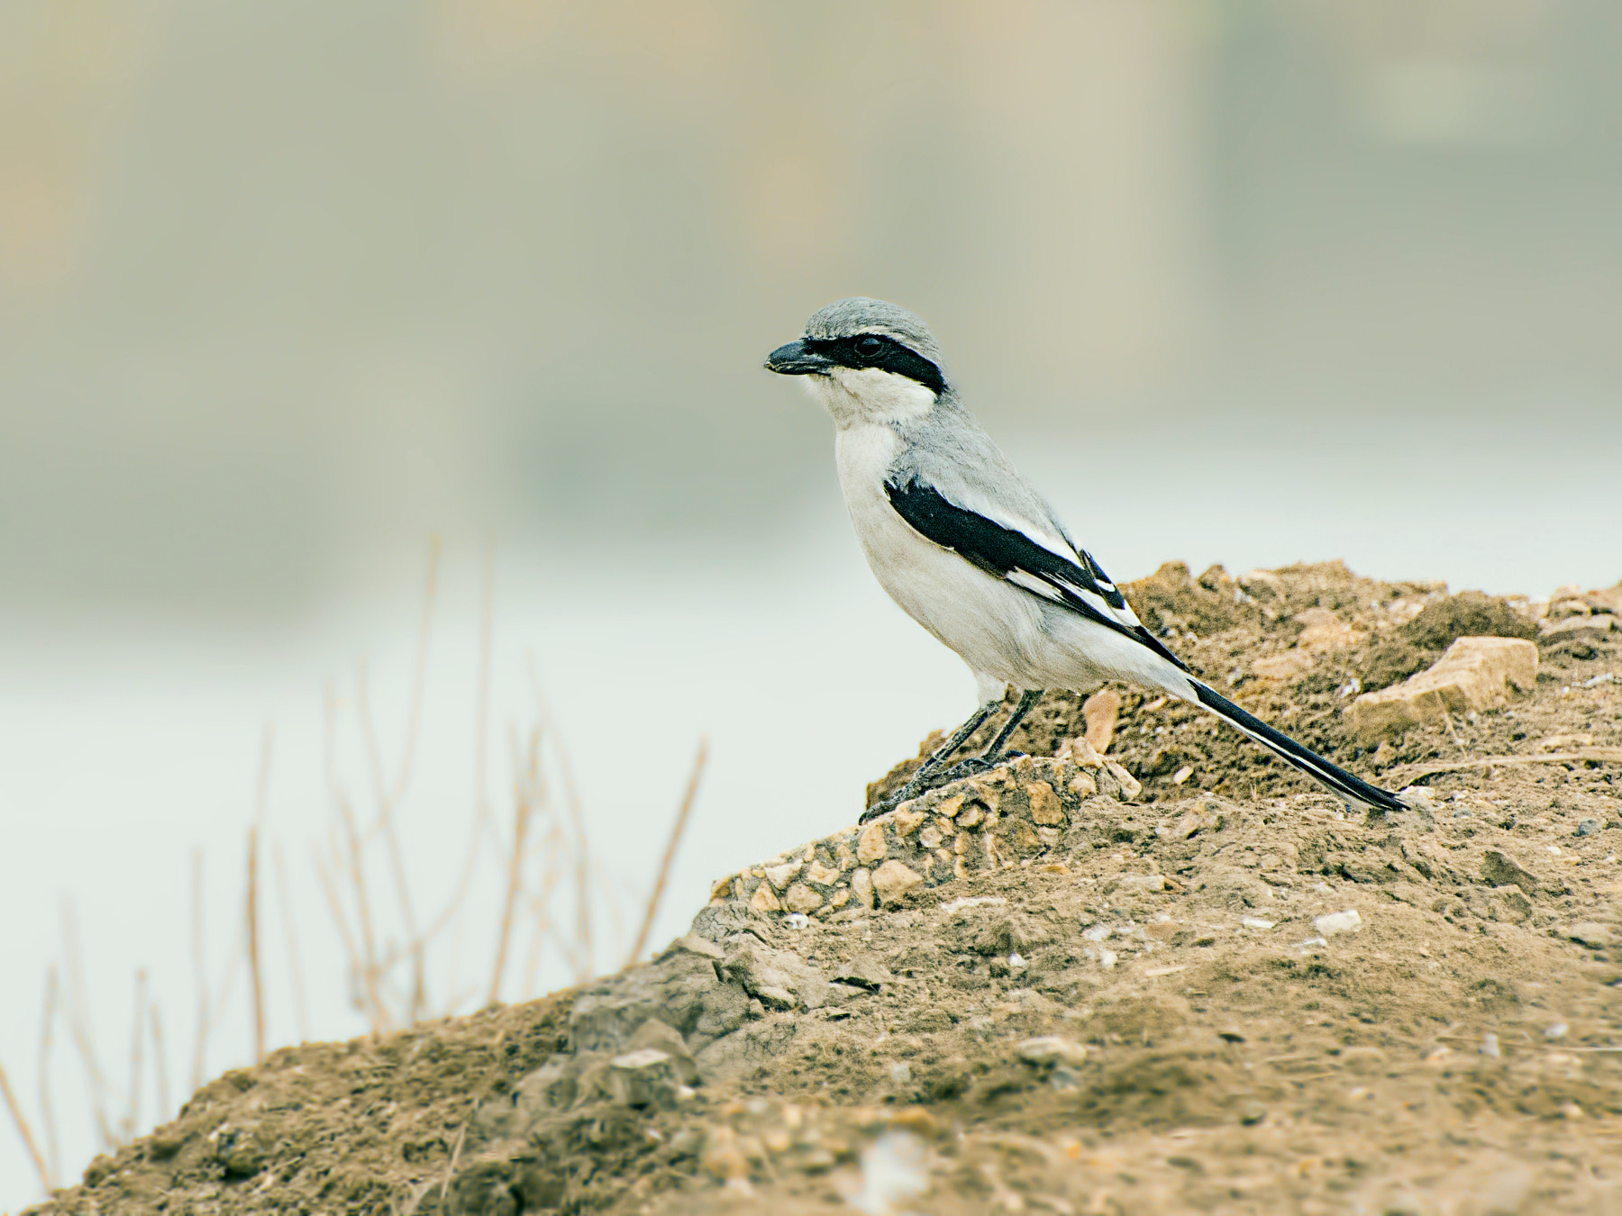
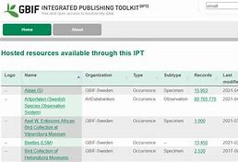
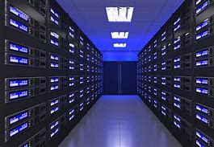
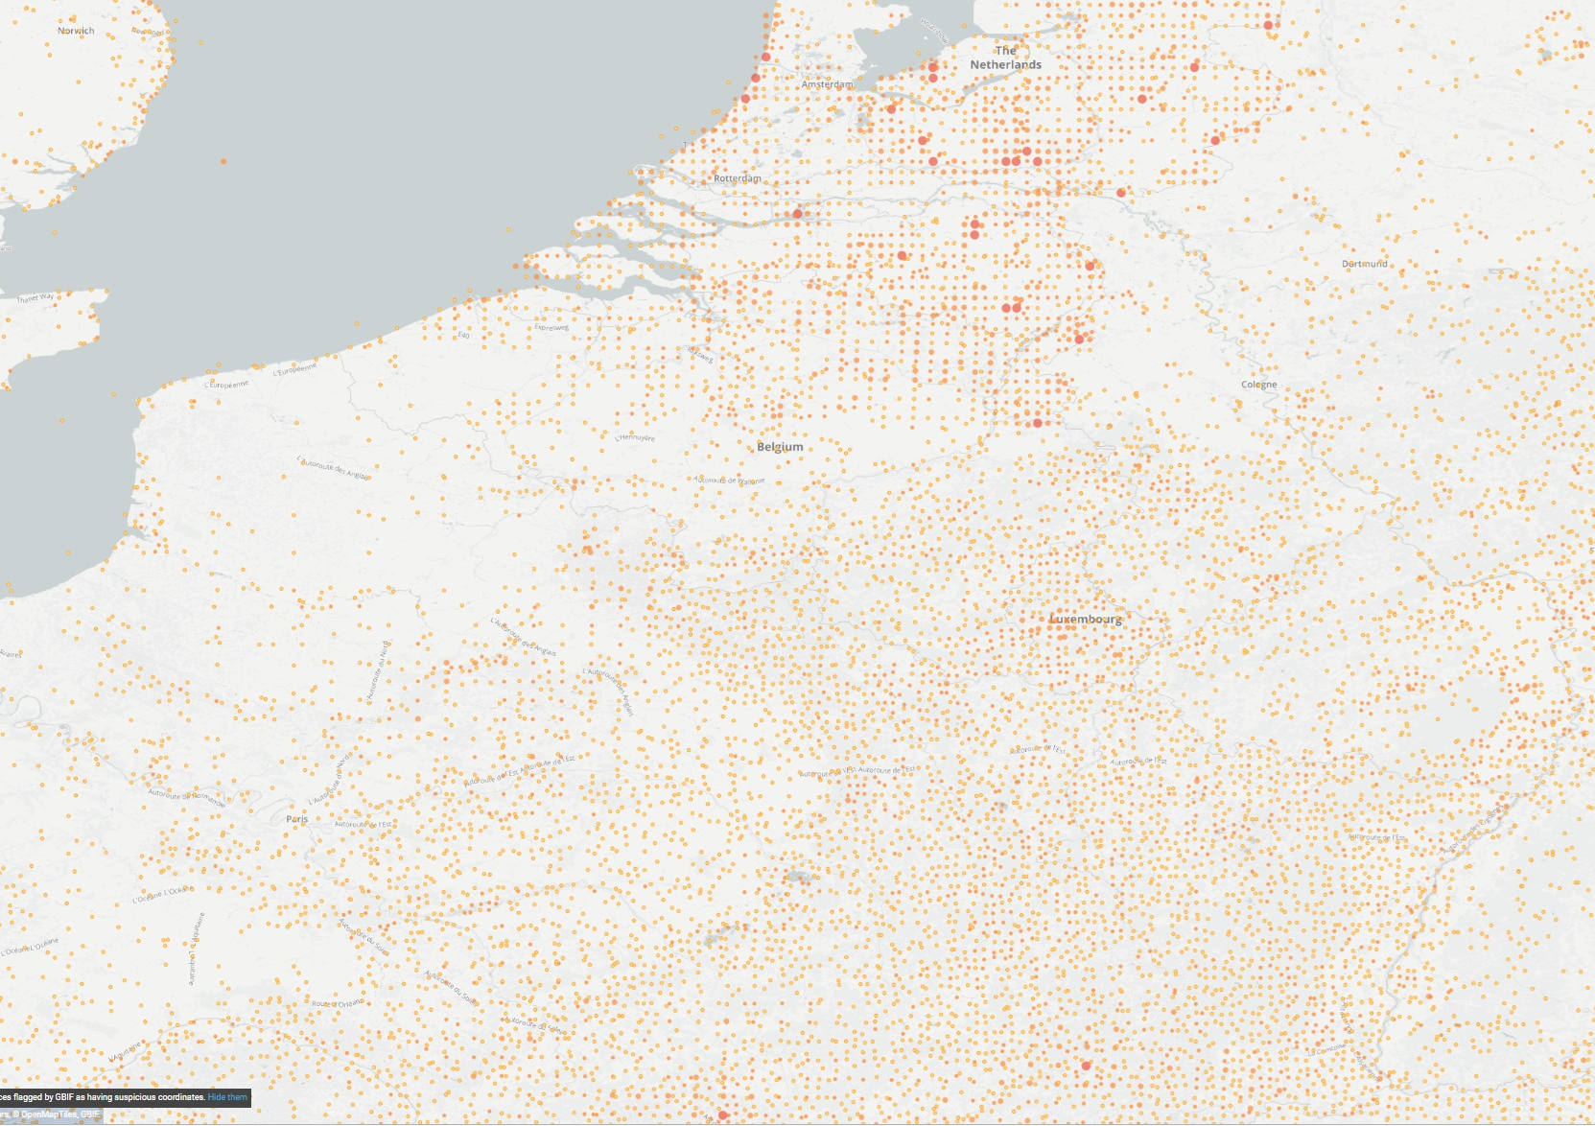
Limitations
Extra data canals to set up
Informatic skills & materials investment
Standards to learn
Legal obligations, limitations, sensible species or personal content, RGPD
Data quality (geography – taxonomy – uncertainty)
Transversal change for well established pipelines
Data generators & users network must be included in the switch
Encoding, consultation facilities as the data are part of our identity !
lanius excubitor © Wikipedia Commons
GBIF available records for lanius excubitor

Slide 14
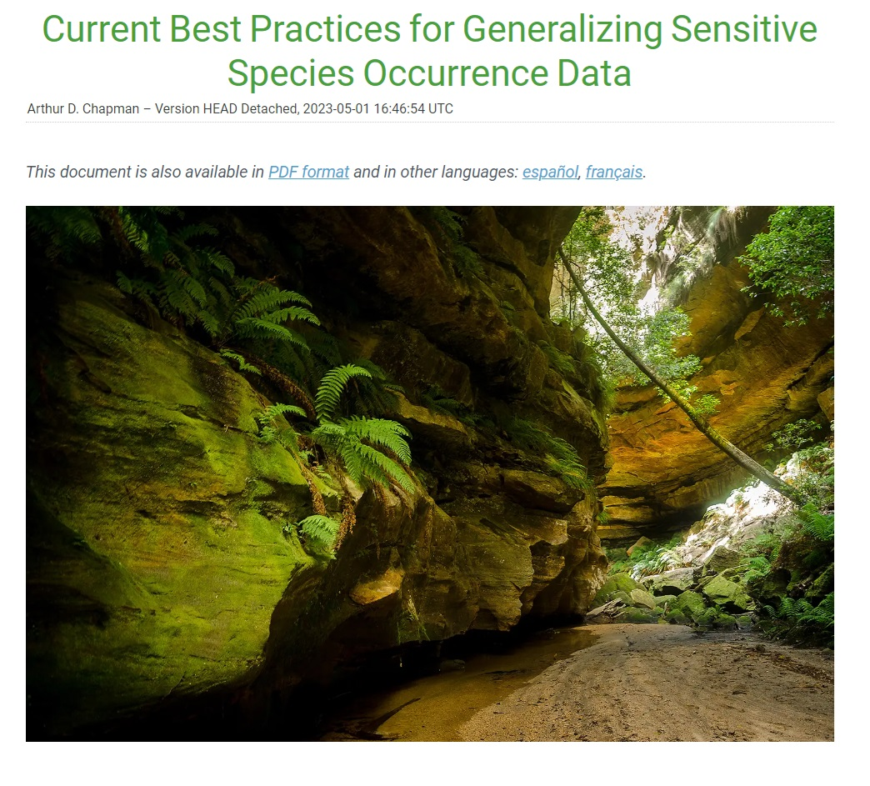
Do the best you can
Investment in data infrastructure, skills within the entire network
Can not replace all established canals
Can significantly lower workload of existing data exchange procedures
As open as possible, as closed as needed (metadata only, resumed information)
Resumed information is not a lack of transparency
Clear institutional data policy (juridical)
Community and hierarchy support
Accept the switch will be progressive
‘What should I do to comply ’ ‘how can I exploit tools and resources’
Focus on easy to share relevant data first (e.g : non-native species)

Slide 15
Information sharing
How GBIF can support us in our missions?
Citizen
Decision makers
Stakeholders
Core missions
Spread data generators
Cleaning-formatting-validation
Data analysis & use
Data sharing (raw)
Various formats and sharing conventions
Gathering
?
Use the tool to enable collaborative and repeatable workflows
Tracking Invasive Alien Species
RIPARIAS
Scientists
Students
Engineering office
Stakeholders
Reporting

Slide 16
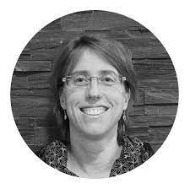
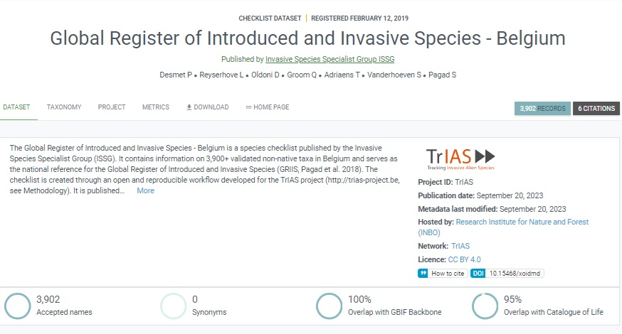
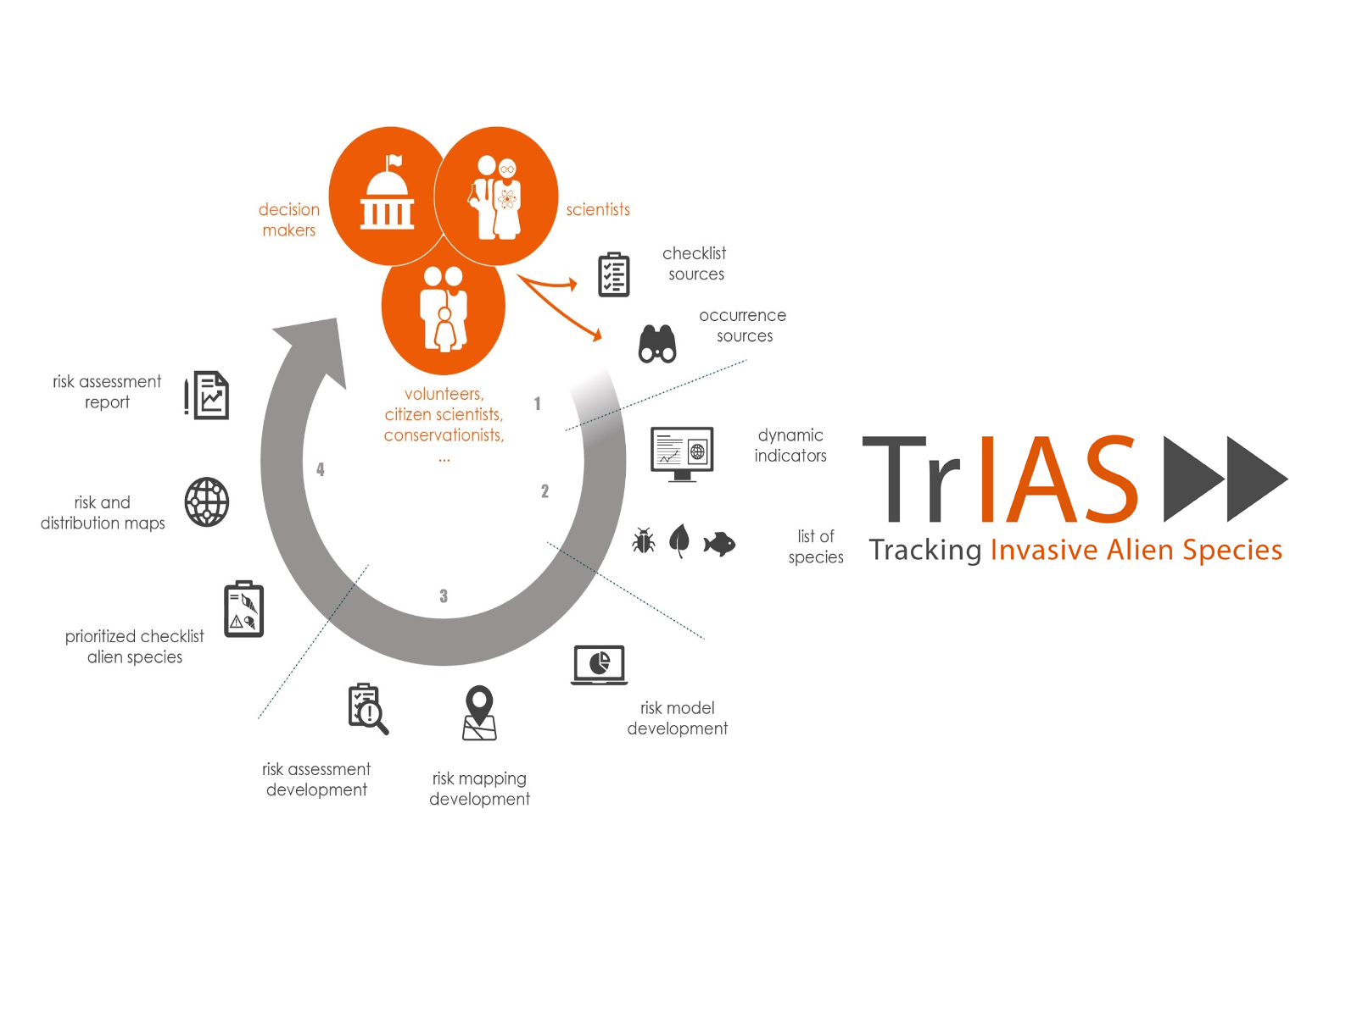
Enable collaborative & repeatable workflows
Trackig Invasive Alien Species (TrIAS)
GBIF as a data mediator
Mobilized network of experts and data collectors
Gather Taxonomic data
Gather occurrences data
Create dedicated pipelines for data anylysis (R)
Automated analytical workflow
Species modelling
Risk mapping
Emerging species
From the record to the decision making
Mobilization efforts !

Slide 17

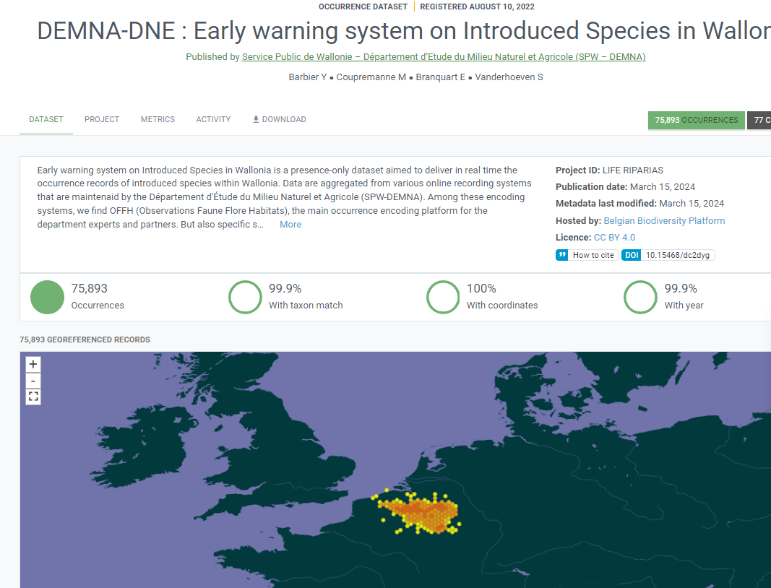
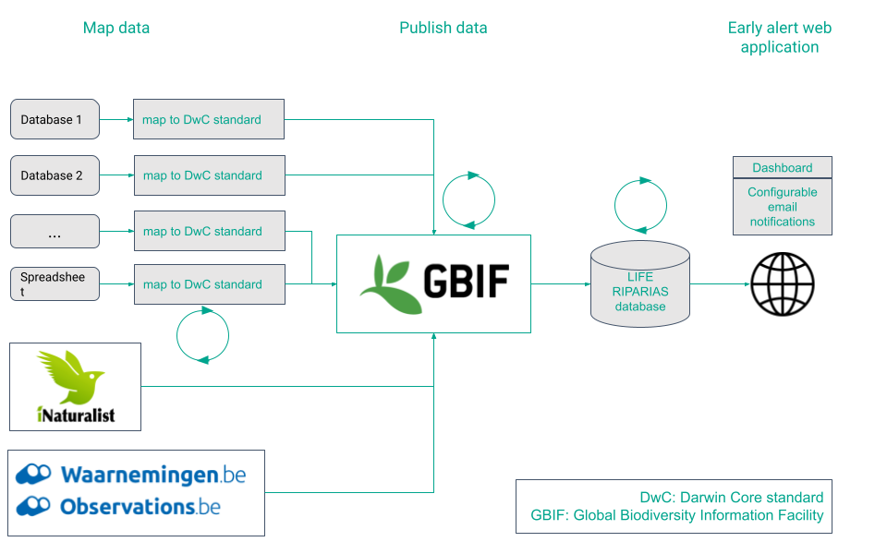

Enable collaborative & repeatable workflows
Life Riparias
GBIF as a data mediator
Early Alert system
Riparian ecosystems
Stakeholders' involvement
High rate of republication (routines, webservices)
Open Source and transposable to other regions/groups
Notifications

Slide 18
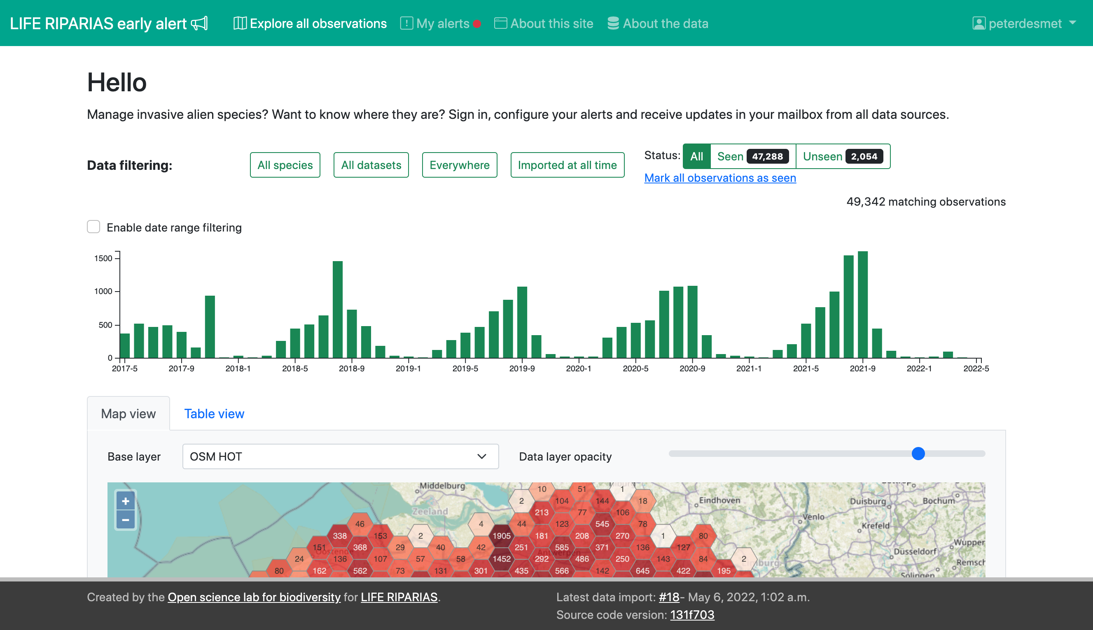
Enable collaborative & repeatable workflows
Life Riparias

Slide 19

Take Home Message
Open Data is both a tool and a mission at the same time !
Requires investment but is a rentable exercise on long term !
The GBIF community component is has much important as data infrastructure, use it !
Do it for yourself, with help !
You’ll need support, advocate !
Collaborative approaches for nature understanding & governance are more accessible than it seems !

Slide 20

THANK YOU

