Slide 1

Sociological and methodological perspectives on citizen participation initiatives
François Mélard (CRIS – ULiège)
Cibiogo – 1st Peer review visit, Namur – Belgium – 19 march 2024.

Slide 2
My argument
Citizen participation can play a decisive role in the governance of biodiversity...
…it's a question of defining the problems
…in a given situation.
Notes:
My argument in this presentation is as follows: citizen participation can only be an ally in the preservation or conservation of biodiversity if it can play a decisive role in its governance.
This "decisive" role depends on the way in which the problem is posed in each situation.
The problem is rarely general; it is often associated with complementary or contradictory uses of the land.
Note: even the problem of producing, interpreting and ... data that is as 'harmless' as it is objective can be at the centre of competing interpretations of its usefulness or relevance.
From this point of view, there is a whole body of scientific literature on the subject, and in particular on the approach known as 'community-based monitoring' (Conrad and Hilchey 2011).
What is central, and everything stems from this, are the different and potentially conflicting ways of defining the problem or the 'problem in situation’.
Example: the case of the beaver in Belgium

Slide 3
View from outside…
What attracts my attention in the way your consortium presents itself publicly is this:
- The assumption that Citizens need to be convinced of the importance of conserving biodiversity. And to do that, we need to inform them and raise their awareness.
- You are calling for citizen participation on a broad and sustainable scale.
- At this stage, there is no explicit methodological position on the part of the consortium. There are (general) observations and wishes.

Slide 4
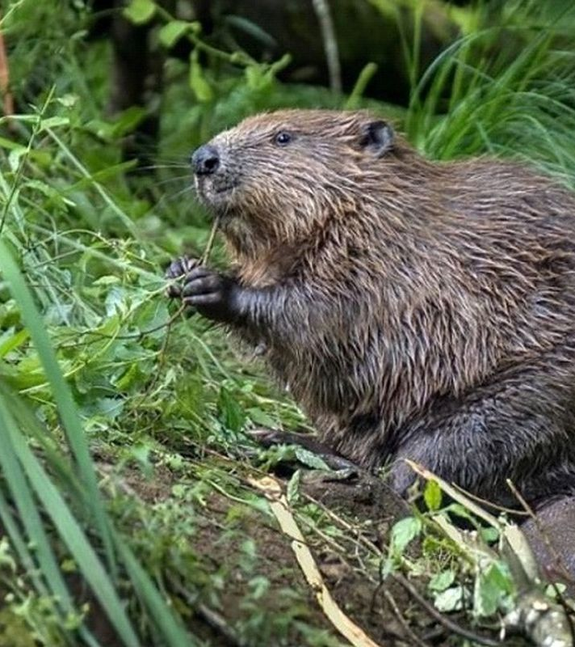
The case of coexistence with the beaver
What's at stake :
an extinct species returning to areas colonised by humans in their absence
Moving from managing the species to managing the individual (locality)
The key role of the history of human relations with beavers
The transformation of the posture and practices of administrative agents (from exploitation to ecosystems preservation)
Promoting coexistence with wildlife = Acceptance of living in a more complex world.
Re-learning by both citizens and public and scientific authorities that nature issues are also society issues.
Notes:
This is problem awarenesses
Note: even the problem of producing, interpreting and ... data that is as 'harmless' as it is objective can be at the centre of competing interpretations of its usefulness or relevance.
From this point of view, there is a whole body of scientific literature on the subject, and in particular on the approach known as 'community-based monitoring' (Conrad and Hilchey 2011).
What is central, and everything stems from this, are the different and potentially conflicting ways of defining the problem or the 'problem in situation'.

Slide 5
Four thoughts on citizen participation

Slide 6
1. "Citizen" participation... who are we talking about?
Notes:
"Citizen" participation... who are we talking about? Many people speak in the name of citizens... hence the confusion that reigns around what can be called "a public". I think one of the challenges is to work not just with associations but with citizens as practitioners (and not as stakeholders). That’s to say as persons having (broad or specific) experiences.
From a democratic point of view, this public represents the vast majority of people involved in and practising their territory.

Slide 7
2. Citizens have skills that experts or public authorities do not have
Notes:
A citizens' panel has skills that experts or public authorities do not have. These skills (Fiorino 1990) depend on the procedure that will be adopted and implemented. You have to be aware that Citizens do not think primarily in terms of causes (as experts would), but in terms of consequences.

Slide 8
Six citizen competencies *
Ordinary citizens frame problems more broadly than experts, because they are not constrained by disciplinary boundaries;
A citizens' panel makes it possible to mobilise a broader spectrum of expertise upstream of decision-making;
The participative involvement of citizens allows us to test the limits of expert models;
Judgements lead to greater awareness of values and common sense;
Citizens are more inclined to identify alternatives and solutions than are experts;
Citizens are more apt to institutionalise regret, to come to terms with uncertainty and to consider the possibility of errors in decisions.
* Fiorino, Daniel J. (1990) Citizen Participation and Environmental Risk: A Survey of Institutional Mechanisms. Science, Technology & Human Values 15.

Slide 9
3. The effectiveness of the participative process = Values + actions
Notes:
Effectiveness is often a question of matching the many values associated with biodiversity with the actions that can be taken. This effectiveness will be closely linked to...
the mandate given by the public or scientific authority to the citizen participation (taking into account its results), which will make it possible both to confer legitimacy and to ensure commitment;
The Respect for the recalcitrance of citizens (i.e. respect for the multiple ways of defining the problem).

Slide 10
4. Three different citizen’s participation dynamics

Slide 11
This collaborative framework can (according to the literature)
have at least 3 dynamics:
The collaborative model (low citizen science)
The deliberative model
The transformative model (hard citizen science)
    What varies is the gradient of citizen participation
Notes:
Each of these models involves a distinct type of audience: an indifferent audience / a differentiated audience / a concerned audience;
Each of these models involves a degree of participation in the problem/protocol framing;
These three models are all relevant, depending precisely on the objectives being pursued.
And they are likely to vary according to the (different) needs of the partners in your consortium.
These objectives must relate in some way to the issue of coexistence, in this case with wildlife (I suppose).

Slide 12

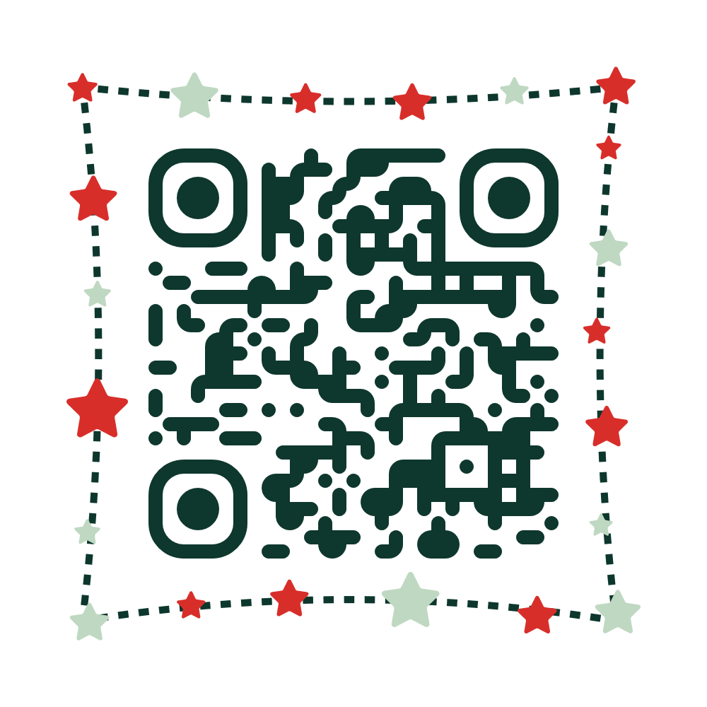

Two references for further reading
In english
Gramaglia, C., & Mélard, F. (2019). Looking for the cosmopolitical fish: monitoring marine pollution with anglers and congers in the Gulf of Fos, southern France. Science, Technology & Human Values, 44(5). doi:https://doi.org/10.1177/0162243919860197
En français
Mélard, F., & Gramaglia, C. (2022). Participation citoyenne et
production de savoirs situés sur les pollutions. Revue d'anthropologie
des connaissances, 16(4), 1-26.

