Slide 1
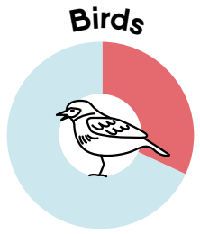
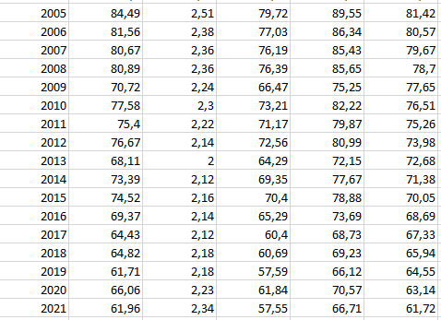
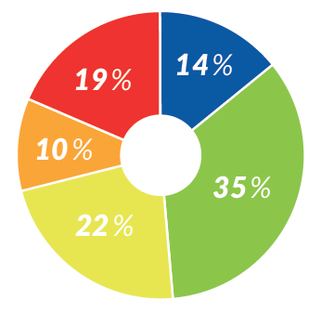
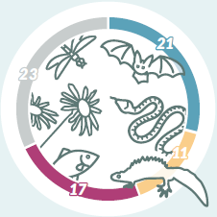
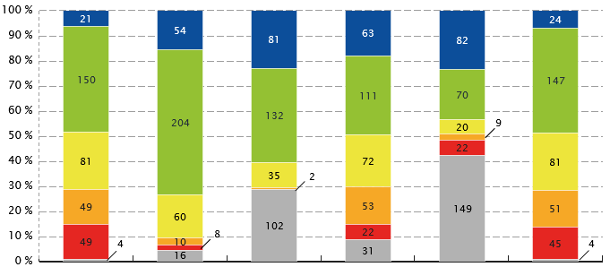
The use of environmental data through the reporting process :
The State of Environment Report - Wallonia
Violaine THIRY and Benoît THEYSKENS
Interreg Europe - CIBioGo
SPW Agriculture, ressources naturelles et environnement
Département de l’Étude du milieu naturel et agricole
19 mars 2024
Notes:
The State of the environment Directorate is in charge of drawing up reports on the state of the Walloon environment. The reporting process begins with the collect of environmental data, their aggregation and analysis, the creation of indicators, and ends by the dissemination of assessments to national and international organisations, to databases and to the general public.

Slide 2
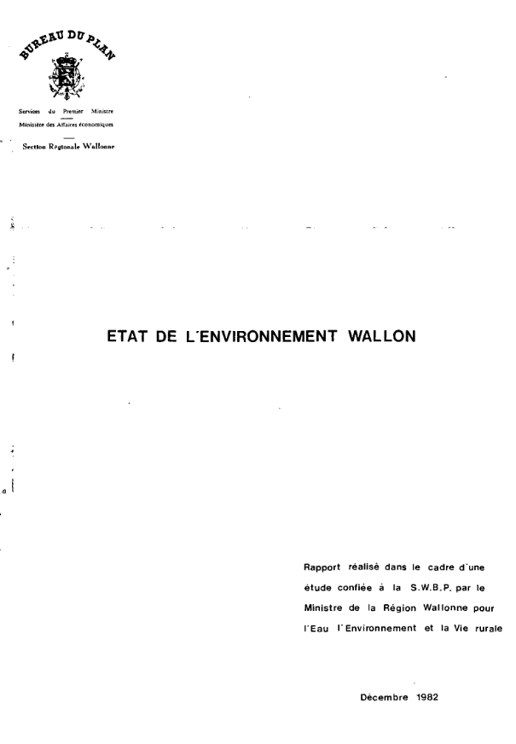
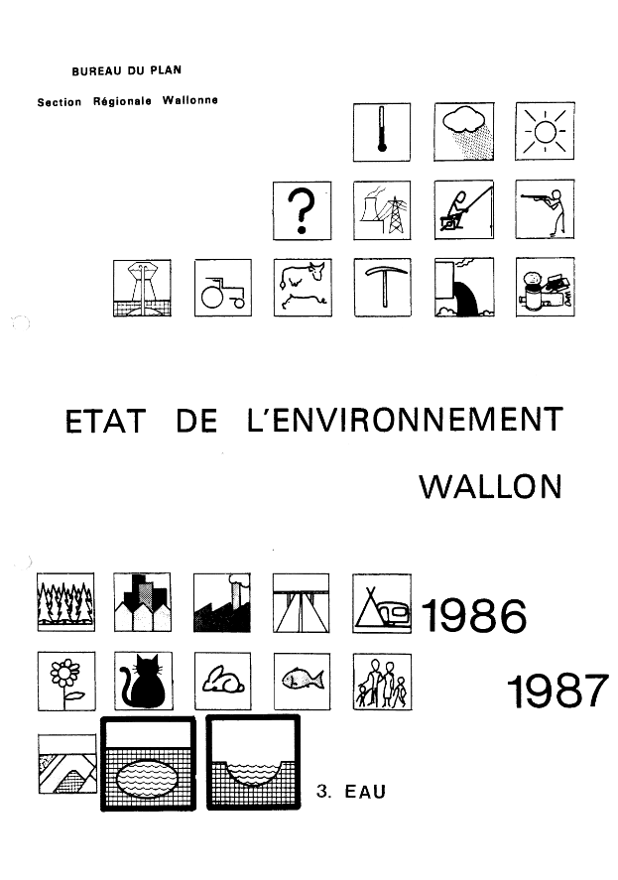
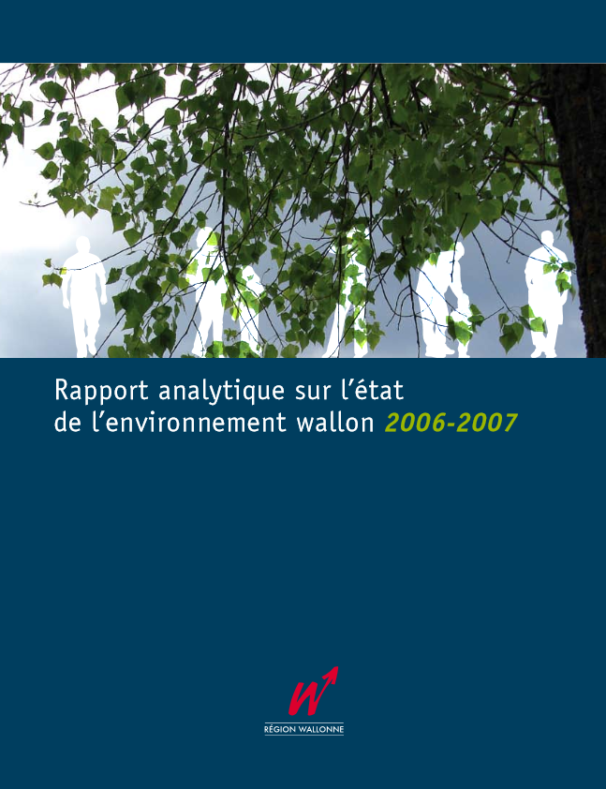
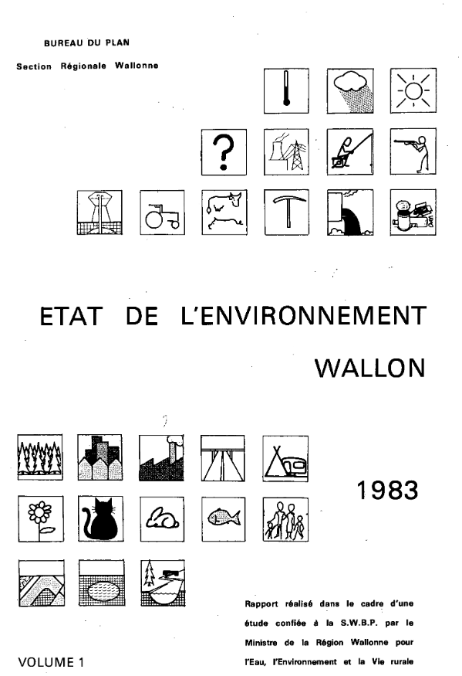
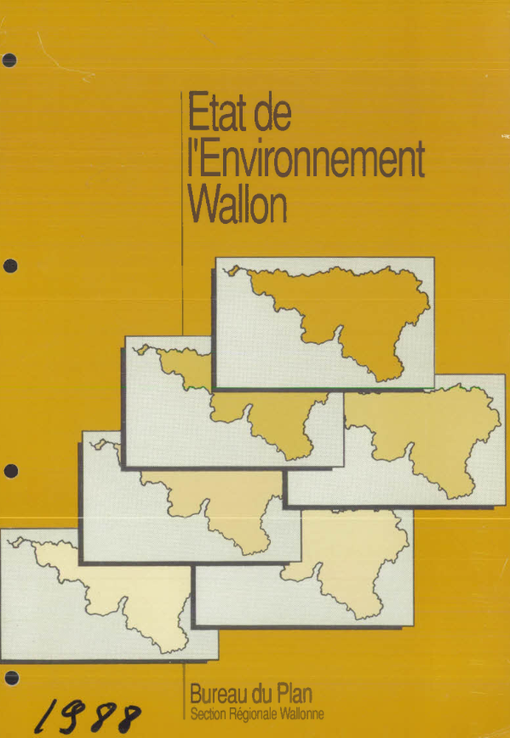
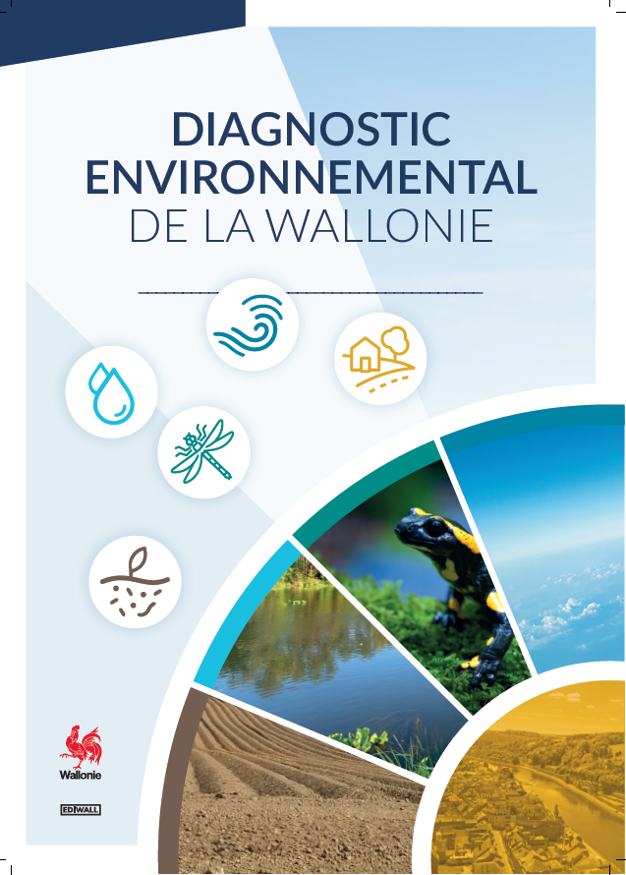
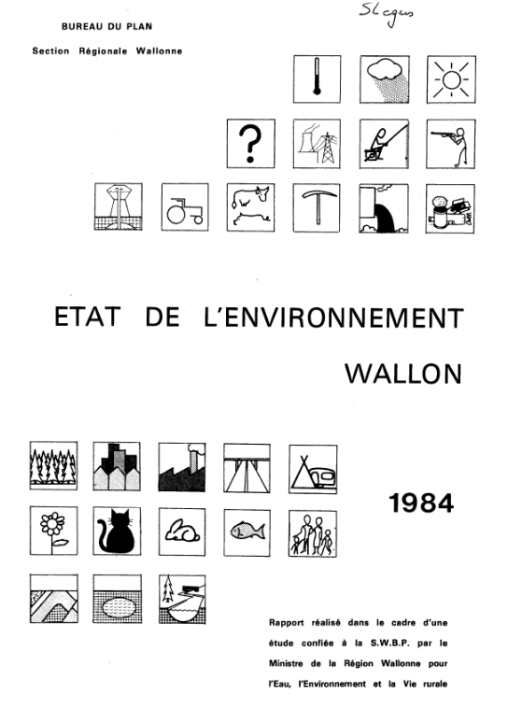
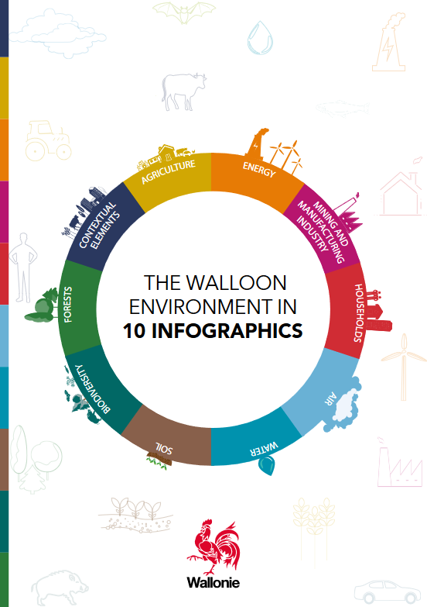
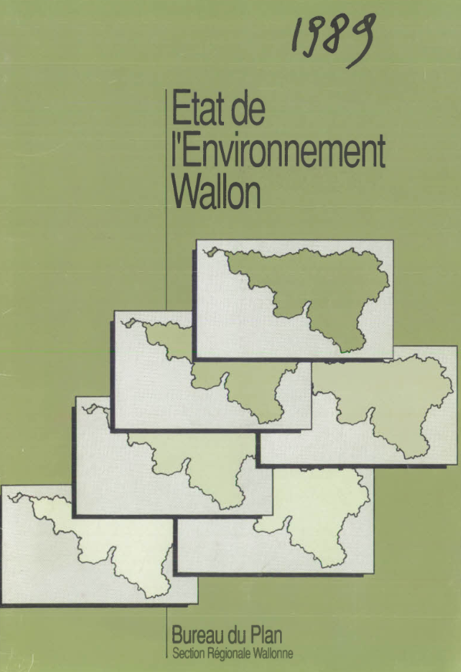
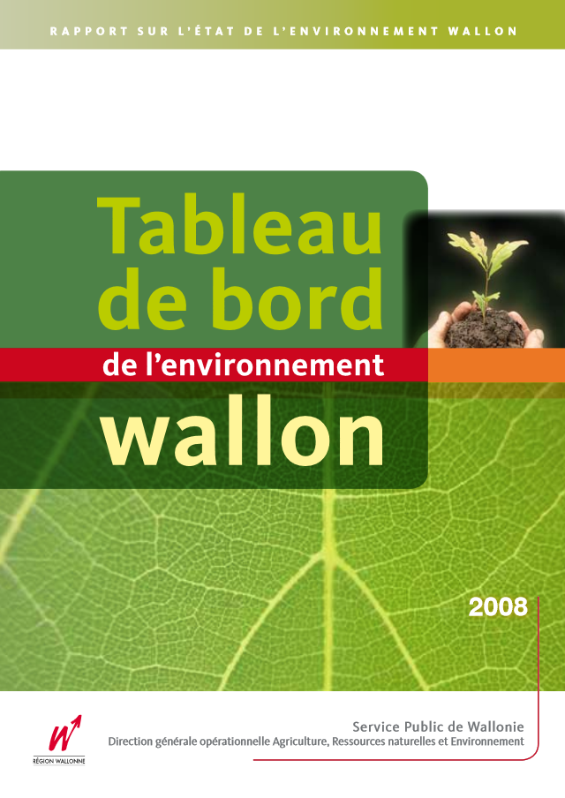
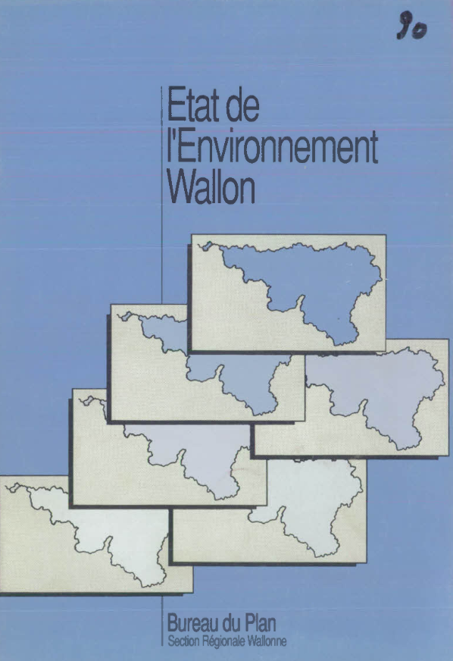
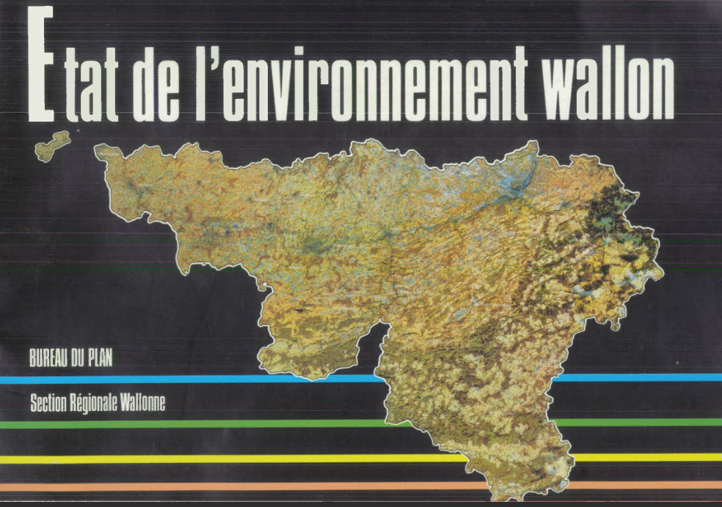
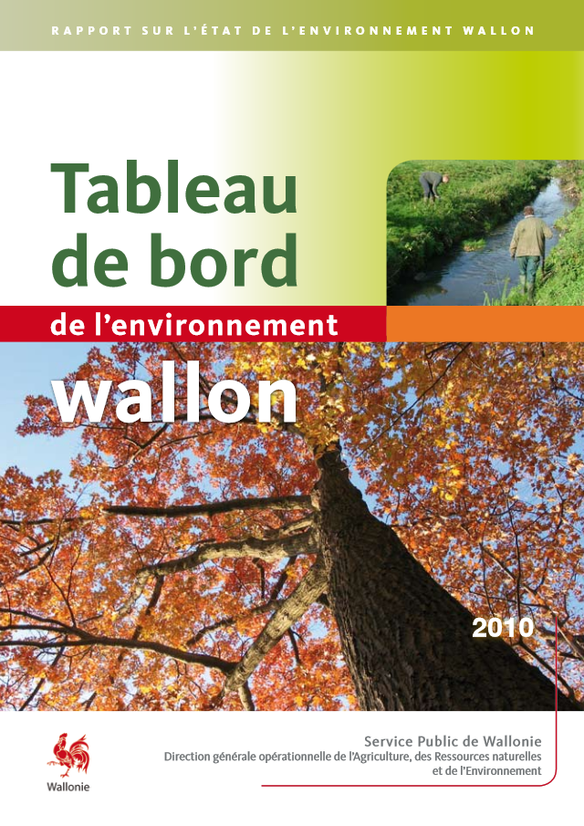
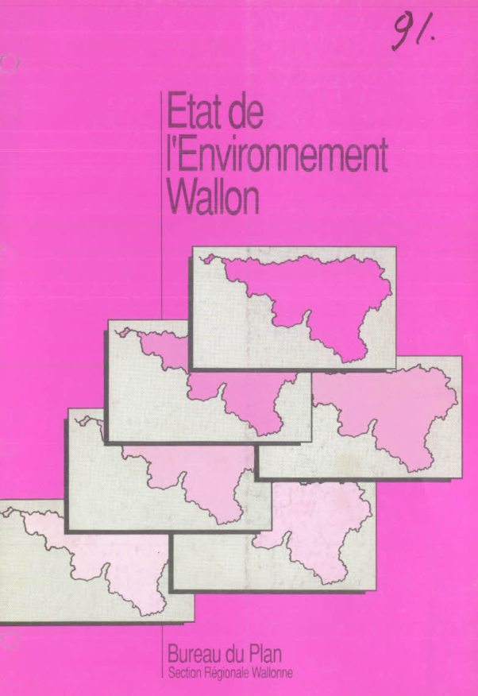
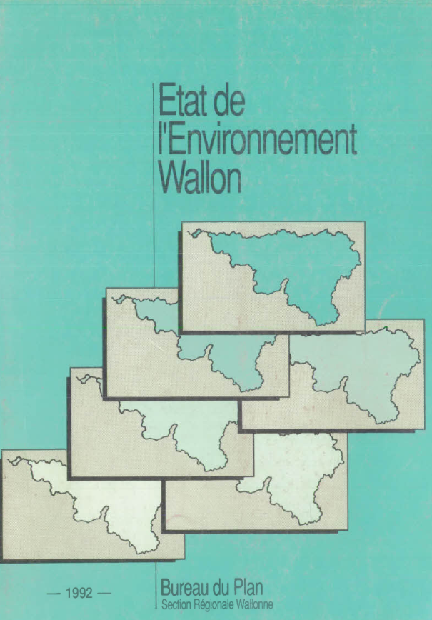
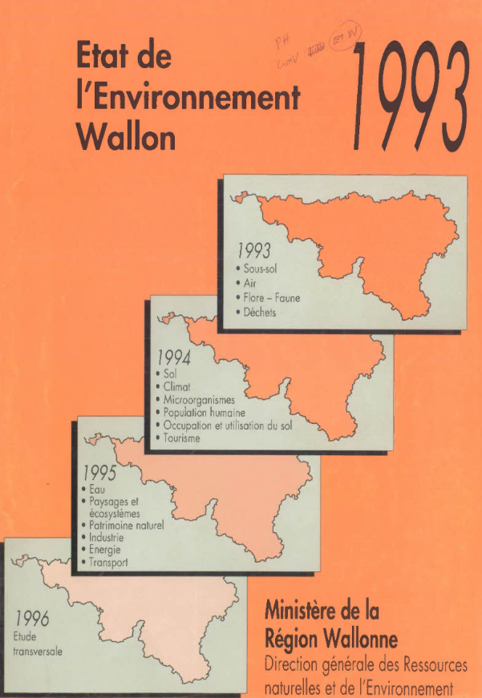
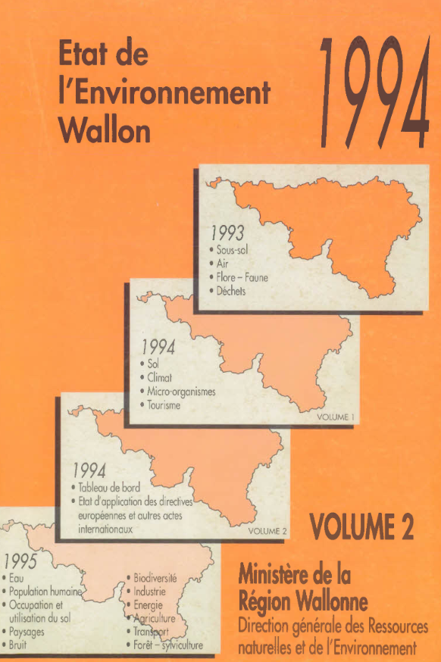
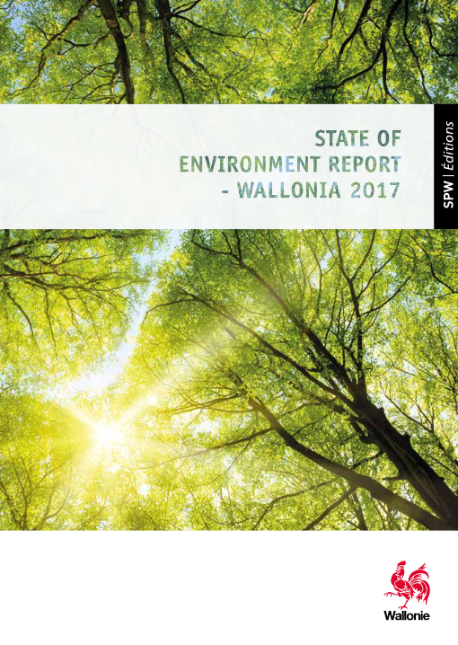
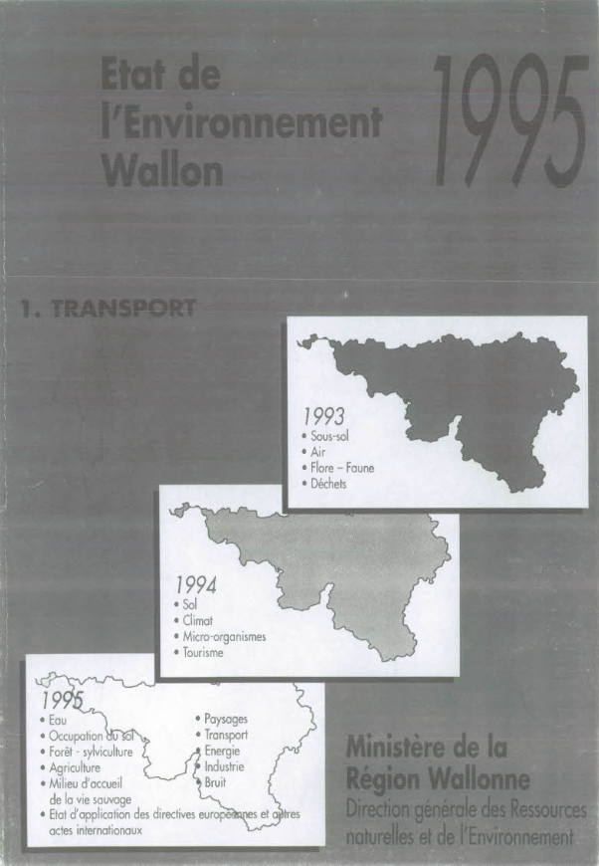
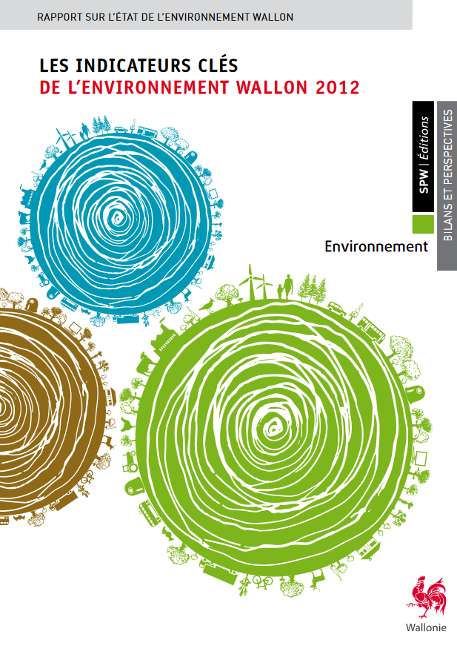
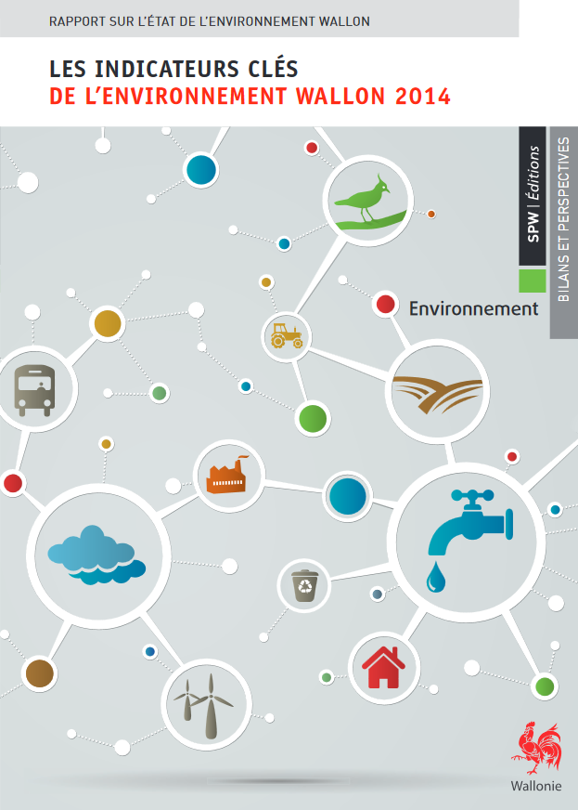
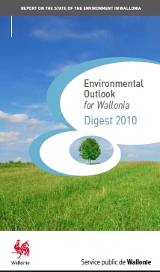
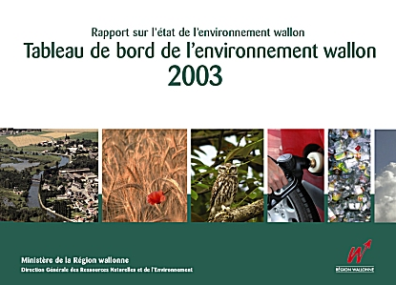
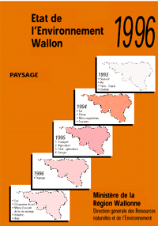
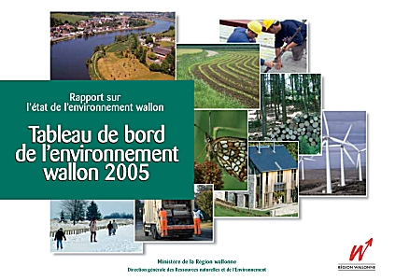
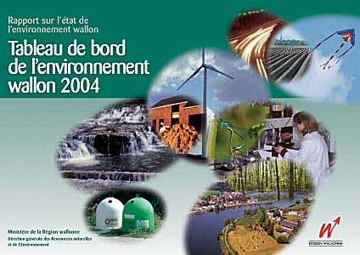
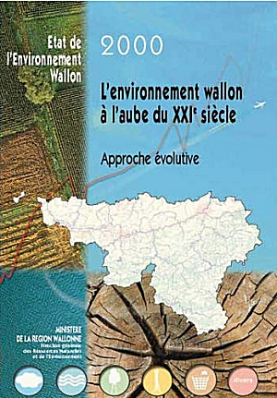
The State of Environment Report in Wallonia
From the early 80’s until now
Legal obligation (Walloon Code of the Environment)
→ Application of the Aarhus Convention (right of access to environmental information)
Notes:
SoER-W reports are published regularly since 1982. The publication of these Reports on the state of the Walloon environment is a legal obligation registered since 1987 in Book 1 of the Walloon Environmental Code and contributes to the application of the Aarhus Convention which aims, among other things, to improve access to environmental information.

Slide 3
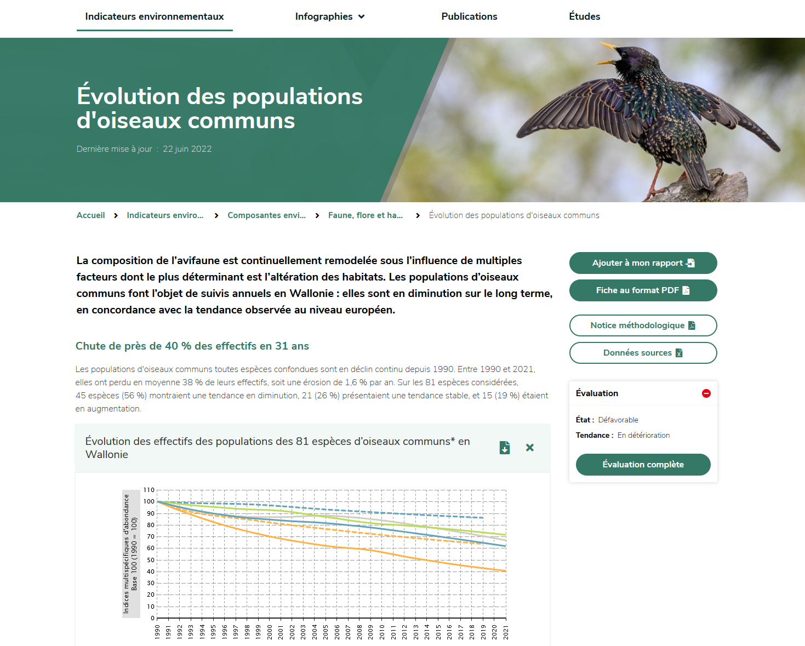
The State of Environment Report in Wallonia
Since 2018, updates of our environmental indicators are published on our website
→ Facilitates the reporting process
→ Allows data to be published as close as possible to their availability
→ Allows provisioning of supporting elements : interactive graphics and maps, methodologies, source data, metadata, references, links…
Notes:
Since 2018, dematerialization : indicator sheets are updated directly online on our website. Advantages : facilitates the reporting process, allows data to be published as close as possible to their availability, allows provisioning of supporting elements (interactive graphics and maps, methodologies, source data, metadata, references, links…

Slide 4
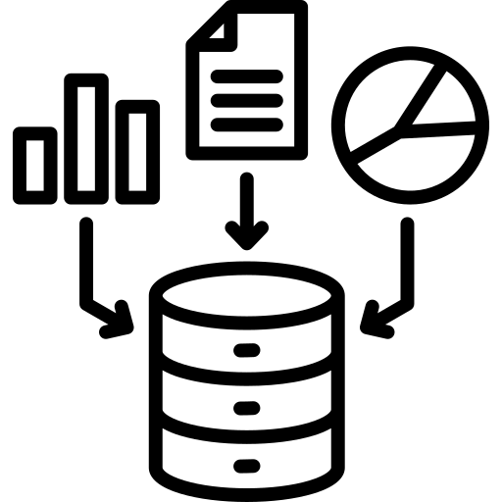
Reporting
Reporting to national and international environmental databases and reports : EEA, EUROSTAT, OECD…
Set of indicators largely based on internationally recognized sets of indicators.
Other indicators may be use to reflect the characteristics of the Walloon context.
Notes:
With regard to the reporting process : the reference data and assessment are supplied to national and international environmental databases and reports, including those of the European Environment Agency (EEA), EUROSTAT, OECD... The choice of indicators processed by our team is therefore largely based on internationally recognized sets of indicators. Other indicators may be use to reflect the characteristics of the Walloon context.

Slide 5



Data sources
Collaboration with a network of experts from :
Regional and federal administrations
Universities
Research centers
Notes:
The data behind the construction of our indicators comes from different sources : regional and federal administrations, universities, research centers…

Slide 6














Thematics
Land use
Use of natural ressources
Agriculture
Energy
Industry
Transports
Households
…
Waste
Air
Water
Soils
Fauna, flora and habitats
Links between environment and human health
Environmental management
Notes:
Our assessments are not limited to the components of the environment: we also monitor the parameters that influence it (use of resources, production processes, consumption, etc.) and that result from it (impacts, management measures, etc.).

Slide 7
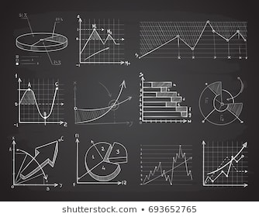
The indicator approach : a concise overview of complex problems
Indicators…
Allow us to synthesize quantitative or qualitative data, in the form of graphs or maps, which facilitate the understanding of complex phenomena
Help us to identify the factors involved in the process
Provide, when it is appropriate, elements which assist in decision-making
Constraints and limitations :
The quality of indicator-based interpretations depends on the quality of the data source;
It can be reductive : an analytical approach of the issues is still necessary.
Notes:
Indicators…
- reflect as objectively as possible the reality of a given phenomenon in the form of graphics or maps, based on a set of quantitative or qualitative data which is aggregated into condensed information. These indicators facilitate the understanding, assessment and monitoring of complex phenomena
- make it possible to identify the factors at play
- provide, where appropriate, elements which assist in decisionmaking.
Constraints and limitations :
- The quality of indicator-based interpretations always depends on the quality of the source data used
- No single environmental issue can be reduced to the aspects highlighted by the selected indicators alone : an analytical approach to the issues remains necessary

Slide 8















From field data to indicators
Example :
Trends in common birds populations

Slide 9
Trends in common birds population
Source data
« Common Bird Monitoring Program in Wallonia » (SOCWAL) (part of a continental surveillance system (PECBMS)
Standardized protocol :
→ For the so-called common species of Walloon avifauna (81 species) 50% of the total number of native nesting species in Wallonia but, in terms of numbers, 98% of Walloon avifauna
→ By point count, detection of territorial manifestations (bird singers), according to a very precise methodology : Under constant conditions (approximately at the same time, on the same date, in favorable weather conditions).
Notes:
The source data come from counts carried out within the framework of the “Common Bird Monitoring Program in Wallonia”, which is part of a continental surveillance system (Pan-European Common Bird Monitoring Scheme (PECBMS) which involves EBCC, the Royal Society for the Protection of Birds, BirdLife International and Statistics Netherlands).
Data collection is carried out according to the standardized protocol of PECBMS and very precise methodology. The survey is based on the detection of territorial manifestations (birds singers) and on easily visible species. Annual surveys by point count are carried out for the so-called common species of Walloon avifauna (81 species). These species represent 50% of the total number of native nesting species in Wallonia ; however, being the most abundant, they represent in terms of numbers 98% of Walloon avifauna.
under constant conditions (approximately the same time, on the same date, in favorable weather conditions).

Slide 10
Trends in common birds population
Source data
Initiated by the association Natagora with the support of the of the Walloon environmental administration (SPW ARNE)
Citizen participation : the monitoring involves a large number of amateur ornithologists
Encoding of observation data in a special page of the “Observations.be” website
Notes:
The Common Bird Monitoring Program in Wallonia is initiated by Natagora with the support of the Walloon environmental administration.
This monitoring involves a large number of amateur ornithologists.
(Ornithology is a popular naturalist activity, with a host of organizations offering training, guidance and field activities. Their observation is facilitated by different elements: the birds are generally clearly visible all year round and present a great diversity of size, shape, color and occupy practically all habitats.)
Encoding of observation data in a special page of the Observation.be site

Slide 11
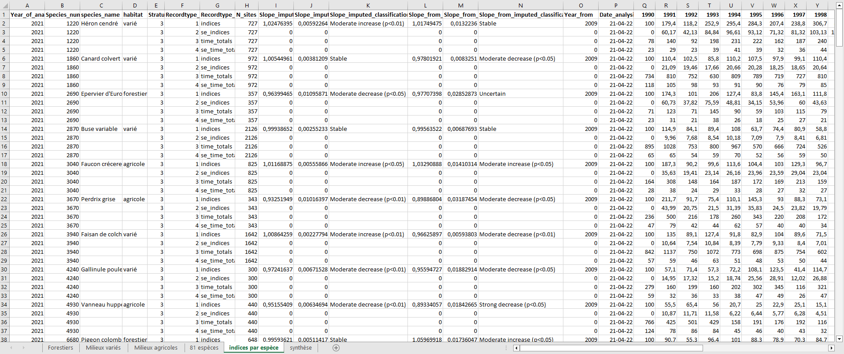
Trends in common birds population
Processing
…………………
Based on the results of a large number of surveys distributed throughout Wallonia, a relative annual population abundance index for each species is calculated and a long-term trend can be estimated
Notes:
Using the results of a large number of surveys distributed throughout Wallonia, a relative population abundance index for each species is calculated annually and a long-term trend can be estimated.

Slide 12
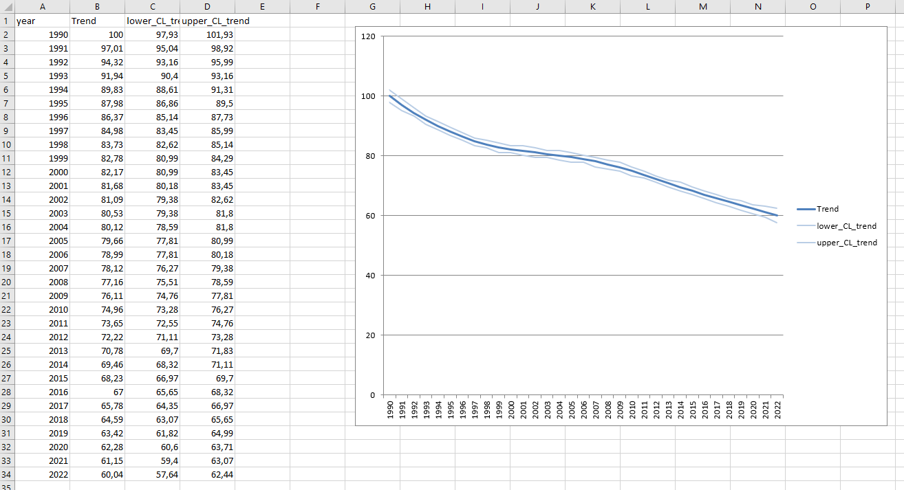
Trends in common birds population
Processing
General trend of the common avifauna can be assessed using a single curve, summarizing the information for all species by a geometric mean of the annual abundance indices
Notes:
The general trend of the common avifauna can be assessed using a single curve, summarizing the information for all species by a geometric mean annual abundance indices.

Slide 13
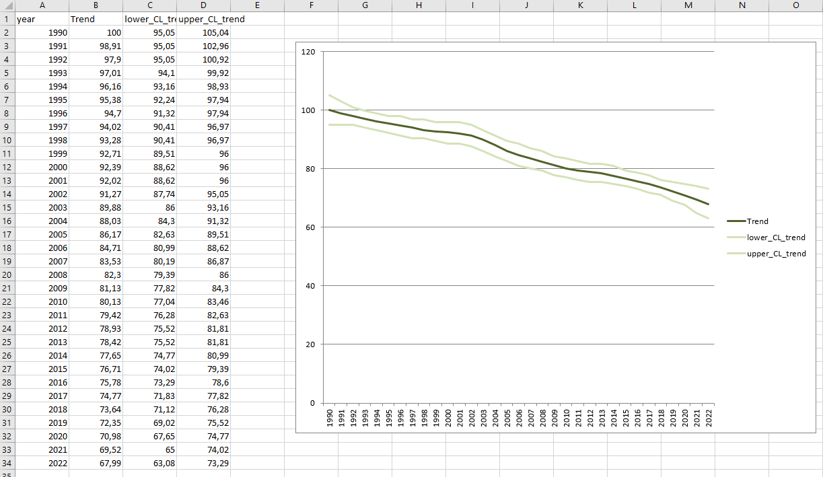
Trends in common birds population
Processing
Species can be grouped according to the type of environments in which they prefer to live.
→ provides a picture of the evolution of the avifauna specific to each type of environment
Species of forest environments
Notes:
In order to calculate indicators more relevant to the evolution of the environment, species can be grouped according to the type of environments in which they preferentially evolve : species of forest environments, species of environments agricultural, other species (species neither strictly associated with forest environments, nor strictly associated with agricultural environments). This allows to obtain an image of the avifauna trend specific to each type of environment. These associations are taken from the list of the European Program "Pan-European Common Bird Monitoring Scheme" (PECBMS) coordinated by the “European Bird Census Council” (EBCC) association.
-> Species of forest environments

Slide 14
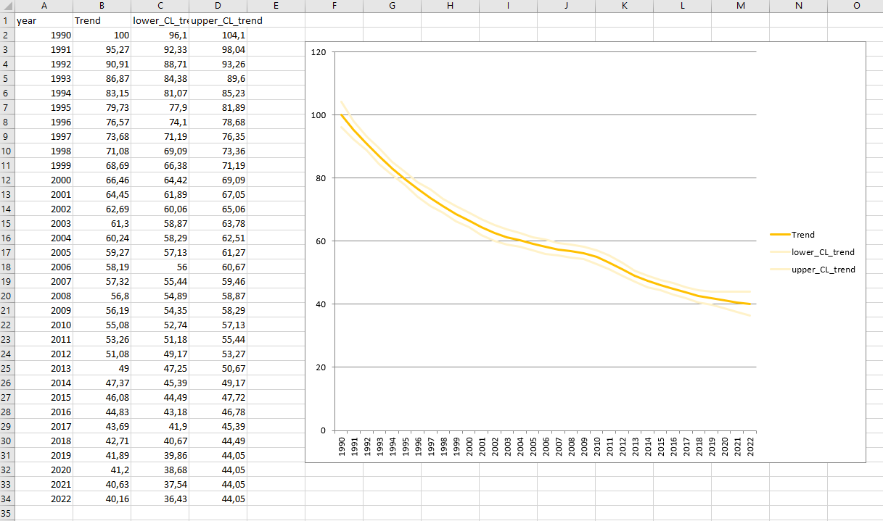
Trends in common birds population
Processing
Species can be grouped according to the type of environments in which they prefer to live.
→ provides a picture of the evolution of the avifauna specific to each type of environment
Species of
agricultural environments
Notes:
-> Species of agricultural environments

Slide 15
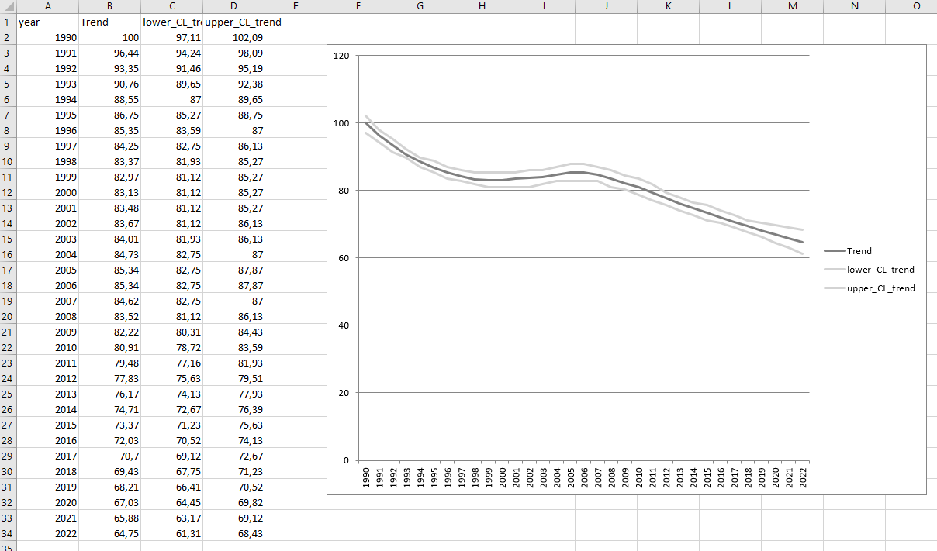
Trends in common birds population
Processing
Species can be grouped according to the type of environments in which they prefer to live.
→ provides a picture of the evolution of the avifauna specific to each type of environment
Other species
species neither strictly associated with forest environments, nor strictly associated with agricultural environments
Notes:
-> Other species (species neither strictly associated with forest environments, nor strictly associated with agricultural environments).
These are the data we receive from our suppliers.

Slide 16
Trends in common birds population
Synthesis
We summarise the data, with varying degrees of processing depending on the case, and create interactive graphics for communication purposes.
Notes:
From there, we synthesize the data, after more or less processing depending on the case, and build interactive graphs from the perspective of communication

Slide 17
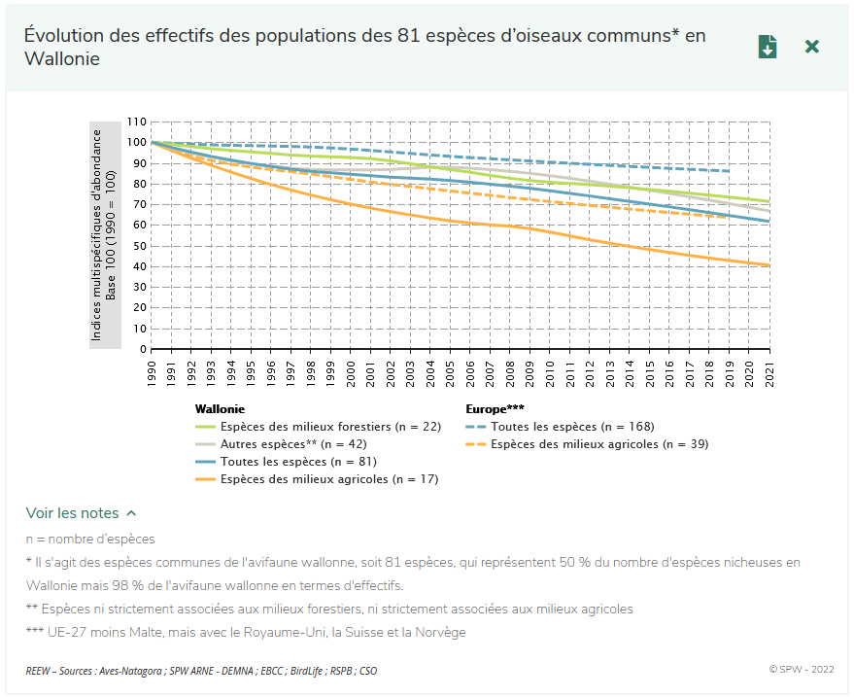
Evolution of the
81 species of common birds in Wallonia

Slide 18
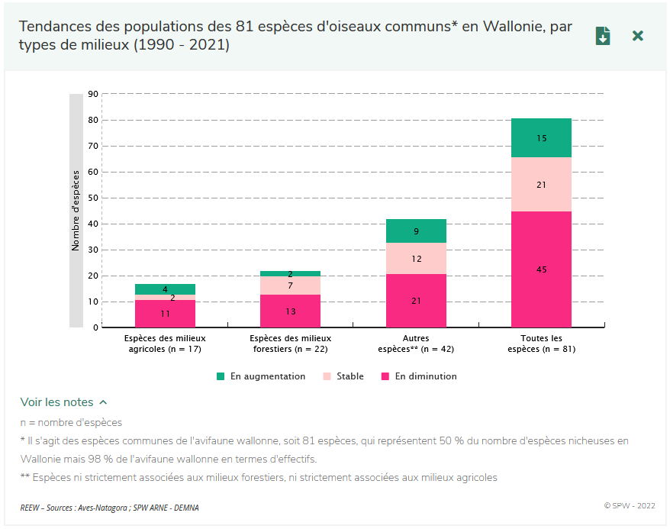
Population
trends of the
81 common bird
species in
Wallonia, by type
of environment
(1990 - 2021)
All species
Other species
Species of
agricultural environments
Species of forest environments

Slide 19
Trends in common birds population
Synthesis
We draft analysis texts related to the indicators, which include the following elements
environmental context and/or issues
summary of the essential elements: current situation (state) and trends, explanatory factors, policies implemented and outlook.
We add :
explanatory notes, legal and bibliographical references, and any references to other indicators
access to source data and methodology sheets
Notes:
We write analysis texts relating to the indicators that includes the following elements :
- environmental context and/or issues
- summary of the essential elements : state of the situation and trend, explanatory factors, policies implemented and prospects
We add :
- explanatory notes, legal and bibliographical references, possible references to other indicators
- Access to source data and methodological sheets

Slide 20
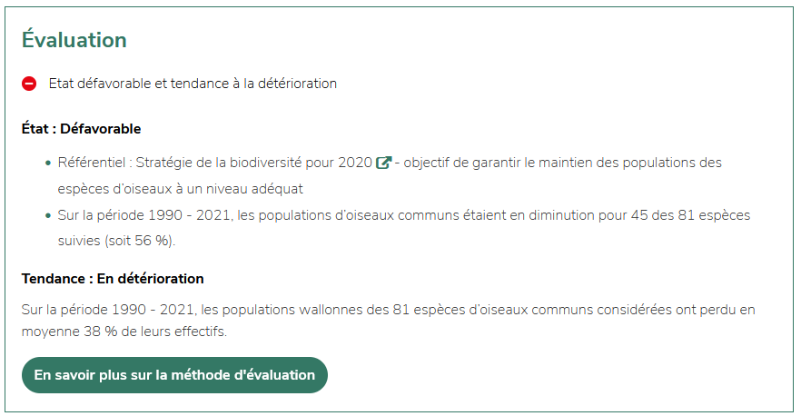
Trends in common birds population
Assessment
The state and trend observed using the indicators are assessed from the point of view of their environmental implications.
Based on a comparison of the current situation with a reference level :
- a value that must not be exceeded as defined in Walloon or European legislation ;
- a value to be achieved within a given timeframe (target value, objective, etc.), defined in Walloon or European legislation, or formulated in policy documents (Plans, Programmes, Regional Policy Declaration, etc.);
- a guide value established by a reference body (WHO, etc.);
- a value cited in the scientific literature and duly documented
Unfavorable status and trend towards deterioration
Notes:
The state and trend observed using the indicators are assessed from the point of view of their environmental implications.
Based on a comparison of the current situation with a reference level :
- a value that must not be exceeded as defined in Walloon or European legislation ;
- a value to be achieved within a given timeframe (target value, objective, etc.), defined in Walloon or European legislation, or formulated in policy documents (Plans, Programmes, Regional Policy Declaration, etc.);
- a guide value established by a reference body (WHO, etc.);
- a value cited in the scientific literature and duly documented
In most cases, it is the proportion of the indicator values (e.g. proportion of the territory or of all the monitoring sites) affected by a deviation between the current situation and the reference level considered that determines the assessment category to be assigned. If this proportion is close to zero, the status is considered favourable. If it is less than 25%, the status is considered slightly unfavourable. Above 25%, the condition is considered unfavourable.For some themes, status is assessed with reference to a dynamic to be achieved. This is typically the case for the assessment of the eco-efficiency of sectors, where the situation is judged to be all the more favourable when there is decoupling between economic activity and the pressures exerted on the environment: unfavourable if there is no decoupling, favourable if there is widespread decoupling and non-assessable if there is decoupling for only some of the pressure indicators.
When the current situation is linked to cyclical factors rather than to measures taken to improve environmental quality, compliance with the reference level is qualified in the supporting commentary. This is the case, for example, when reductions in atmospheric emissions are linked to a fall in economic activity.The assessment of the trend is based on a comparison of the current situation with that prevailing in previous years, the number of years taken into account depending on the temporal variability of the data concerned. In most cases, this involves a period of at least 10 years.
Sometimes it is not possible to assess the state or trend because of the absence of a reference level, a lack of information, a change in methodology, breaks in the time series or because several factors are moving in opposite directions without it being possible to state unequivocally what the environmental implications are. In some cases, it is not relevant insofar as the indicators currently available cannot be directly interpreted in terms of the state of the environment, its improvement or deterioration. Indicators relating to checks on compliance with environmental legislation, for example, fall into this category: the number of administrative actions taken only indirectly reflects actual breaches of environmental legislation.
Finally, some subjects are dealt with using data whose innovative nature or limited scope in time (one-off studies) or space (sub-regional scale) makes it impossible to carry out an assessment.

Slide 21
Trends in common birds population
Validation process
Validation of our work is done
by an internal peer-review
by an external peer-review (data providers, scientists)

Slide 22

To the indicator sheet

Slide 23
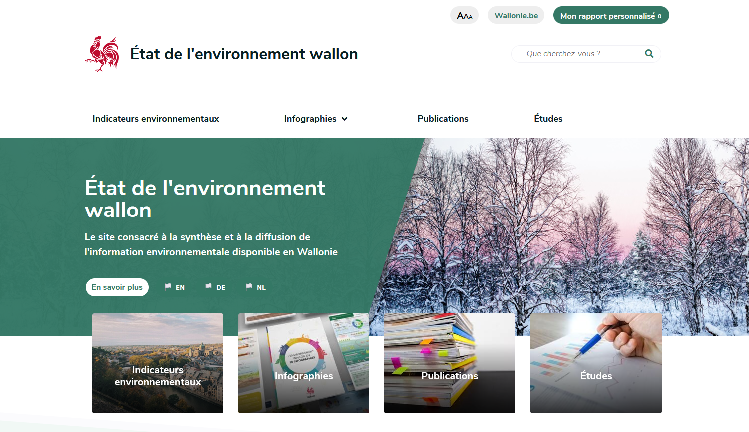
http://etat.environnement.wallonie.be

Slide 24
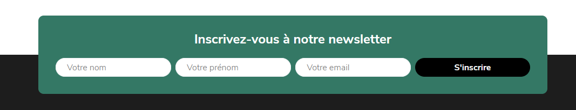
http://etat.environnement.wallonie.be
Notes:
Do not hesitate to subscribe to our newsletter!

Slide 25
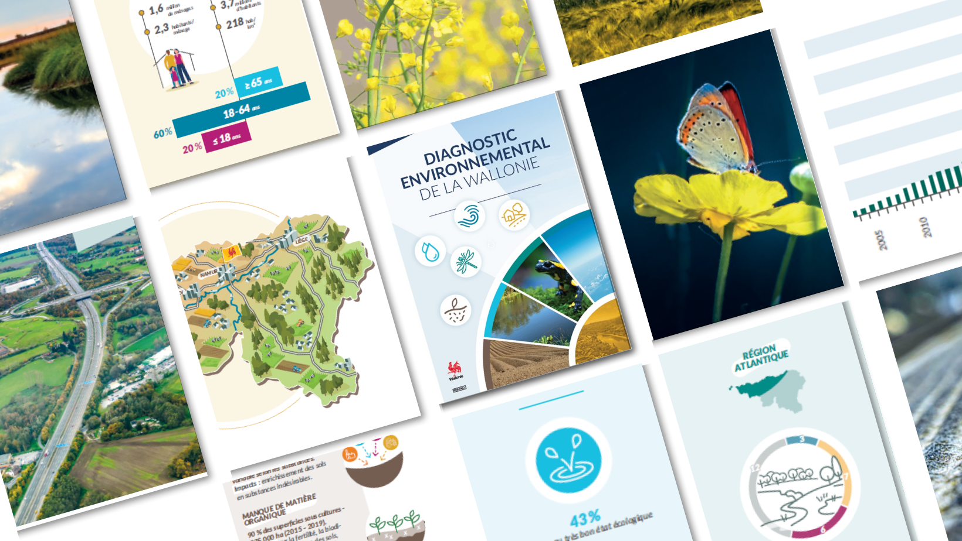
publication to be published soon: the environmental diagnosis of Wallonia
Report to be published soon :
« Diagnostic environnemental de la Wallonie »

Slide 26
Thank you for your attention !
SPW Agriculture, ressources naturelles et environnement
Département de l’Étude du milieu naturel et agricole
19 mars 2024
© Franck Renard

