Slide 1
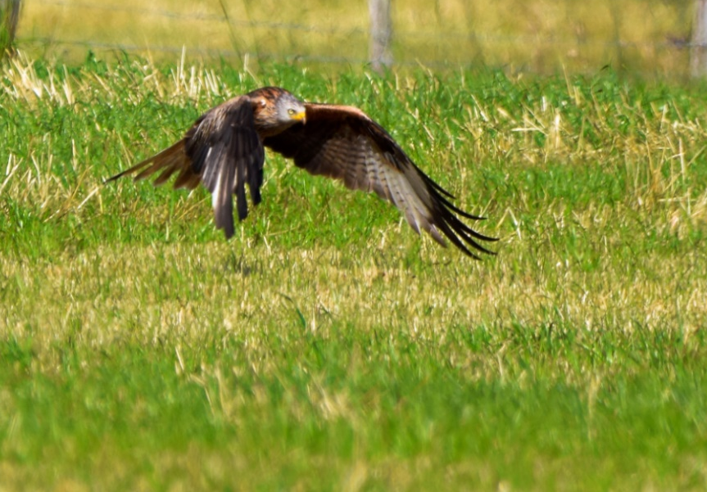

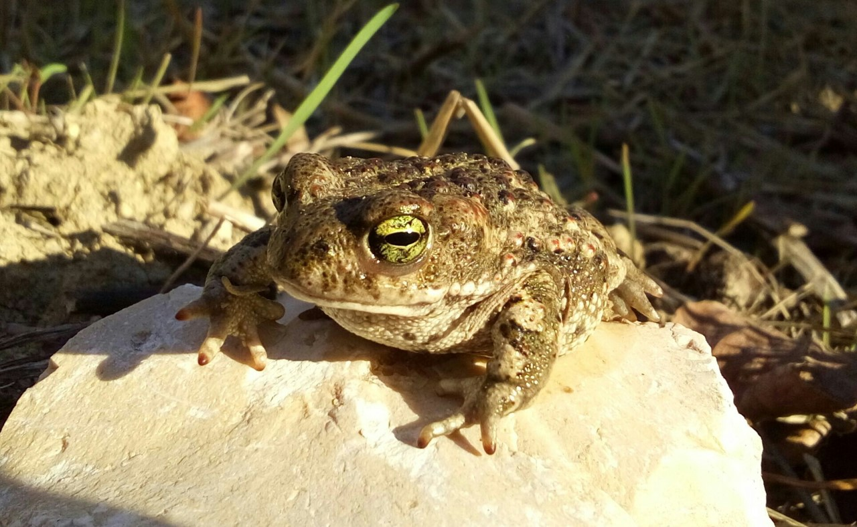
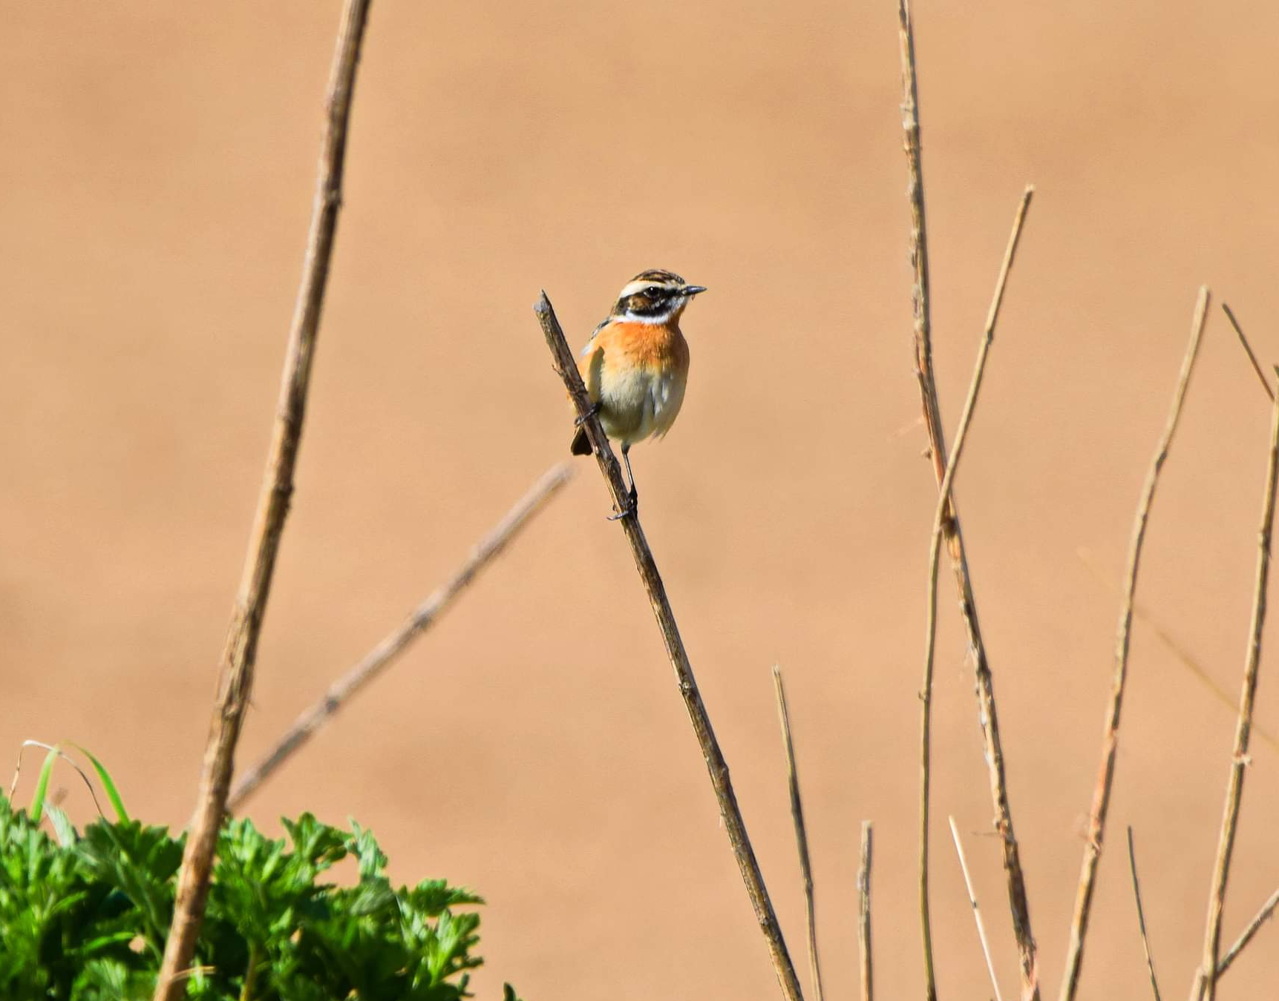
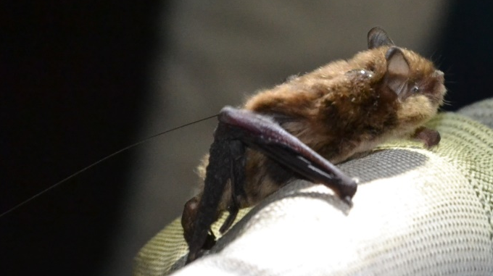
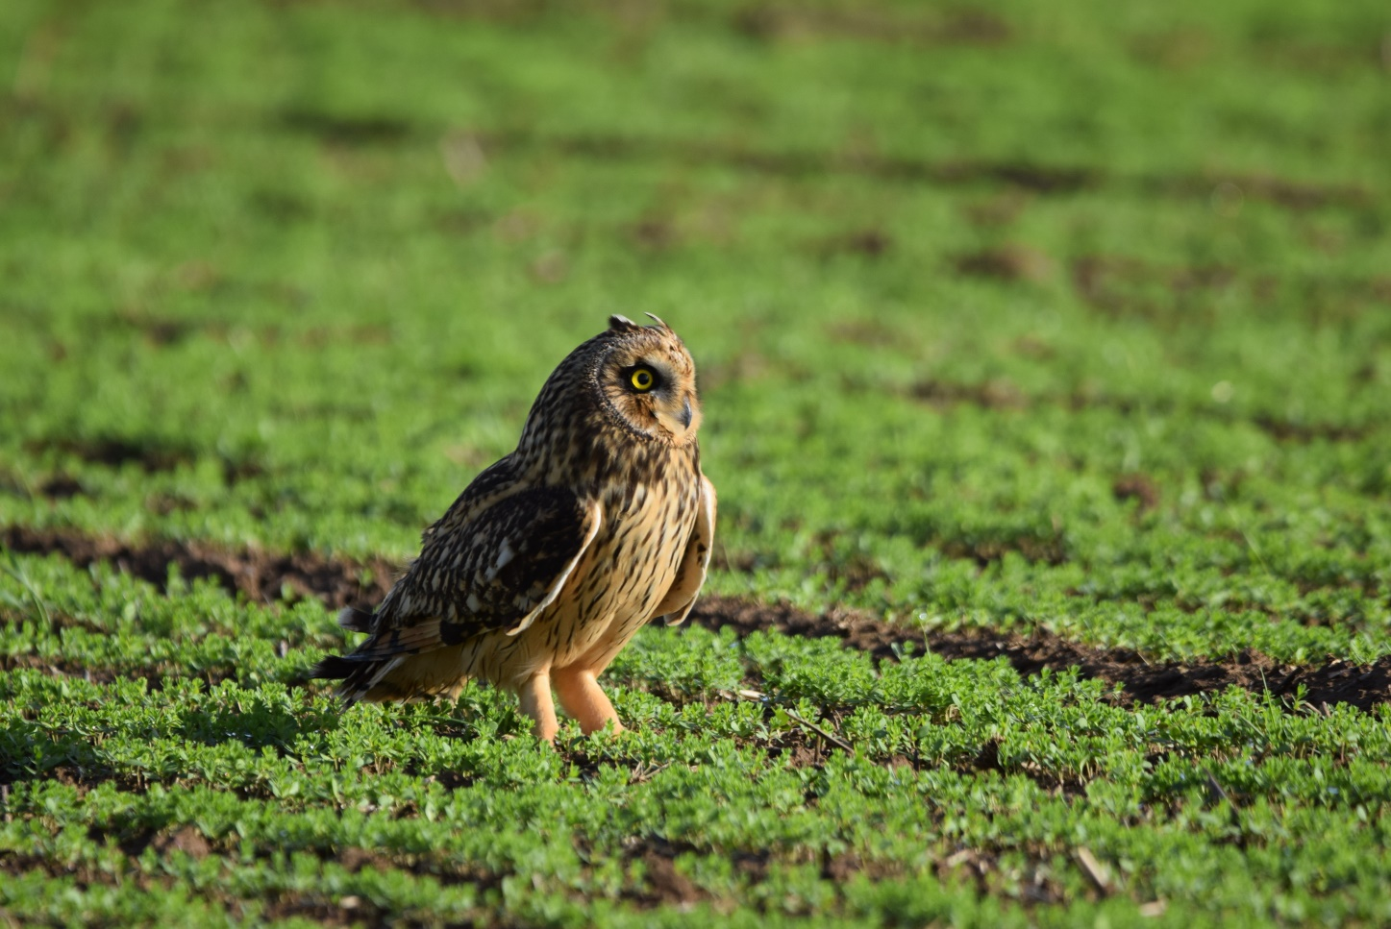


The value of biological data in environmental impact studies
Arnaud BECKERS – 19.03.2024

Slide 2

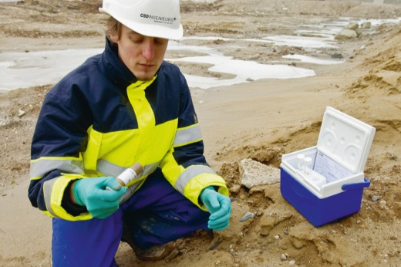
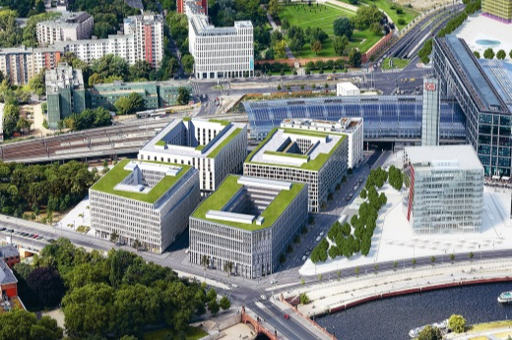

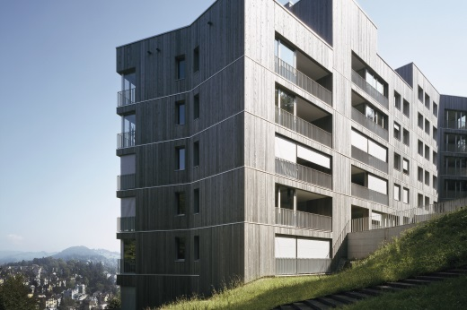
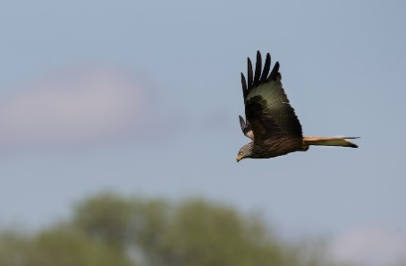
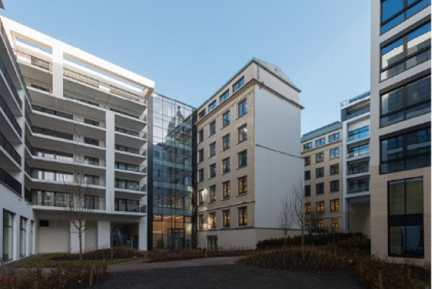
Who we are : an engineering and environnemental consultancy
CSD Ingénieurs
SOIL
CONSTRUCTION
IMPACT ASSESSMENT, PERMITTING
SPECIAL BUILDING TECHNICS
STABILITY
BIODIVERSITY
Notes:
CSD = panel d’experts multidisciplinaires composés d’ingénieurs, de géologues, de géographes, d’architectes,…

Slide 3
Who we are : an engineering and environnemental consultancy
CSD Ingénieurs
SOIL
CONSTRUCTION
IMPACT ASSESSMENT, PERMITTING
SPECIAL BUILDING TECHNICS
STABILITY
15 people in Namur (Belgium)
BIODIVERSITY
Notes:
CSD = panel d’experts multidisciplinaires composés d’ingénieurs, de géologues, de géographes, d’architectes,…

Slide 4
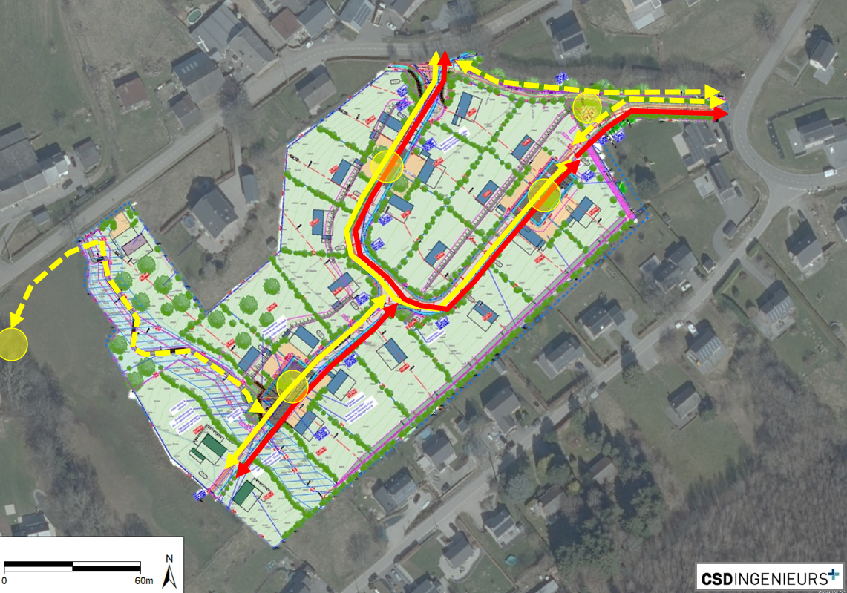
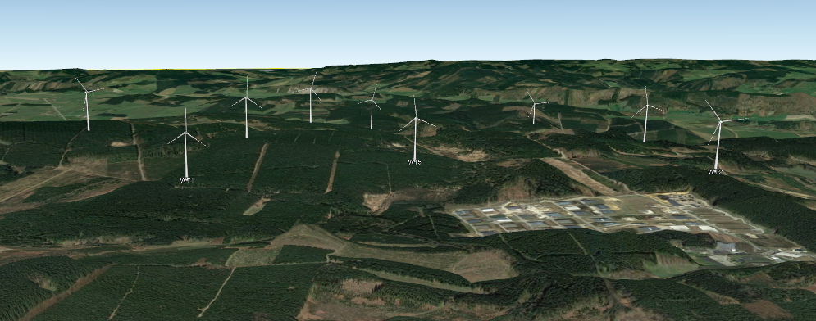
Our job regarding biological data
Introduction
Conducting studies for private and public clients
Environnemental impact assessments
Appropriate environmental impact assessments (Natura 2000)
Derogation requests to the Nature conservation law
Scientific studies
…
Housing project in hay meadows
Each study is based on new biological data acquired by our team AND existing biological data
Wind farm project in coniferous plantations

Slide 5



Where does « external » biological data come from ?
The value of biological data in environmental impact studies
Citizens (unpaid)
Professionals
« isolated » observers
Members of NGOs
NGOs
Regional administrations
Consultants
Bird ringing center (federal)
Producers
Data storage
Note book,
memory
partial transfer
Various ways
Digital platform
Providers
NO
partial transfer
NO
Bird ringing center
Easy access ?
NO
YES (cost)
YES (free)
NO
NO (cost)

Slide 6
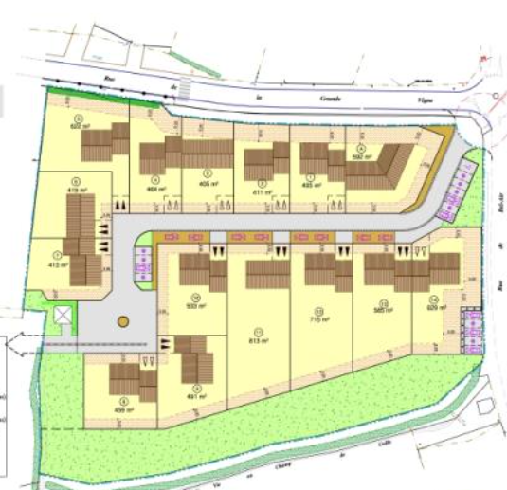
The importance of biological data during the study design
The value of biological data in environmental impact studies
Housing/commercial/industrial projects
Small sites
Low risk of significant impact on protected species
Often only 1 day on field observation
Biological data are essential for highlighting biological issues and advice the project developer to carry on additional field observations

Slide 7
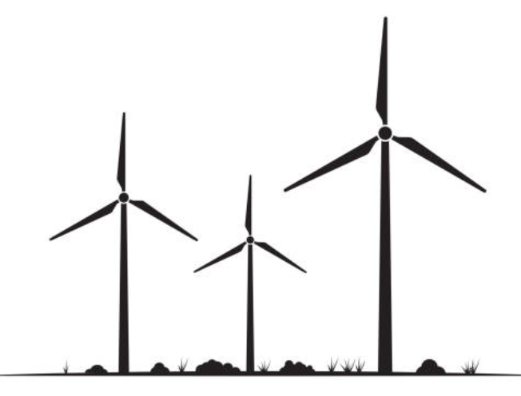

The importance of biological data during the study design
The value of biological data in environmental impact studies
Housing/commercial/industrial projects
Small sites
Low risk of significant impact on protected species
Often only 1 day on field observation
Biological data are essential for highlighting biological issues and advice the project developer to carry on additional field observations
Wind farm projects
High risk of significant impacts on protected species (birds & bats)
Official guidelines for field observations
16 to 34 days of field observations

Slide 8
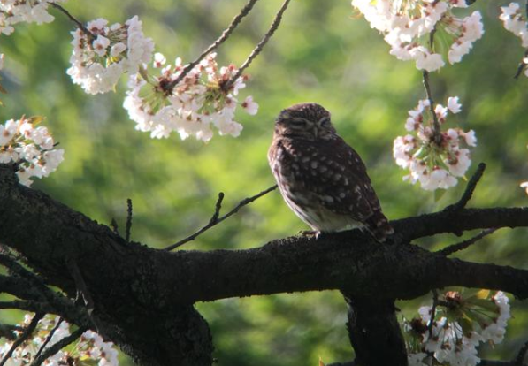
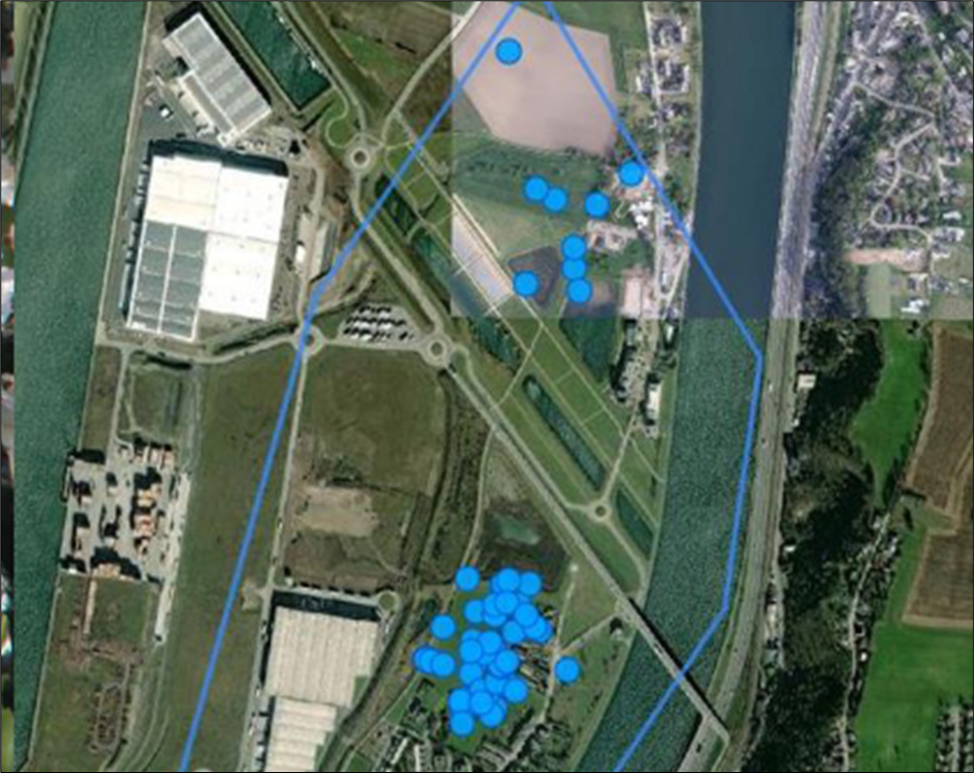
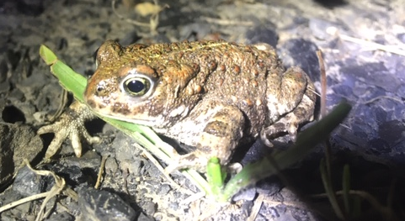
The importance of biological data during the study design
The value of biological data in environmental impact studies
Example 1 : housing project and Owl
Before the beginning of the study, existing biological data highlighted two protected species whose local population could be threatened by the project.
We carried out specific field surveys (day and night) to study the home range of Little owl (Athena Noctua) and important areas for Natterjack (Epidalea calamita).
Strong base to apply of the avoid, reduce and compensate principle
Little owl (CSD, 2022)
Available observations of the Little Owl from the NGO Natagora
(observations.be)
Natterjak (CSD, 2022)

Slide 9
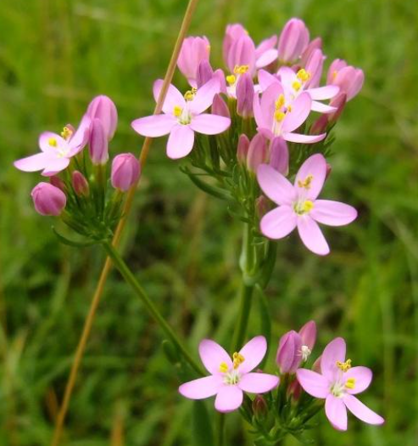
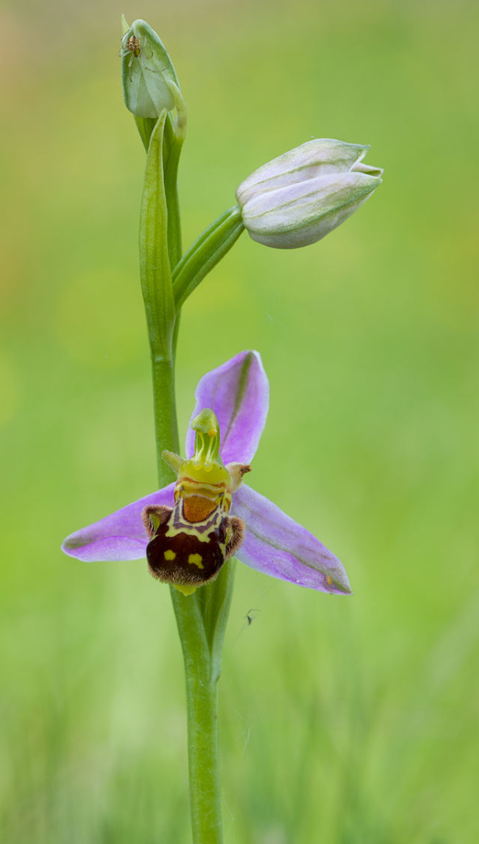
The importance of biological data during the study design
The value of biological data in environmental impact studies
Example 2 : business park project and protected flowers
The project developer first agreed to only pay for 1 field survey
Available data showed the proven presence of protected plants: Centaurium erythraea and Ophrys apifera
Based on that, we were able to convince him for two additional field surveys to cover the flowering periods in May and August and accurately map the two species
Centaurium erythraea (© T. Martin)
Existing data = key element to convince our client to pay more to improve the study design and quality
Ophrys apifera (Wikipedia)

Slide 10
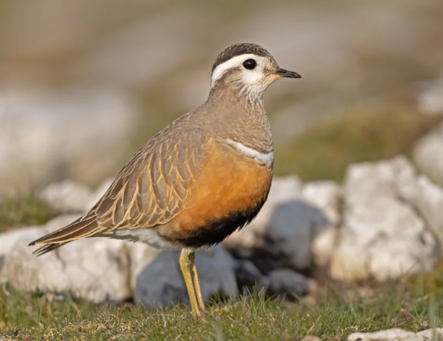
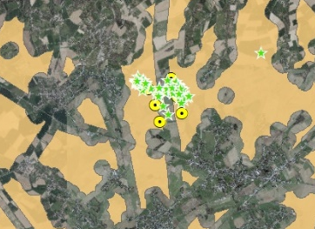
The importance of biological data during the impact assesment
The value of biological data in environmental impact studies
Example 3 : wind farm project and Eurasian Dotterel
Eurasian dotterel (Eudromias morinellus) uses open farmlands in Belgium as stopover sites in August-September
Rare species, very difficult to see (short stops + inter-annuel variations)
Not seen during our bird surveys (only some calls) but high-quality data available from unpaid birdwatchers prooved that the site is a very regular stopover place
Eurasian dotterel
(© D. Williams)
We concluded to a major impact on the local population (habitat loss)
The project has not been authorised
Star = observations; orange = potential habitat

Slide 11
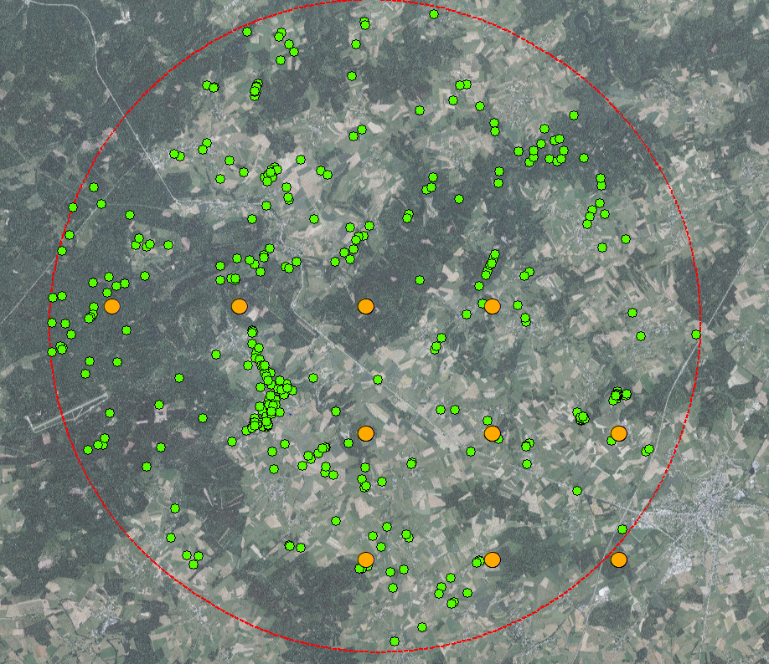
Strengths and weaknesses
The value of biological data in environmental impact studies
Strengths
Very large amount of data for some taxa (e.g. birds)
Good cooperation between most stakeholders
Weaknesses
Geographical precision reduced for some users -> problem for impact assessment !
Significant cost for small projects
Weak diffusion of data acquired by consultancies (except birds in wind farm projects studies) due to commercial issues and time consuming encoding
4 km
Example of data provided by the regional administration with 70 % of the data points having a reduced geographical precision asked by the producer (in orange, codes « CONF4 » and « CONF5 »)

Slide 12
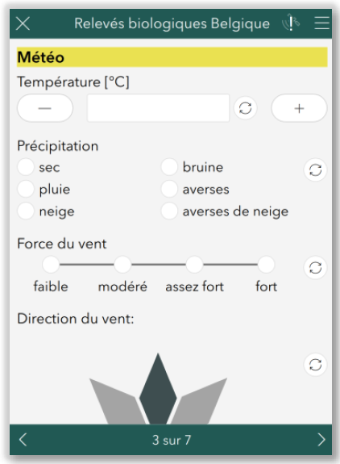
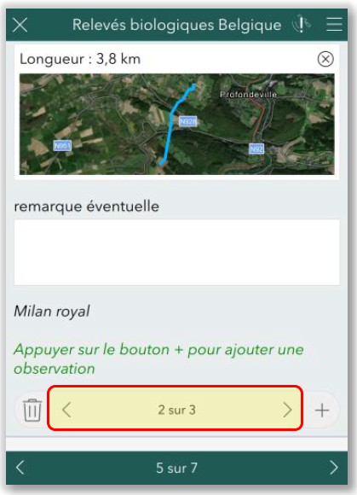

Solution developed by our team to improve data transmission to the administration
The value of biological data in environmental impact studies
An App to record data in the field
No time-consuming encoding tasks anymore
High level of geographical precision
Confidential data stored on a secured cloud
Used since 2022 for bird observation, upgraded with other taxa this spring
Data transmission to the administration once/twice a year, after the study has been communicated to the public

Slide 13


Conclusion
The value of biological data in environmental impact studies
Existing biological data has a high value in impact assessment studies, from study design to impact assessment and recommandations
Very large amount of data in Wallonie (☺) but taxa-dependant (birds ↑↑) (☹)
Our request : reducing the geographical degradation applied in the regional database (OFFH – DEMNA)
We are developing a new tool to improve data accuracy and make easier data transfer to the regional database (> 20.000 points / year)

Slide 14

Thank you for your attention !
a.beckers@csdingenieurs.be

